Slide 1
How well do scientific organisations communicate about controversial science?
Dr Louise Dunn
Notes:
Do

Slide 2
Science in Public
Science controversies and the resultant crisis in public confidence: Chernobyl nuclear disaster, 1986; BSE & ‘Mad cow’ disease (1986); MMR Vaccine and Autism (1988); Genetically Modified Organisms ‘Frankenfood’; Nanotechnology ‘grey goo’; gene therapy; climate change….. then…. COVID19
Gap in the literature: Role of scientific organisations. Understanding of the organisational and cultural influences on scientific comms and engagement through the eyes of senior communications policy decision makers.
Why does this matters? Communicating effectively about science can facilitate rational policy making, prevent harm, minimise risk and social and economic cost.
Notes:
Do

Slide 3
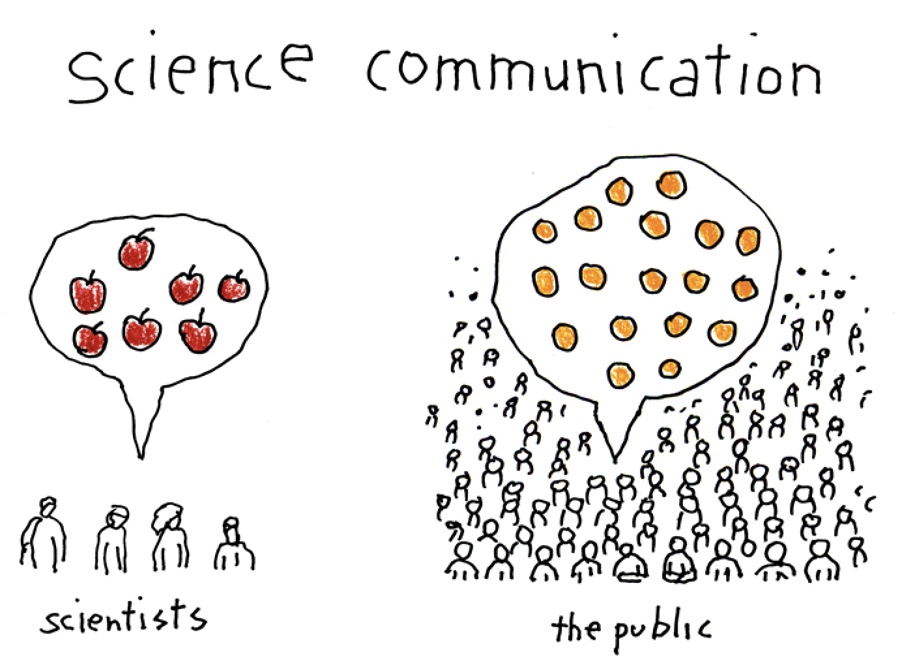

Slide 4
Key questions to ask ourselves
Q2. To what extent is the deliberative ideal behind programmes of scientific engagement distorted in practice, and why?
Q1. How are policies and strategies for engagement and communications activities influenced by the culture and interests of the organisation that they represent?

Slide 5
My Research
Literature: Rooted in the literature of science and technology studies (STS), science policy, and science communications.
Theory: Created and applied a theoretical framework derived from Jurgen Habermas’s theories of communicative action.
The analysis: The ‘5Cs’ (context, conduct, content, construction of knowledge, competence)
Notes:
Do

Slide 6
An Analytical Framework
The epistemological construction of knowledge and truth
Knowledge and Human Interests (1972)
The context of the discourse
Structural Transformation of the Public Sphere (1989)
The content of the arguments and claims
Communicative Action (1984, 1987)
The conduct of the discussions and arguments
Concepts from Discourse Ethics Moral Consciousness and Communicative Action (1993)
The communicative competence (skills) of the participants
Concept from Universal Pragmatics (various publications)

Slide 7
Themes for vaccines: Familiar?
Context: Difficult environment! Partisan politics and ideologies are influencing beliefs about science. Undermining of experts.
Conduct: Culture impacts comms. ‘Corporatisation’ of science. Strategic focus. Government ‘control’ on the message. Instrumental activities. Lower standards in public life post-BREXIT. Hostility. Speaking out is high risk. Dialogue is high cost. Safety in numbers. BUT a recognition that change is needed, and new approaches emerging.
Content: The ‘infodemic’; misinformation & disinformation. Myth busting and rebuttals dominate, but not effective. Content needs to engage, connect and entertain. Gap in balanced, authoritative reference information sources. Hard to cut through the noise.
Construction of knowledge: Science’s preference for facts and data. Fallacy of one ‘truth’ and ‘one message’. Failure to address fears about new technology, wider societal concerns, ethical and moral dilemmas. Positioning anti-science activists as irrational conspiracists. Labelling legitimate scepticism as anti-science.
Competence: Lack of understanding of how to navigate the new environment. Uneven adoption of behavioural science & marketing techniques. Underestimating the public’s intelligence. Lack of insight into how scientific institutions are contributing to the problem.
Organisations motivated to do the right thing but facing internal barriers and a difficult external environment. Leading to a lack of co-ordination across scientific institutions and few reliable authoritative reference sources of information for the public during controversy.

Slide 8
Questions?
Notes:
Do

