Slide 1
Where to bury nuclear waste? 36 years of GIS research and general trouble-making
Dr Steve Carver
School of Geography, University of Leeds

Slide 2
Geography matters
Geohydrology
Containment
Geology
People
Environment
Geomorphology
Geotechnics
Engineering
Industry
Opinion
Climate
Geodemographics
Geography
Ecosystems
Politics
Population
distribution
Species
Habitats
Culture
Land use
Traditions
Agriculture

Slide 3
Skin in the game 1986 - date
Carver, S.J., 1991. Integrating multi-criteria evaluation with geographical information systems. International Journal of Geographical Information System, 5(3), pp.321-339.

Slide 4
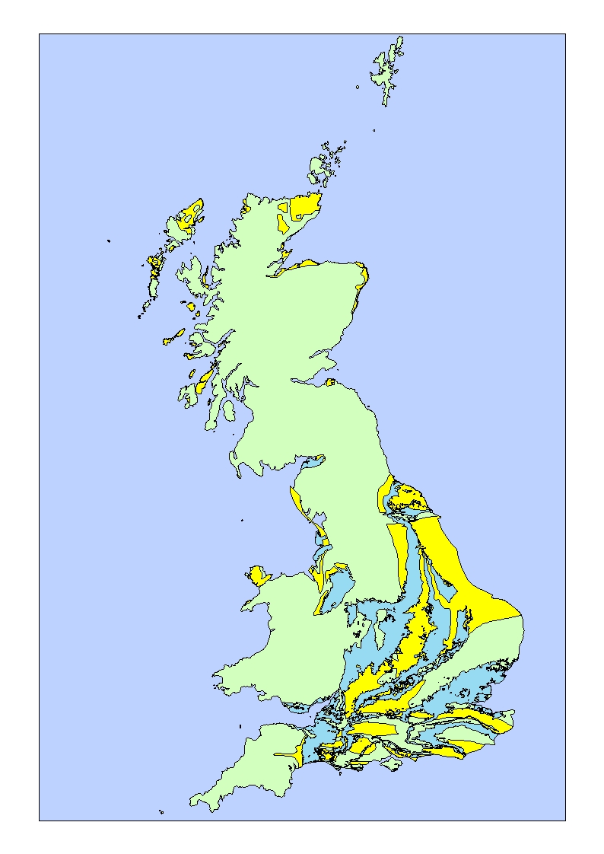
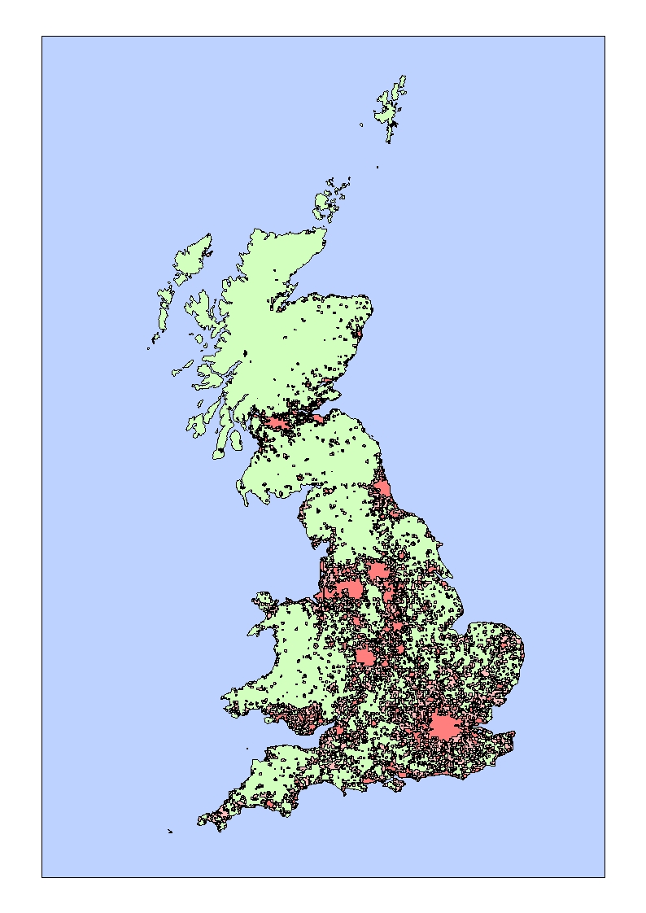
Two stories 1. Two words

Slide 5
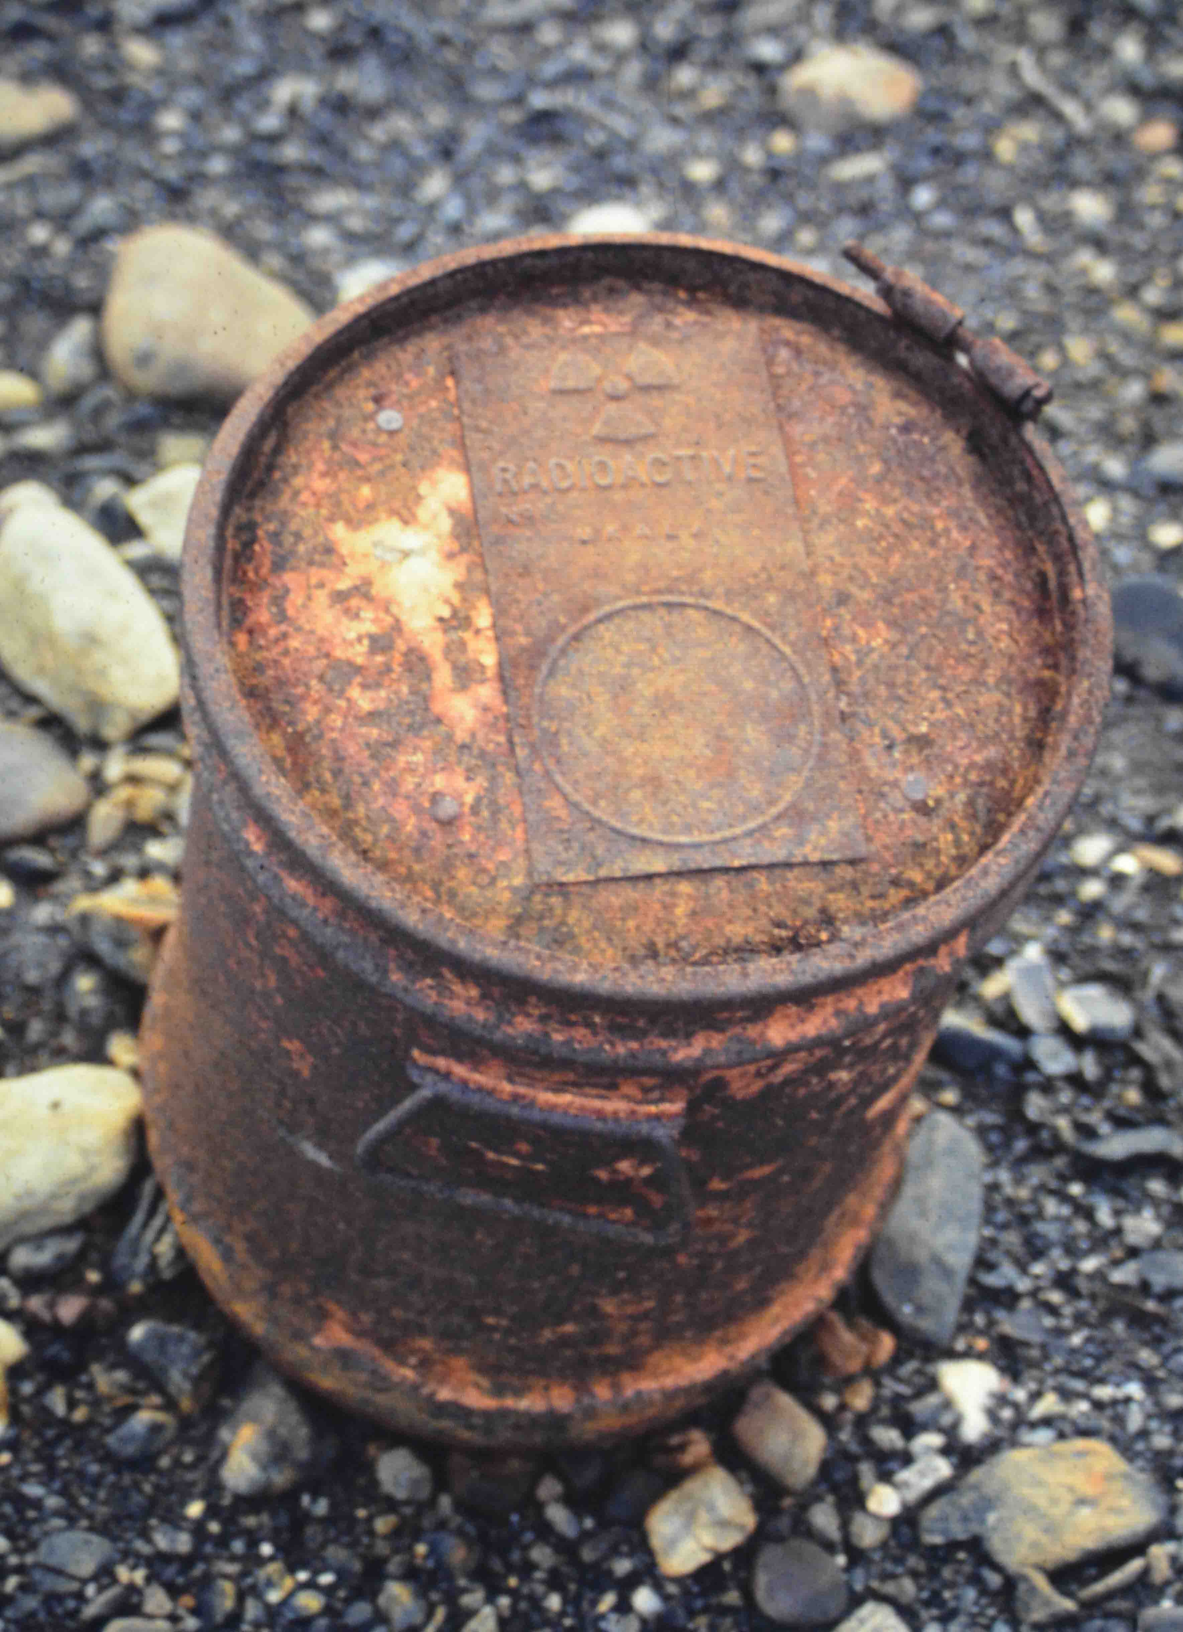
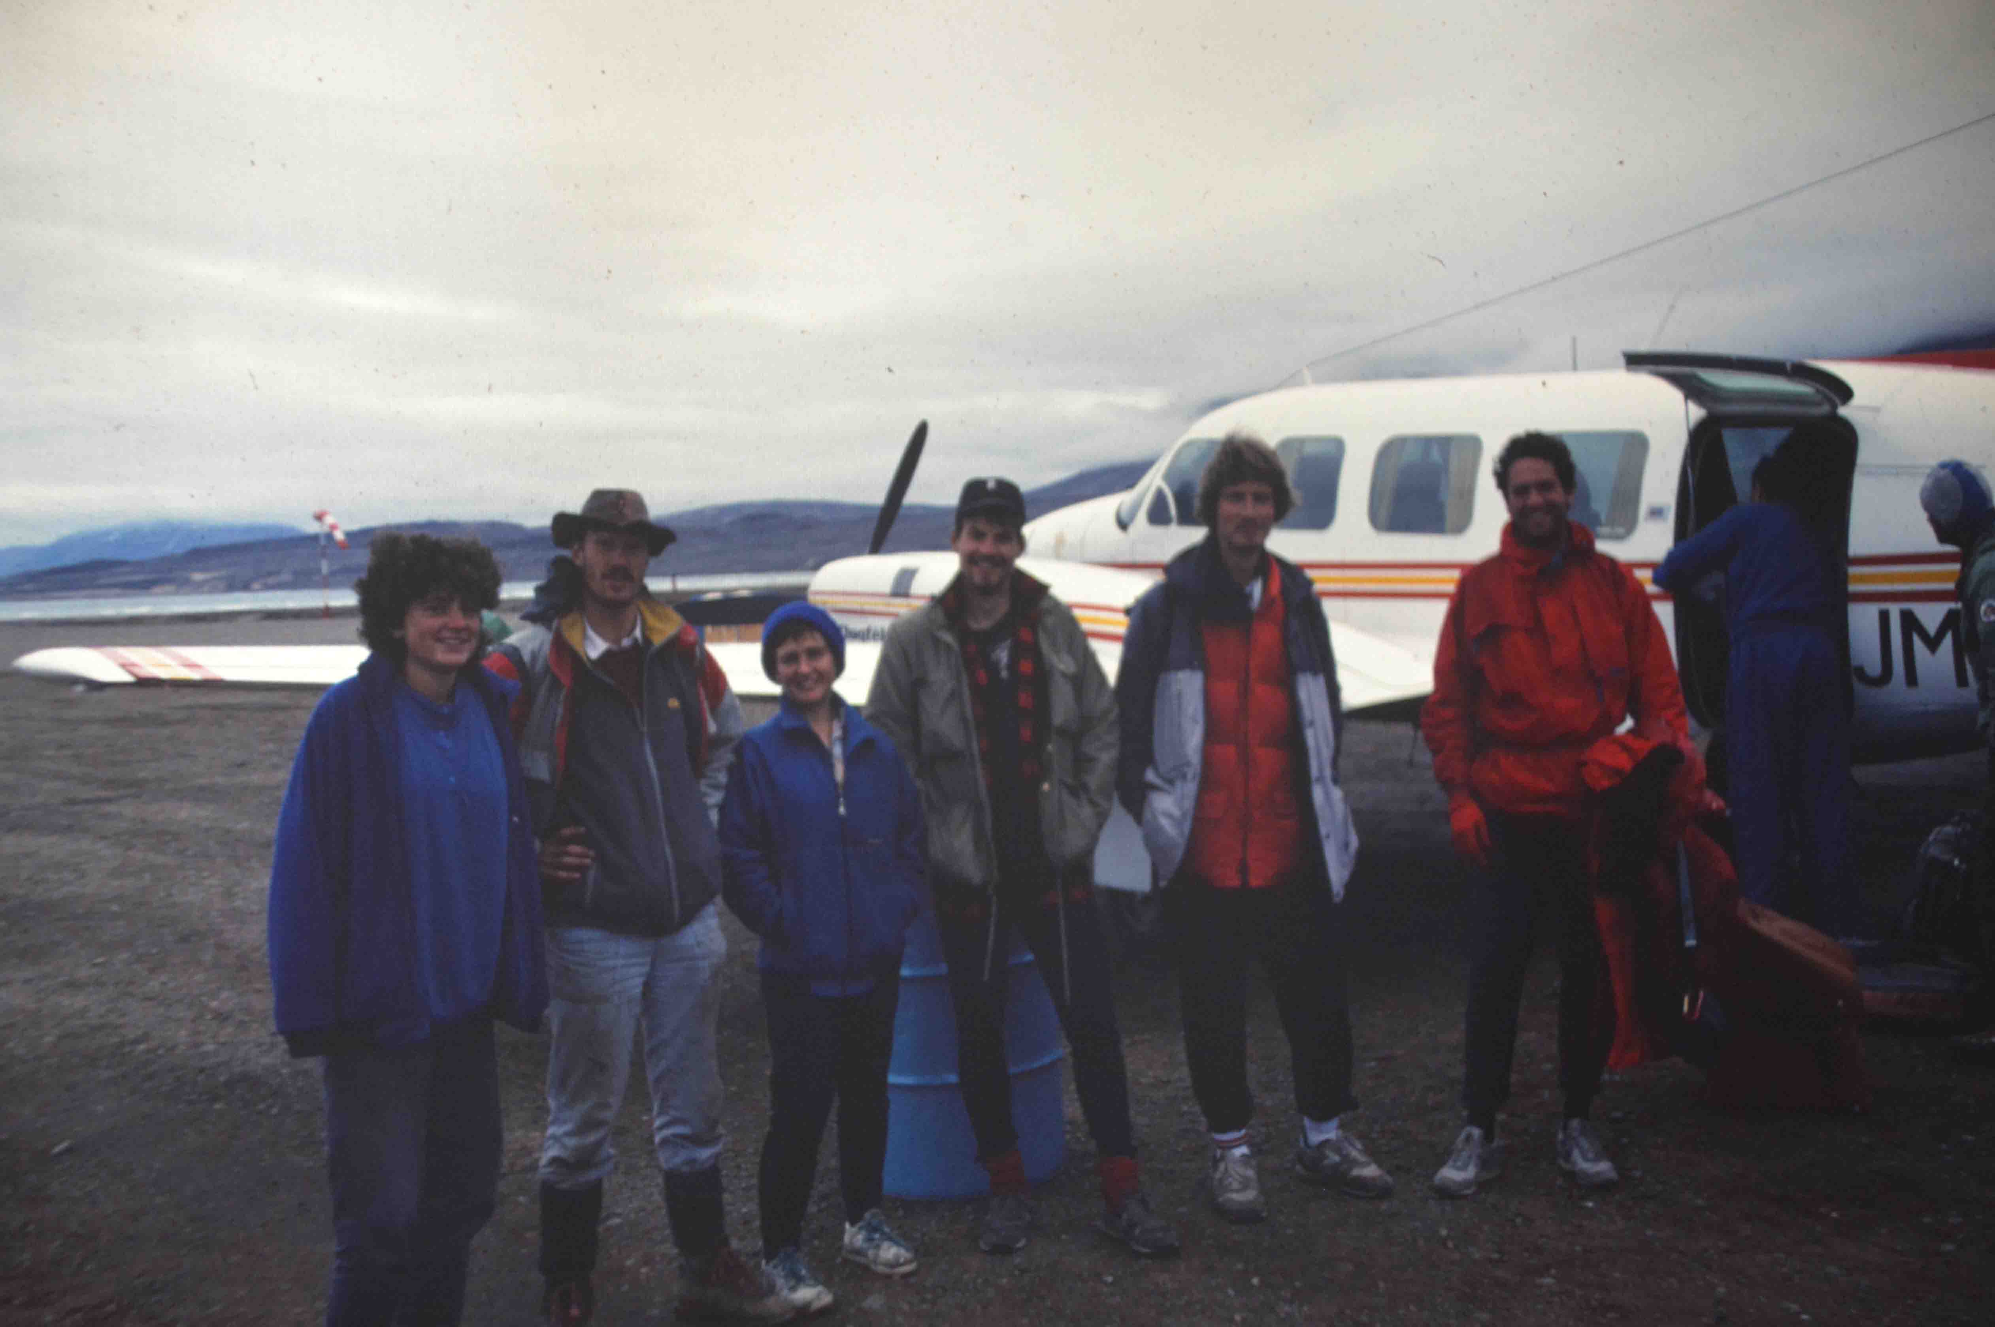
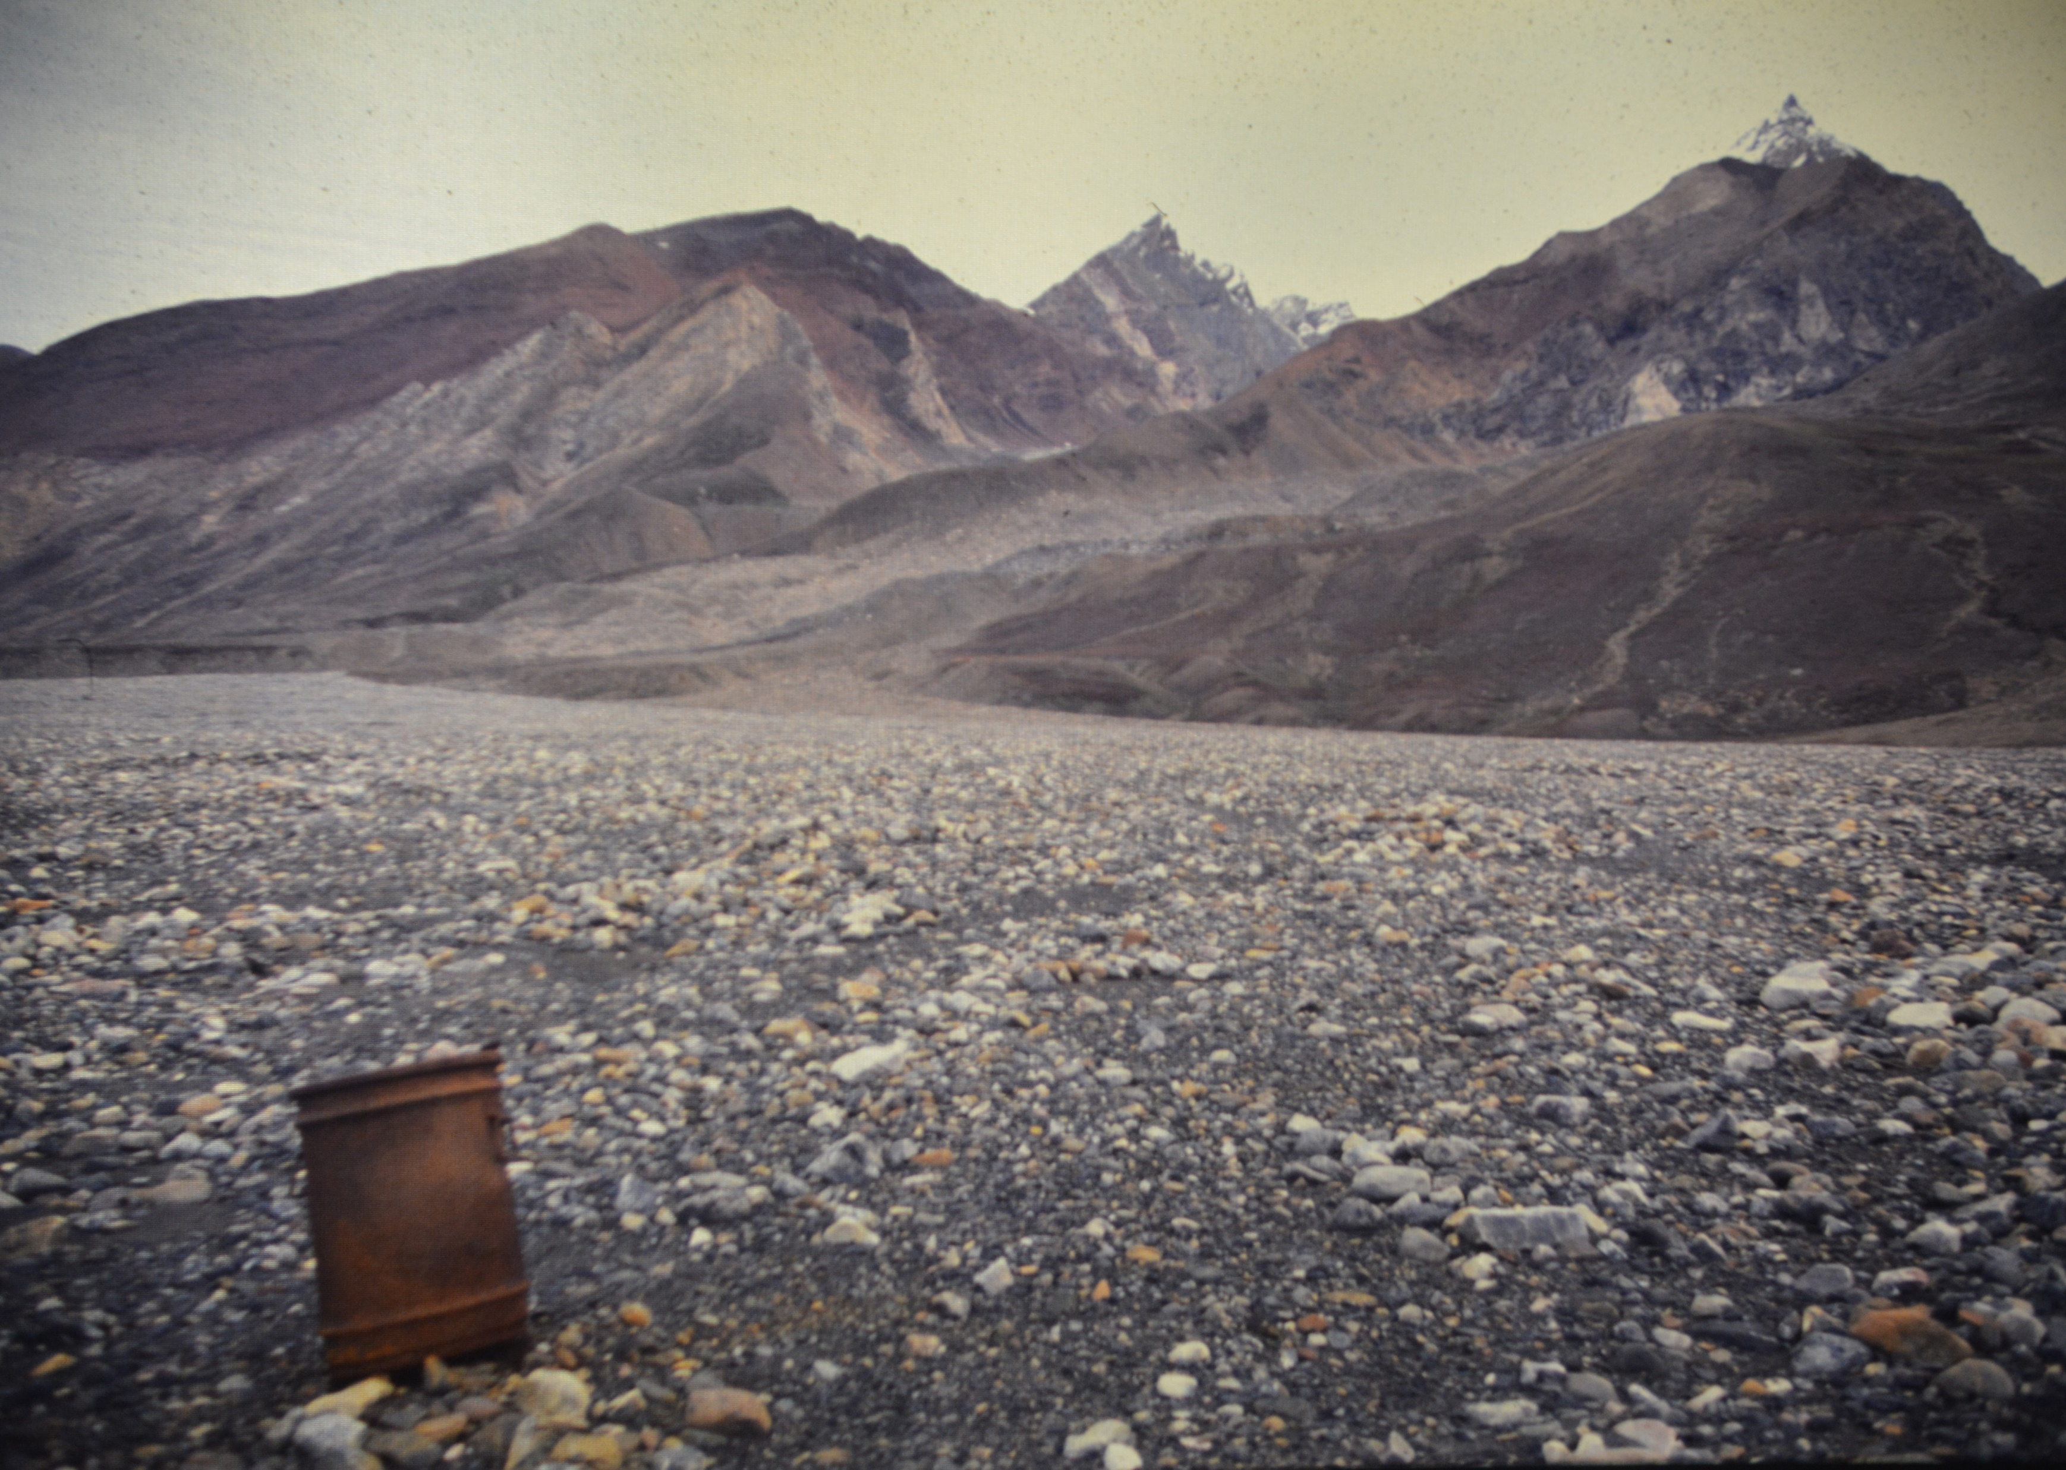
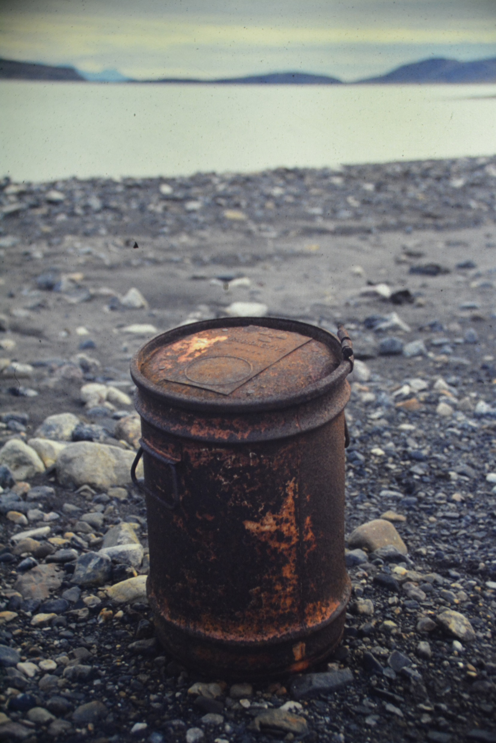
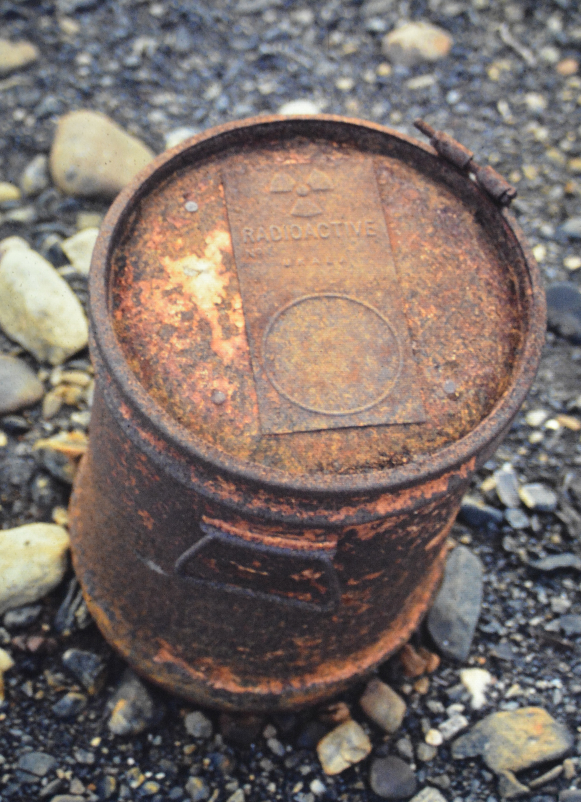
Two stories 2. Lost & Found

Slide 6
Lessons learnt
Need
Best available technology
More information
Full(er) transparency
Facilitating participation
Build trust

Slide 7
Going forward
Participatory GIS
Participatory web-based mapping tools for aiding site search and community decision making.
revise the existing spatial multi-criteria WEIGHTER applet
include user-specified spatial decision criteria (factors and constraints)
options for user specified constraint thresholds
weighting of factors according to perceived importance
facility for top-slicing results (enabling optimal or near-optimal sites to be easily identified)
storage of user solutions (weights and criterion choices), and
combination of multiple user solutions into composite decision maps.
Extend the toolkit into an easy-to-use conflict resolution dashboard incorporating participatory and social web capability (Web2.0) functionality to enable inclusive community and public involvement in site search, collaborative decision making and confliction resolution.

Slide 8
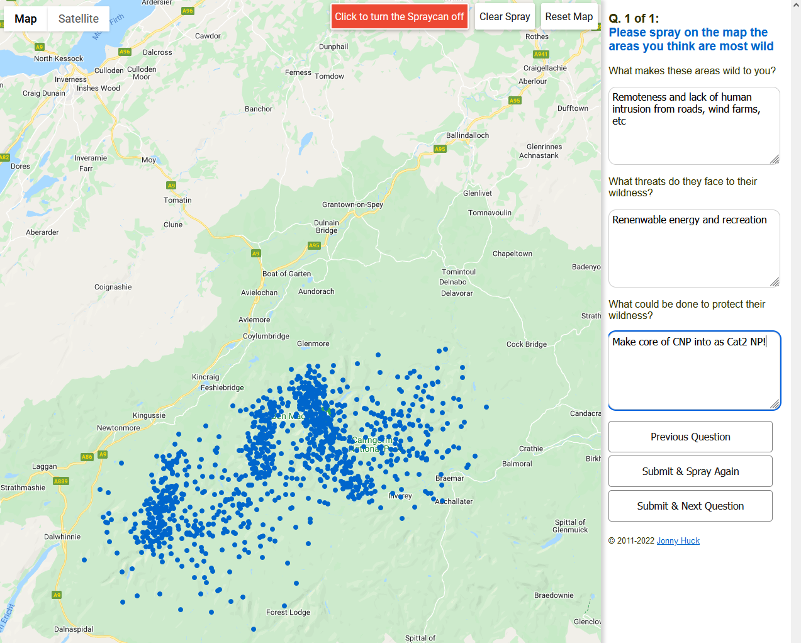
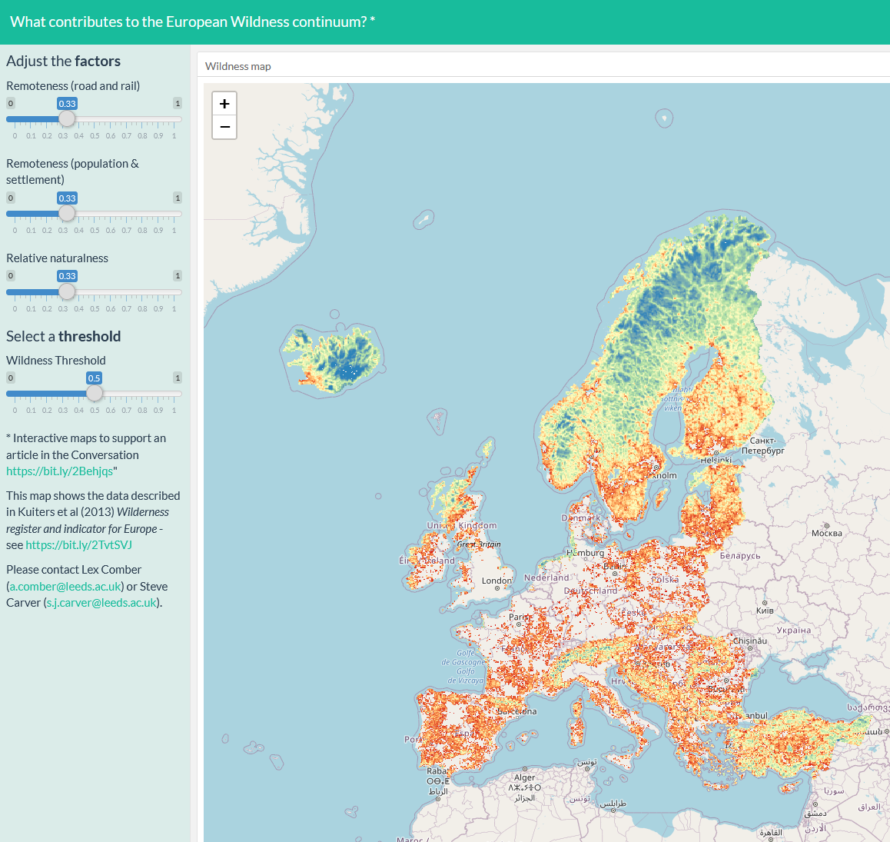
Two sites
https://saric.shinyapps.io/wild_euro/
http://map-me.org/sites/wiws

