Slide 1
NWS RSO Annual Conference Updates 2025: Highlights, Challenges and Opportunities. Kath Morris, Kat Raines

Slide 2
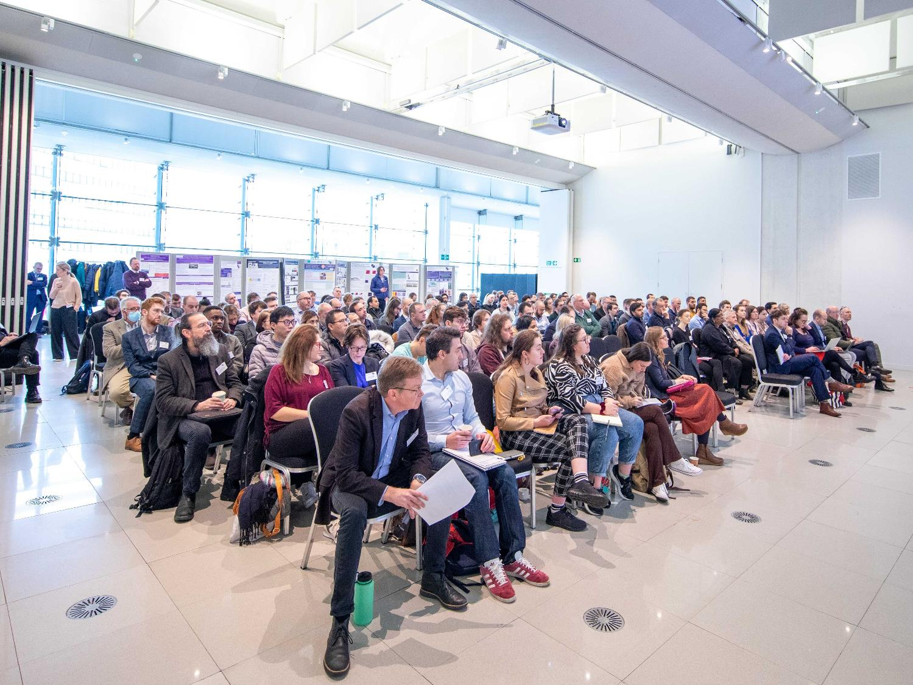
Warm Welcome 5th Annual RSO Conference University of Bristol

Slide 3
RSO Renewal 2025-2028

Slide 4
International
Skills
Cross Cut: Social Sciences
Topic Area: Environment
Geosciences & Biosphere
Topic Area: Materials
HHGW & EBS
Core Team:
strategy & coordination
Cross Cut: Radioactivity
Topic Area: Engineering
Cross Cut: Modelling & AI
Industry & NDA
RSO College

Slide 5
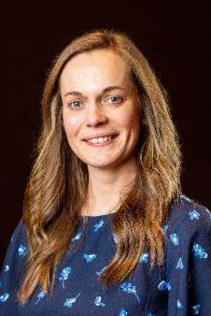
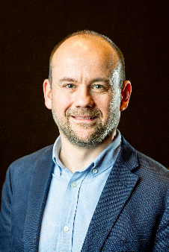
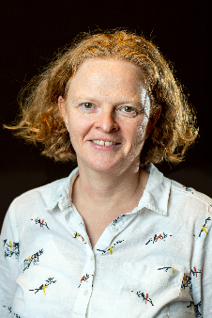
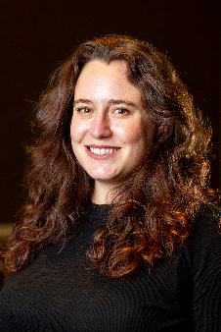
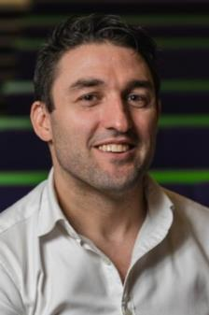
Core Team:
strategy & coordination

Slide 6
Topic Area: Environment
Topic Area: Materials
Core Team:
strategy & coordination
Topic Area: Engineering
Notes:
New academic positions for “Environment” and “Materials” – Advertised in Spring 2025

Slide 7
Cross Cut: Social Sciences
Topic Area: Environment
Geosciences & Biosphere
Topic Area: Materials
HHGW & EBS
Core Team:
strategy & coordination
Cross Cut: Radioactivity
Topic Area: Engineering
Cross Cut: Modelling & AI
Notes:
Cross Cut Areas – essential vehicles for interdisciplinary and systems thinking
New academic positions for Social Sciences and Radioactivity – Advertised in Spring 2025

Slide 8
Skills
Cross Cut: Social Sciences
Topic Area: Environment
Geosciences & Biosphere
Topic Area: Materials
HHGW & EBS
Core Team:
strategy & coordination
Cross Cut: Radioactivity
Topic Area: Engineering
Cross Cut: Modelling & AI
Notes:
KM
Skills embedded throughout – opportunities for NWS to engage in academic space, opportunities for researchers to engage in NWS space
Annual training budget, consideration in context of other researcher training (e.g. CDTs etc)
Community outreach really important

Slide 9
Skills
Cross Cut: Social Sciences
Topic Area: Environment
Geosciences & Biosphere
Topic Area: Materials
HHGW & EBS
Core Team:
strategy & coordination
Cross Cut: Radioactivity
Topic Area: Engineering
Cross Cut: Modelling & AI
RSO College
Notes:
KM
RSO College – non exclusive affiliation of current community DLs and SMEs – engagement with RSO CT DALs and CCT leads, ability to develop concepts and ideas, coordinate workshops etc. – real opportunity
Interested to hear thoughts and comments about how best to engage with this community – co-opting into discussions, college membership as RSO college fellow

Slide 10
International
Skills
Cross Cut: Social Sciences
Topic Area: Environment
Geosciences & Biosphere
Topic Area: Materials
HHGW & EBS
Core Team:
strategy & coordination
Cross Cut: Radioactivity
Topic Area: Engineering
Cross Cut: Modelling & AI
Industry & NDA
RSO College
Notes:
KM - summary
Important partnerships with Industry, NDA, International Community (EURAD2, GEOSAFE, others)

Slide 11
New Structure –Vacancies
Environment
Radioactivity
Engineering
Social Science
Materials
Modelling and AI
Parallel Roles – Early Career Research Community

Slide 12
RSO Renewal
Annual conference
Workshops - Community & funding development
Engineered Barrier System Performance, Spring 2025
Technical
Lab tours, BGS tour, NWS large equipment facility tour, International RCLs, Modelling training
Early Career Forum
Annual meeting, Independent research award, Research culture award, Communication award
Benefits realisation
Questionnaires and engagement with SME, capture in NWS forum

Slide 13
RSO Facts and Figures
57
5
20+
25+
18+
Active NWS-funded Researchers and RSO-Affiliates
RSO members into NWS related academic or industry positions
Notable Prizes to both researchers and to the RSO
Institutions that have benefitted from having academic research funded via the RSO
New permanent academic positions in NWS relevant research in UK Universities

Slide 14
RSO – Questions

