Slide 1
RSO EBS Discipline Update
Matthew Kirby (NWS), Majid Sedighi (Manchester University)

Slide 2
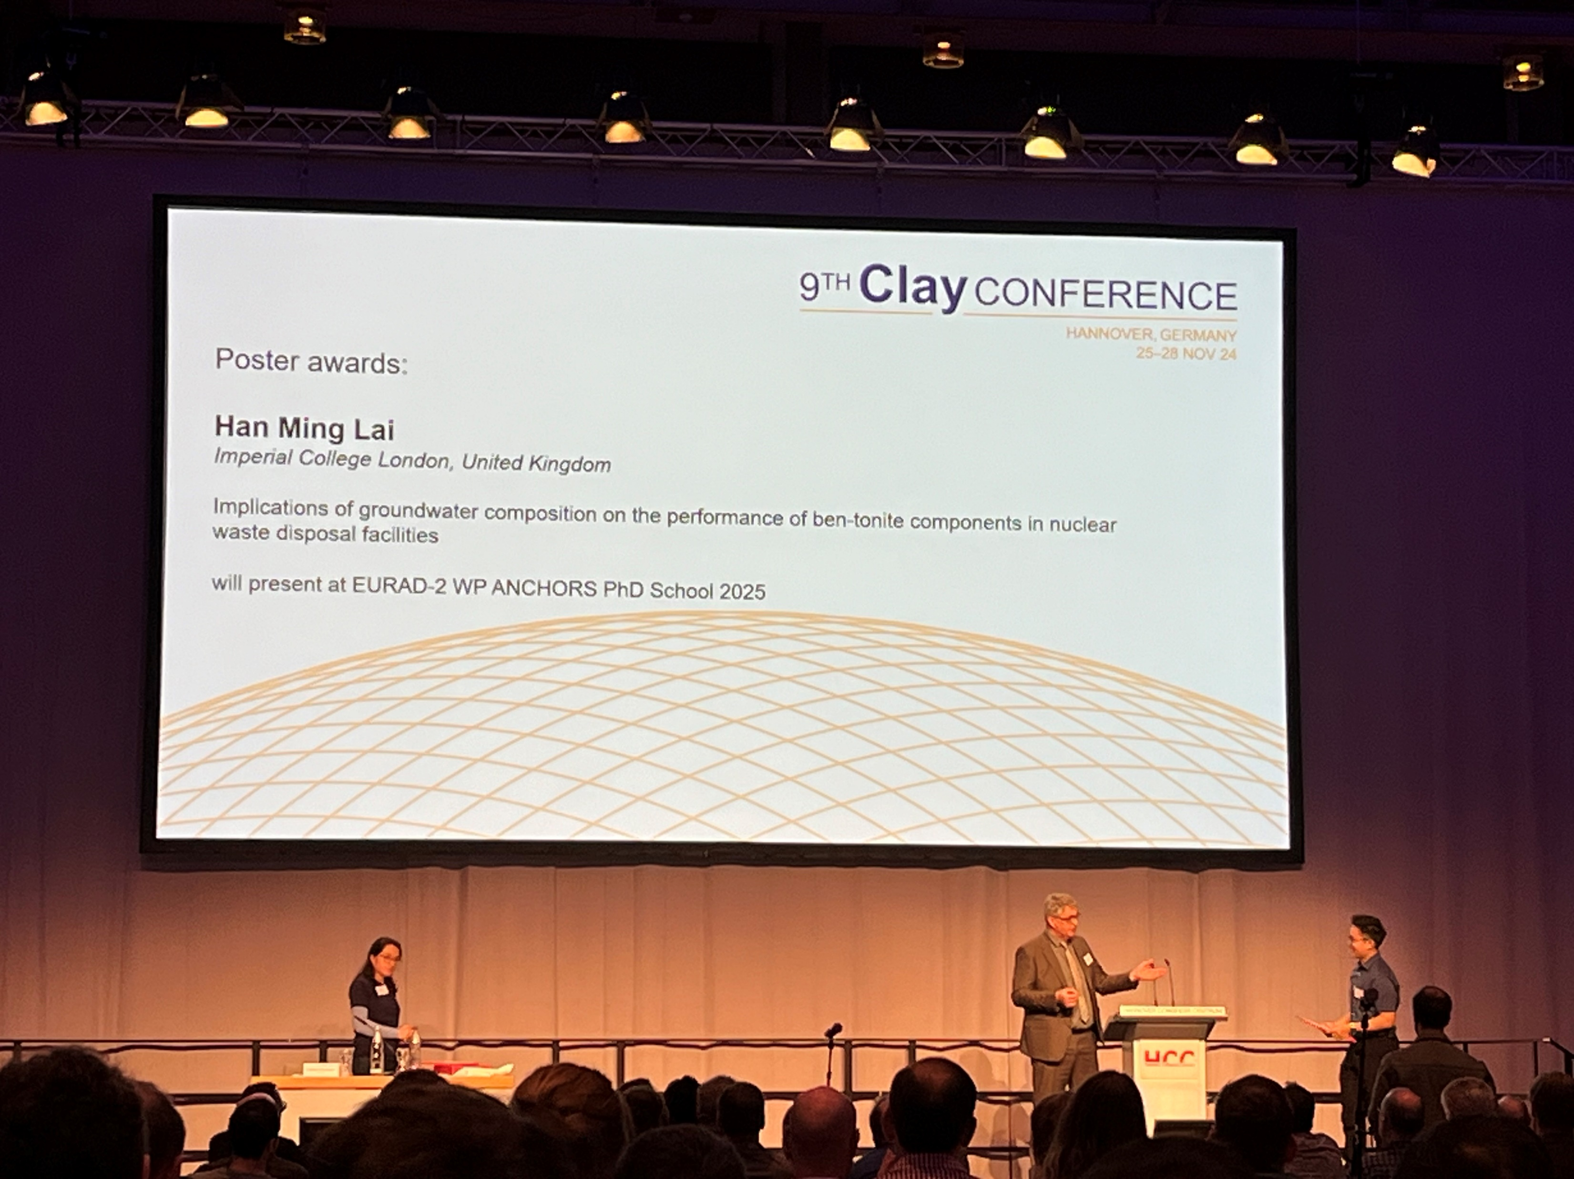
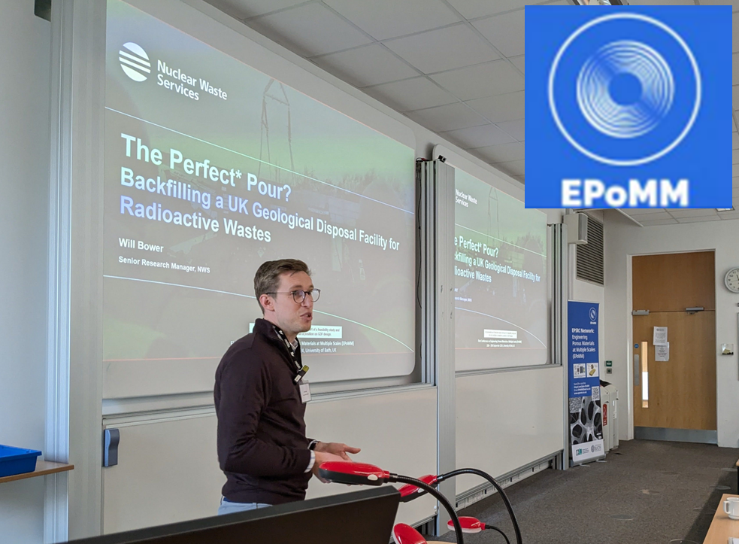
2024 Highlights
The RSO are currently funding 11 EBS-related PhD students across four universities.
PhD project launched at University of Strathclyde investigating the suitability of salt cements as low heat generating waste backfill materials.
Established an annual bentonite R&D forum fostering collaboration between PhD projects, supply chain projects and NWMO (Canada).
PhD presentations at the Clay Conference, November 2024
Knowledge exchange at the EPSRC network for Engineering Porous Materials at multiple scales (EPoMM), September & December 2024

Slide 3
Future Plans
Focus academic research to provide fundamental understanding of EBS performance under UK site-relevant conditions. Examples include:
Demonstrating the EBS (local backfill, gas permeable seals, mass backfill) can work together to manage gas within Low Heat Generating Waste disposal concepts.
Implications of sustainability-driven changes within the cement industry on barrier performance.
Demonstrate the High Heat Generating Waste buffer can protect the container from corrosion processes.
Planned research in progress webinar topic: cement-based engineered barriers.
Discussions are ongoing with RSO core team regarding holding an EBS research symposium in 2025.

