Slide 1

GeoSafe: Towards Safe Geological Disposal of Radioactive Waste in Lower Strength Sedimentary Rock (LSSR)
Challenge 2: Contaminant Pathways
Sam Shaw (Manchester) and Will Bower (NWS)
NWS-RSO Annual Conference
Bristol, UK
16th January 2025
1
Notes:
Sam Shaw lead of Challenge 2 working along side WB for Challenge 2
GeoSafe Challenge 2 focuses contaminants pathways – as Robert described the set of Wp’s in this challenge area are focused on the transport and fate of radionuclides with LSSR

Slide 2
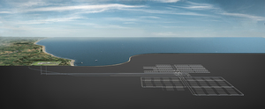
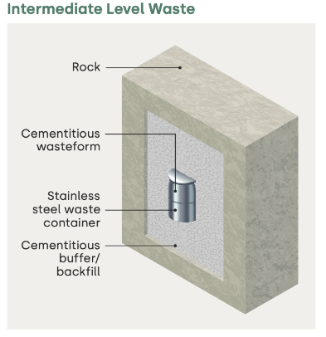
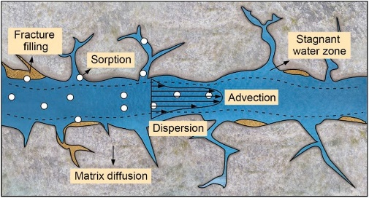
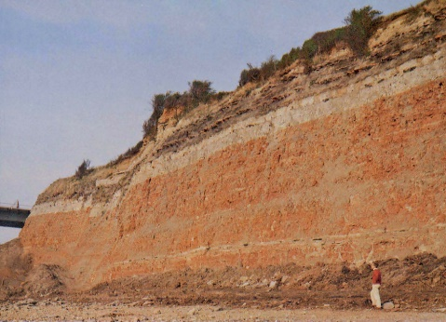
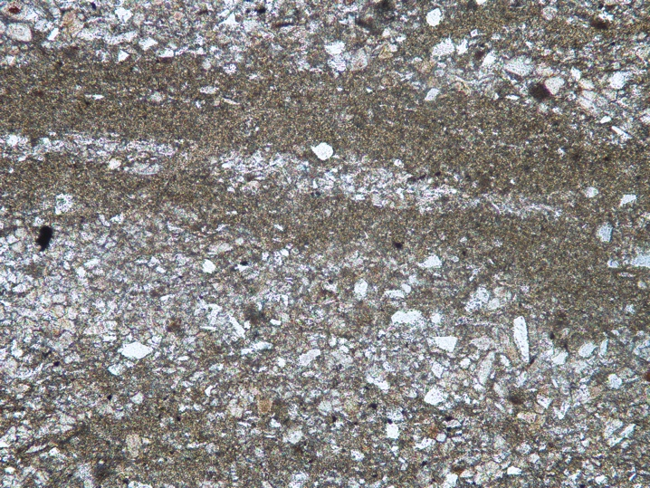
Biogeochemical controls on radionuclide fate and transport
Aim: identify and assess key (bio)geochemical processes that control radionuclide speciation/transport in LSSRs
Key Challenges:
Heterogeneous LSSR lithologies (<mm to >m scale)
Biogeochemical processes occurring from Å to m scale within pores and fractures key to radionuclide transport and fate
Unique geochemical conditions within LSSR adjacent to Geological Disposal Facility (GDF) (e.g. High salinity and pH)
Zhang et al. 2022
1mm
Zhang et al. (2022) J. Haz. Mat. 424C, 127550
Notes:
The key aims is……
Overall this component of the project aims to determine the process by which radionuclides are sorbed and during transport through the LSSR, and the factors controlling their sequestration and rate of transport through these sedimentary rock.
You had the broad background project area RZ
Key challenges when study radionuclide interaction within the LSSR associate with this study i.e. OXC and MMG
Heterogeneity ---how do we account for and conceptualize the effect of this heterogeneity on the fate and transport of rads.
Secondly, the effects of biogeochemical process on the radionuclide within the LSSR and
Finally, the unique chemical conditions within the LSSR in particular the high salinity of the ground waters (up to 100’s g’s per litre)
Overall, these challenges are somewhat unique to these LSSR’s in the UK and are in many ways distinct form the LSSR formations being considered for GDF host rocks by other countries and WMO’s

Slide 3
Challenge 2 Work Packages (WP’s)
WP 3 Geochemical Controls on Radionuclide Transport and Fate in Heterogeneous LSSR – from Atomic to Macro-scale
WP 3.1 Bulk radionuclide LSSR interactions
WP 3.2 Radionuclide interaction with LSSR via flow experiments with multi scale characterisation
WP 3.3 Dynamic imaging and quantification of radionuclide transport and fate in LSSRs
WP 3.4 Thermodynamic modelling of radionuclide fate and transport
WP 4 Geomicrobiological controls of radionuclide transport and fate
WP 4.1 Microbial characterization of representative LSSR samples
WP 4.2 Biogeochemical impacts on radionuclides in batch systems
WP 4.3 Microbial impact in flow-through systems
Notes:
overall, a combination of experimental, analytical and modelling approaches to

Slide 4




GeoSafe Challenge 2:
Contaminant Pathways
WP3
University of Manchester
Sam Shaw (PI)
Prof. Katherine Morris (Co-I)
Callum Robinson (PDRA)
Karl Kraavi (PhD)
British Geological Survey
Keith Bateman (Co-I)
National Nuclear Lab
Liam Abrahamsen-Mills (Co-I)
Aislinn Boylan (Co-I)
University of Helsinki
Gareth Law (project partner)
WP4
University of Manchester
Jon Lloyd (PI)
Chris Wort (PhD)
TBC (PDRA)
Rebecca Snow (PhD)
British Geological Survey
Simon Gregory (Co-I)
Jess Mackie (PhD)
4
Notes:
To meet this challenge we have a broad range of expertise including geochemists, mineralogists, geomicrobiologists and experts in biogeochemical modeling, with the key institutions UoM, NNL and BGS.
This package commenced in September with the recruitment of our first full time PhD student in September 2024, and we are in the process of appointing 2 more PDRA’s and A PhD student, all of which will be in place by the end of March.
However, despite the early stage of the project we begun to develop experimental programs within both wp’s

Slide 5
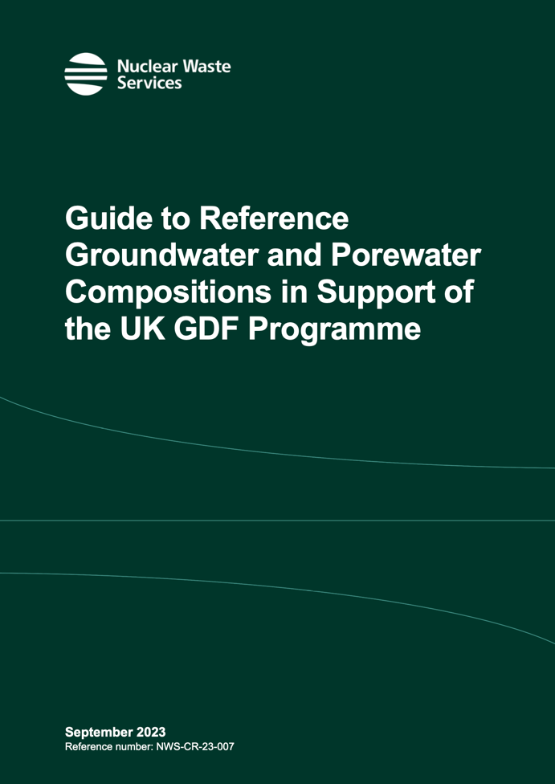
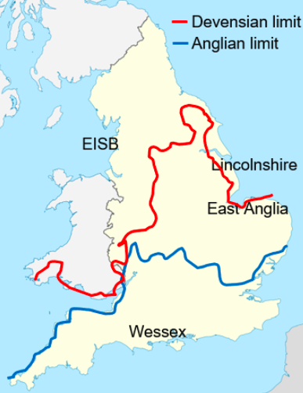
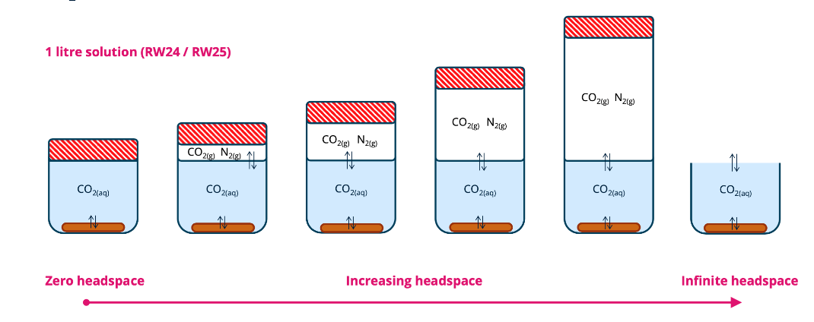
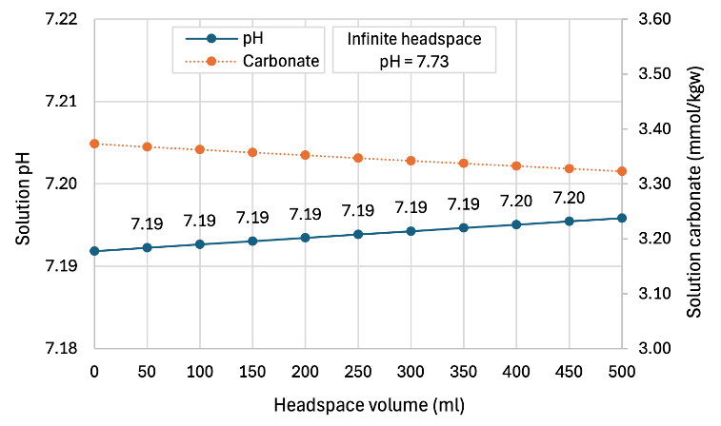
LSSR groundwater interactions:
Geochemical modelling
Groundwater selection based on NWS porewater study
  High salinity up to >5 x seawater
  Saturated wrt key phases
  Oversaturated wrt CO_{2(g)}
Sample description | Oxford Clay groundwater | Following equil. with Oxford Clay
RW Code | RW25 | -
 | mol/kgw | mol/kgw
Ca | 1.36E-02 | 1.56E-02
Mg | 5.37E-02 | 5.33E-02
Na | 4.77E-01 | 4.77E-01
K | 1.04E-02 | 9.08E-03
HCO₃ | 1.39E-03 | 3.37E-03
SO₄ | 3.23E-02 | 3.23E-02
Cl | 5.58E-01 | 5.58E-01
SiO₂(aq) | 0 | 1.76E04
Al | 0 | 3.89E-09
pH | 7.1 | 7.19
Sample description | Oxford Clay | Mercia Mudstone Group
RW Code | RW25 | RW5
TDS (ppm) | 36,135 | 189,191
Ca | 544 | 2287
Mg | 1306 | 1236
Na | 10,968 | 69,090
K | 406 | 488
HCO₃ | 85 | 104
SO₄ | 3102 | 5272
Cl | 19,726 | 110,697
SiO₂(aq) | 9 | 55
Al | 5.00E-05 | 0.01
pH | 7.1 | 6.5
PHREEQC v3.7.3 geochemical modelling (Thermochimie SIT v12a database)
Units = ppm
Notes:
Firstly, in order to begin an experimental program we need to develop protocols of synthesizing groundwater, which will be stable in our experimental systems and not directly react with the LSSR. This is not usually a challenge when considering lower salinity groundwater, but in some of the systems we are working with the salinity could be up to 5x seater, and sauatarte wrt evaporite phases including gypsum and even halite (or sodium chloride).
So to assess the groundwater, we are starting with compositions for the Oxford Clay and MMG groundwaters published recently by NWS . The teams at NNL and Manchester used bith expriemntal and modlelig approaches to assess the groundwater stability, initally focusing on the Oxford clay.
Composition (XRD):
Quartz (SiO₂)
Calcite (CaCO₃)
Kaolinite (Al₂Si₂O₅(OH)₄)
Illite KMg₂(Si,Al)₄O₁₀
Pyrite (FeS₂)

Slide 6
LSSR groundwater interactions:
PHREEQC modelling
Groundwater selection based on NWS porewater study
  High salinity up to >5 x seawater
  Saturated wrt key phases
  Oversaturated wrt CO_{2(g)}
Sample description | Oxford Clay groundwater | Following equil. with Oxford Clay
RW Code | RW25 | -
 | mol/kgw | mol/kgw
Ca | 1.36E-02 | 1.56E-02
Mg | 5.37E-02 | 5.33E-02
Na | 4.77E-01 | 4.77E-01
K | 1.04E-02 | 9.08E-03
HCO₃ | 1.39E-03 | 3.37E-03
SO₄ | 3.23E-02 | 3.23E-02
Cl | 5.58E-01 | 5.58E-01
SiO₂(aq) | - | 1.76E-04
Al | - | 3.89E-09
pH | 7.1 | 7.19
PHREEQC v3.7.3 geochemical modelling (Thermochimie SIT v12a database)
Experimental pH 7.10
Units = ppm
Notes:
Firstly, both models and experimental study showed that the solution were stable wrt sold phase precipitation, and the composition of the groundwater stay close to the original recipe, this is also supported by the experimental results, as shown here the see a very small change in pH, well within natural variations.
However the modeling highlighted that the groundwaters are oversaturated wrt Co2 gas, and if left unconstrained this degassing could significantly change the composition for one example increasing pH to above 9
Therefore its clear that these groundwater must be stored in closed vessel with minimal head space, but how much headspace is too much
, and by modelling groundwater in equilibrium with the host rock mineralogy in vessel with a range of headspace volumes we were able to show that if we constrain the headspace to <10% of the solution volume the change in composition is minimal.
The outcome from this work is that we now have a protocol to prepare, store and using these GW's in experiments, this is not only supporting the GeoSafe project, but other experimental progams in other RSO and NWS project's.
Composition (XRD):
Quartz (SiO₂)
Calcite (CaCO₃)
Kaolinite (Al₂Si₂O₅(OH)₄)
Illite KMg₂(Si,Al)₄O₁₀
Pyrite (FeS₂)

Slide 7
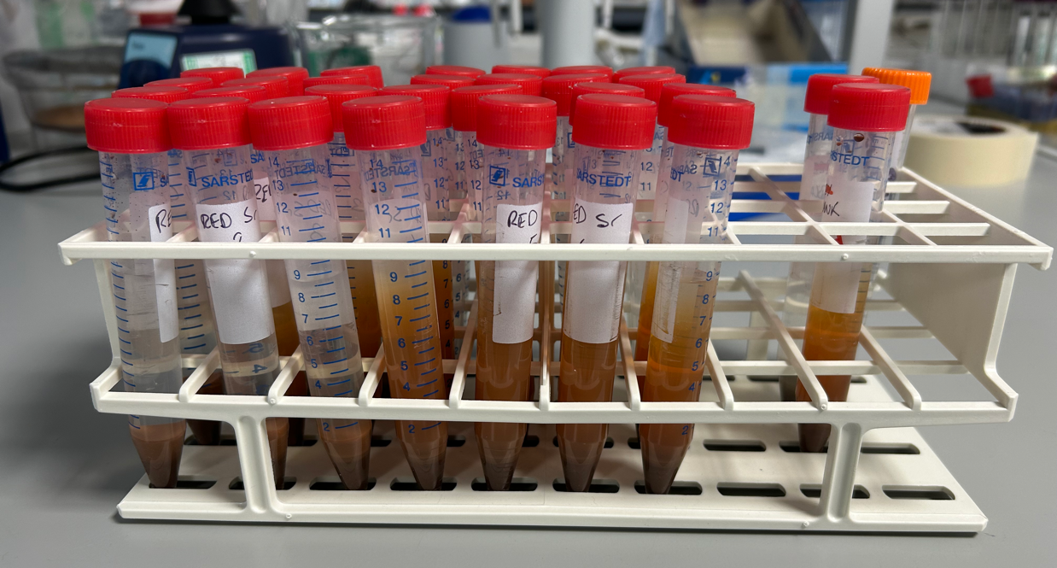
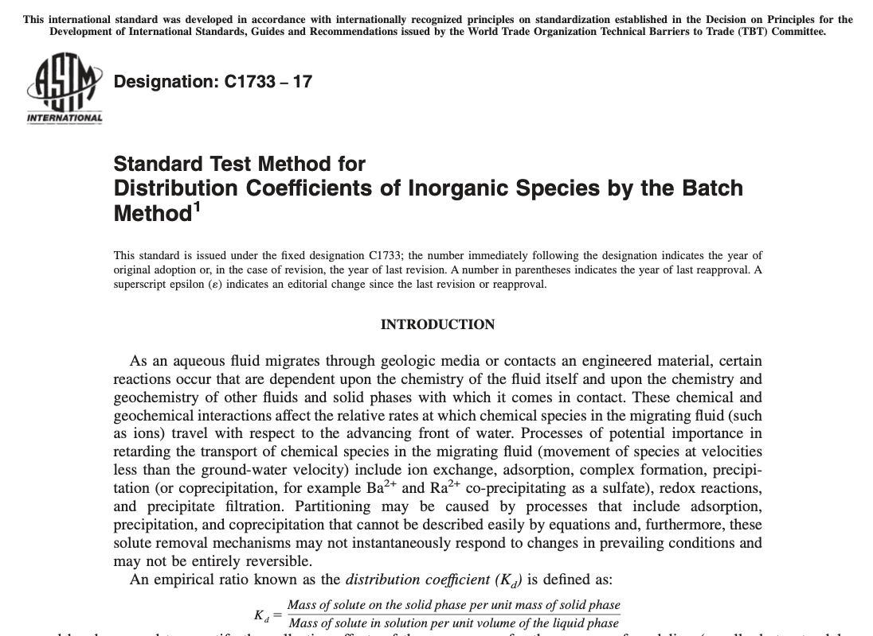
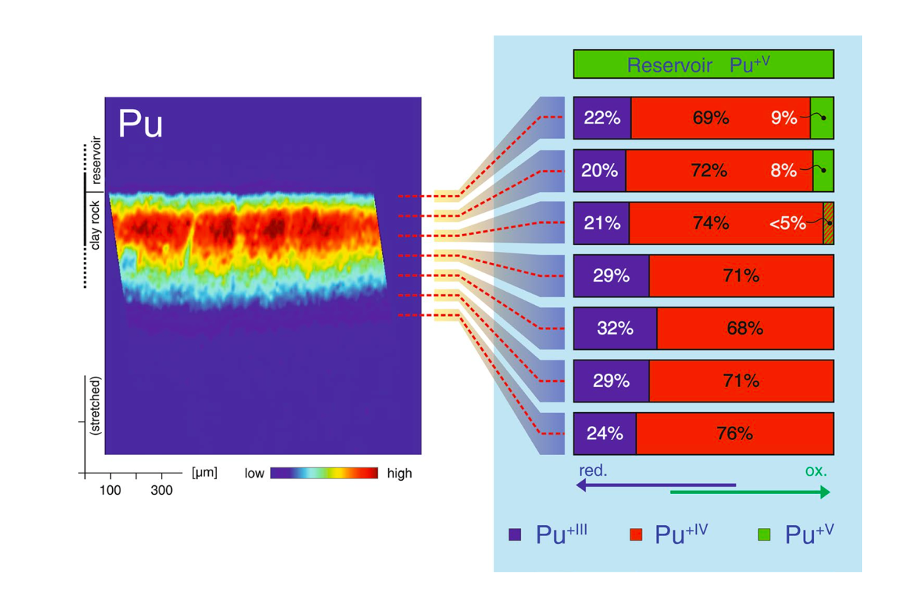
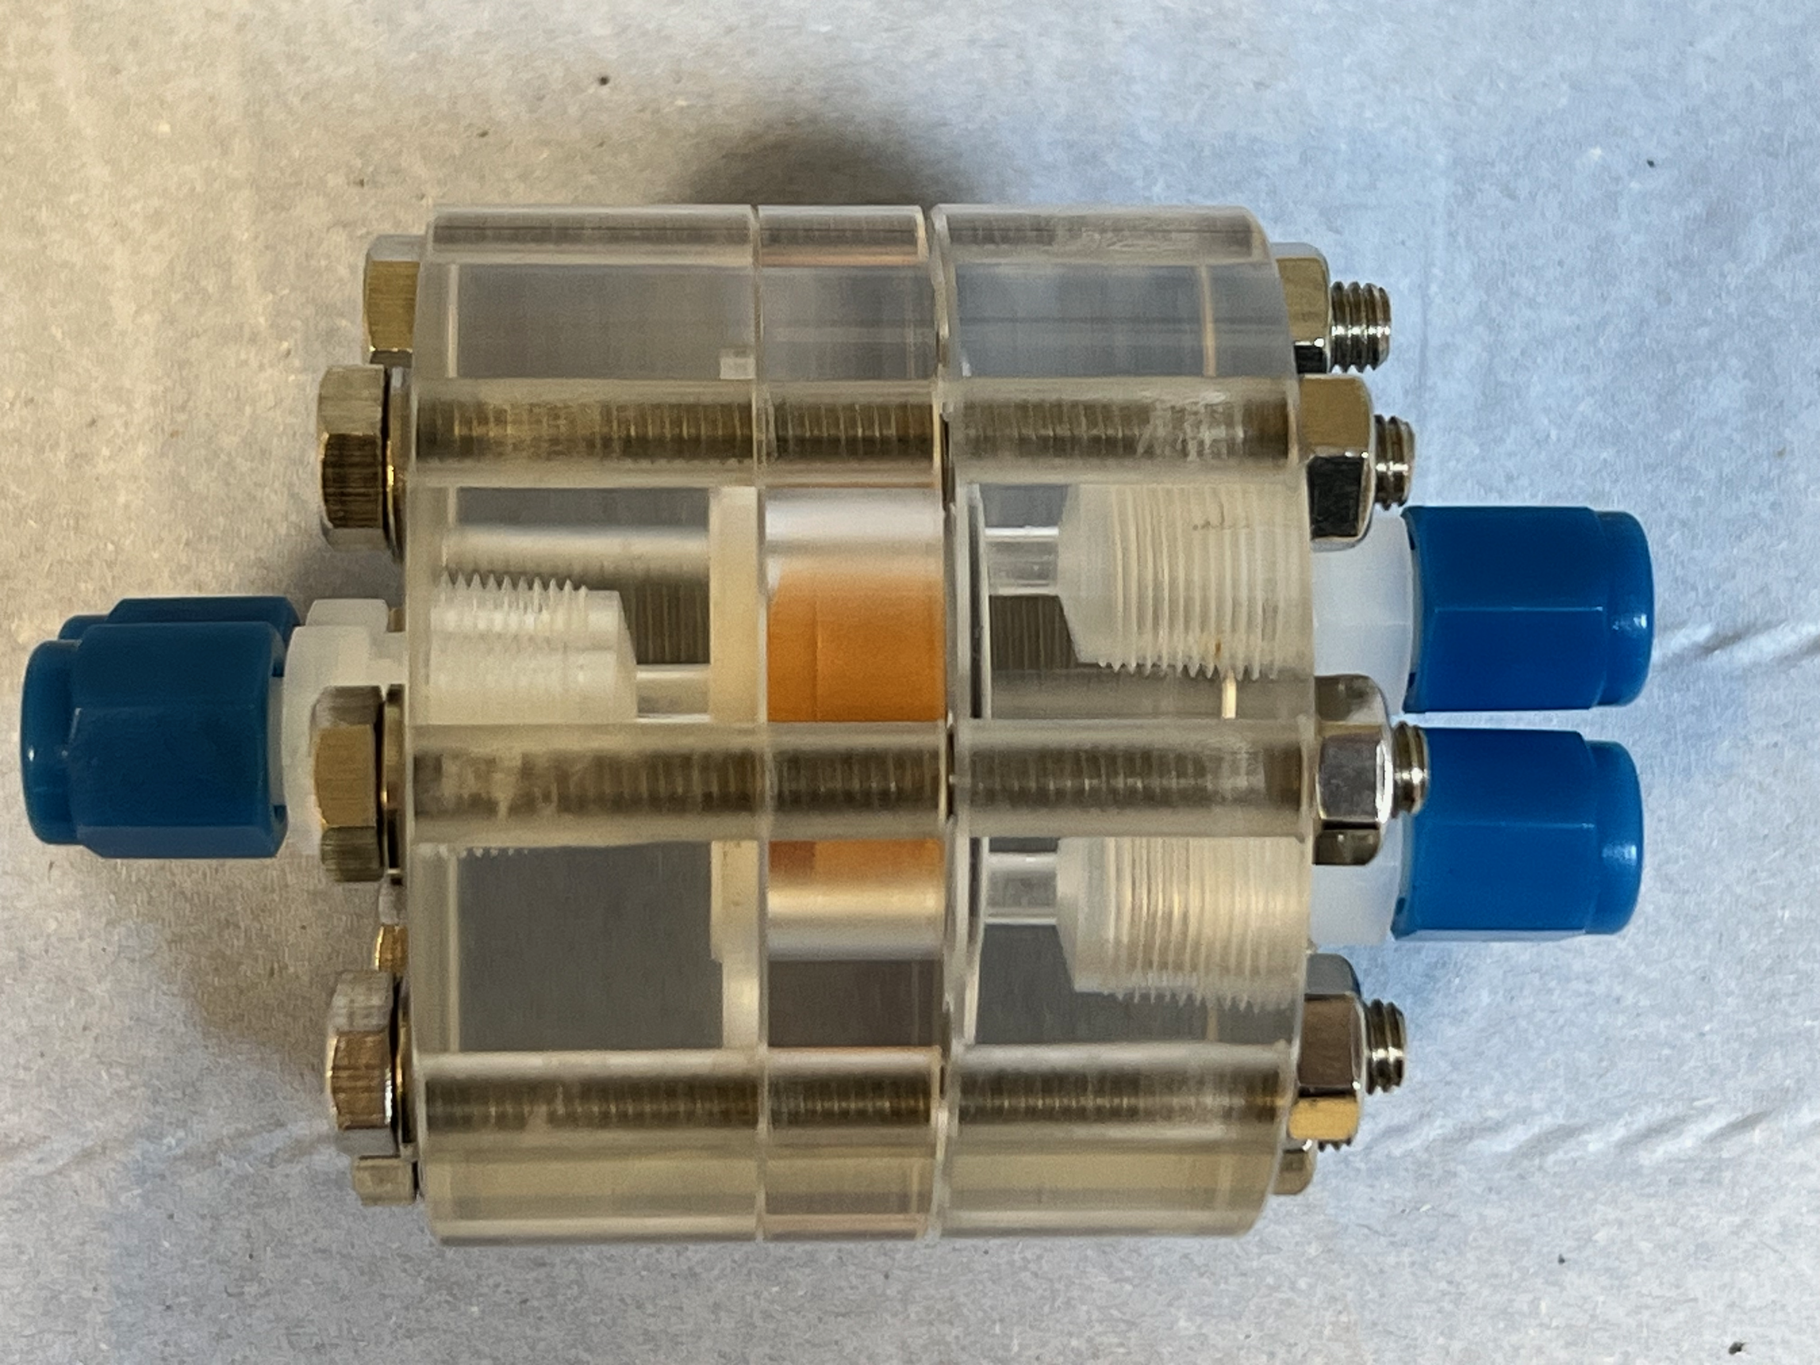
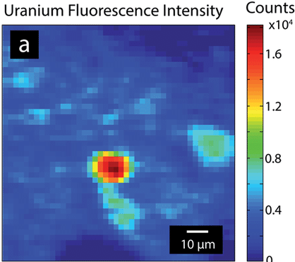
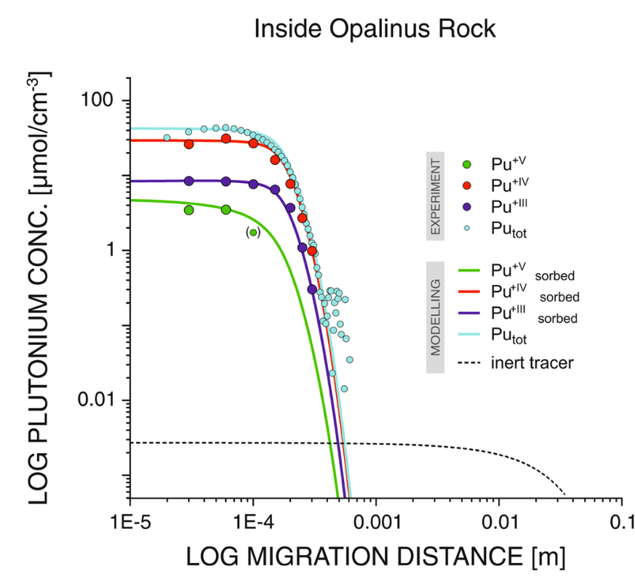
Radionuclide sorption and transport
Radionuclide sorption to LSSRs as a function of geochemical conditions
  Adsorption isotherm studies (method – C1733 -21) www.astm.org
  Radionuclides: U, Np, Ra, Se, Tc and Ni
  LSSR groundwaters
Fate and transport rate of radionuclides through LSSRs.
1mm
Flow Mode
Diffusion Mode
Kaplanet al. Sci Rep 14, 3087 (2024).
Crean et al. (2020)
Notes:
So now we have the starting materials the rock and groundwaters, we are now beginning the radionuclide uptake experiments which is one of the key components of WP3 in GeoSafe, we have adopted the use of the standard ASTM protocol to align with international best practice, to determine the degree of radionuclide adsorption under GDF conditions. This will be complemented by state of the art X-ray spectroscopy measurement which will allow us to determine the mechanism of radionuclide uptake, for example the mechanism of surface adsorption or the formation of discrete mineral phases.
Focusing on LSSR conditions
We have also developed protocols and sample cell for flow through experiments to allow us to study the transport of these radionuclide through the LSSR, either by advective of diffusive transport. However, as these rock are heterogeneous one of the the key components of these part of the work will be be the use of X-ray and electron beam microanalysis techniques to determine the radionuclide distribution and speciation, including there oxidation state, associate with the different components of the LSSR at the nm to cm scale.
ASTM International, “American Society for Testing and Materials”

Slide 8
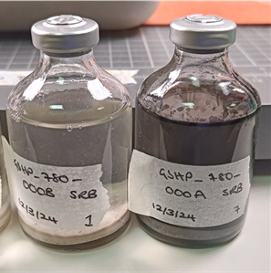
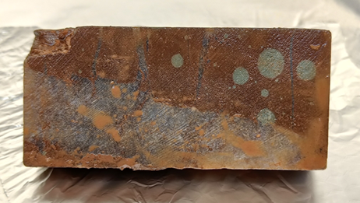
Microbial characterisation of
Oxford Clay (OXC) and Mercia Mudstone Group (MMG)
WP 4.1 Fresh MMG/OXC
WP 4.1 Characterise in situ communities
WP 4.1 produce cultures from LSSR
WP 4.2 Biogeochemical impacts on radionuclides in batch systems
WP 4.3 WP 4.3 Microbial impact in flow-through systems
8
Notes:
Next ,
Move onto wp4 which is focused on the geomicrobiology controls of radionuclide fate and transport.
including the study of microbial communities in post closure LSSR environments. These studies will employ culturing techniques to study microbial process within LSSR systems using a range of LSSR’s and utilising inoculate from URL’s and the Harpur hill CDZ analogue to study near field and far field repository systems.
As previously state we are just at the start of this work, but the teams at the BGS and UoM have begun the tasks within WP.
In these early stage of the project we are focused to the in situ microbial communities with the LSSR’s. The information will then be use to support the later components of the project
Characterising microbial communities within heterogenous materials (e.g. MMG) improves Waste Management Organisation’s (such as NWS) understanding of subsurface conditions relevant to radioactive waste disposal locations.
Objective: To determine how the heterogeneity of LSSR affects its ability to support microbial activity through the provision of electron donors and acceptors
Questions in GeoSafe: Could organic matter in LSSR support microbial activity? Could sulphate in the LSSR/groundwater support sulphate reducing activity?
MMG: Microbiologically preserved samples obtained for future experiments and to produce representative cultures from indigenous community
Oxford Clay: Non-microbiologically preserved samples valuable as “matrix” in experiments to understand microbe-mineral interactions

Slide 9
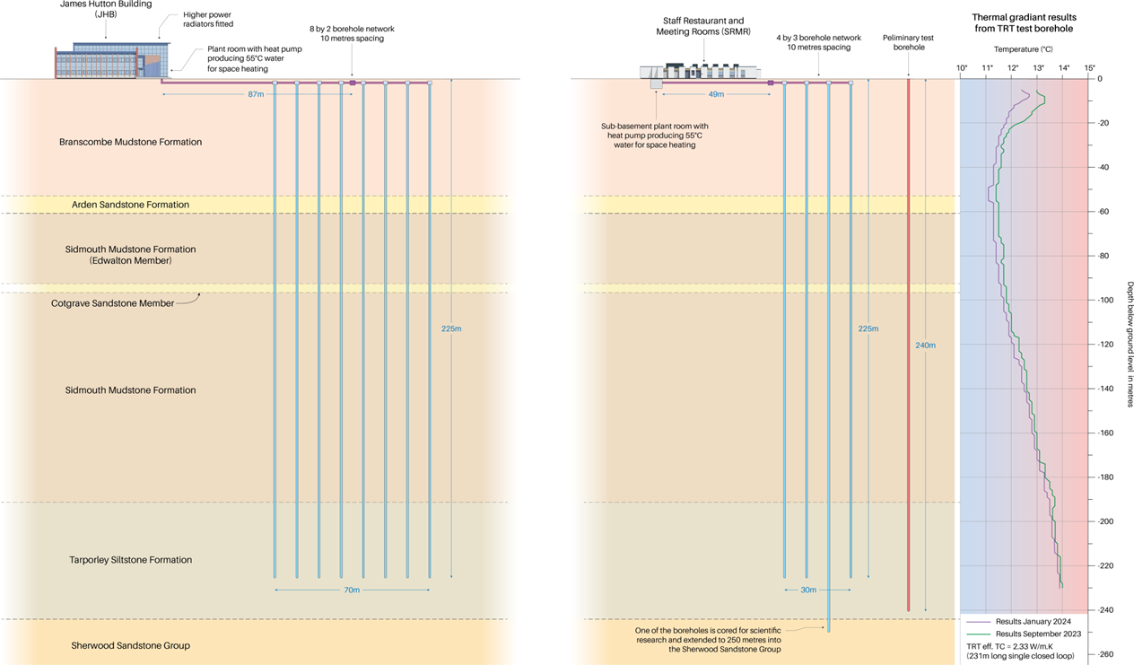
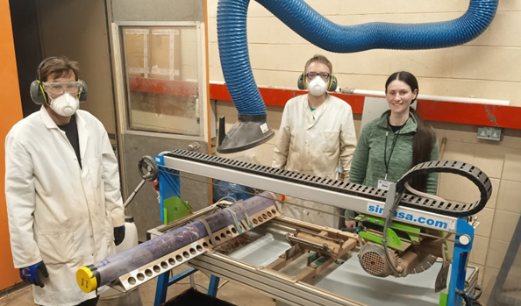
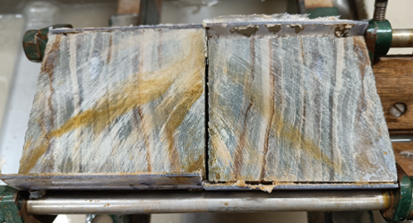
Microbial characterisation of representative LSSR samples
Mercia Mudstone Group
Subsampling with core saw, pictured above. 10cm core during quartering process, pictured below.
250m
Lithologies of borehole being subsampled including Mercia Mudstone groups.
Notes:
In this initial stage of the project the team have been characterising fresh MMG borehole samples, used aseptic technique to avoid contamination of the rock during sampling. They then conducted an MPN assay for SRB – to determine the number of culturable SRB’s in the rock samples
These initial result show that these rock samples contain v low levels of culturable cells, within these well seal formation, which is consistent with what we expect for these low porosity mudstones, and similar to rock from similar systems e.g. Mount terri rocks. They are now working through these MPN tests to determine the level of other biogeochemically active microbes e.g. iron reducers
Overall, what this shows there are active microorganisms all be it at a low level, and overall this type of study provides us with the Baseline understanding of the microbial activity within these rocks, and as we move through the project we will characterise how these microbial communities will responds to perturbations related to the GDF system and their effect on the radionuclide fate and transport, using both batch and flow through experimental approaches.
Oragnism aactivate and organisma can come through
More in fractured zones.
– cell per ml in media – low level 0.1 cell per rock
Now working through to look differe
nt organism e.g. iron reducers
In all rock types
Soil 10^9
Sampling protocol overview:
Subsampling 10cm length core every 6m.
10cm core quartered for various tests including: geomicrobiology culture tests, geomicrobiology DNA tests and thermal properties.
Core saw sterilised with IPA before making cuts.
Samples stored at -80°C for DNA or 4 - 8°C (after anaerobically vacuum sealing and storing in a nitrogen flushed heat sealed bag) for culture tests.

Slide 10
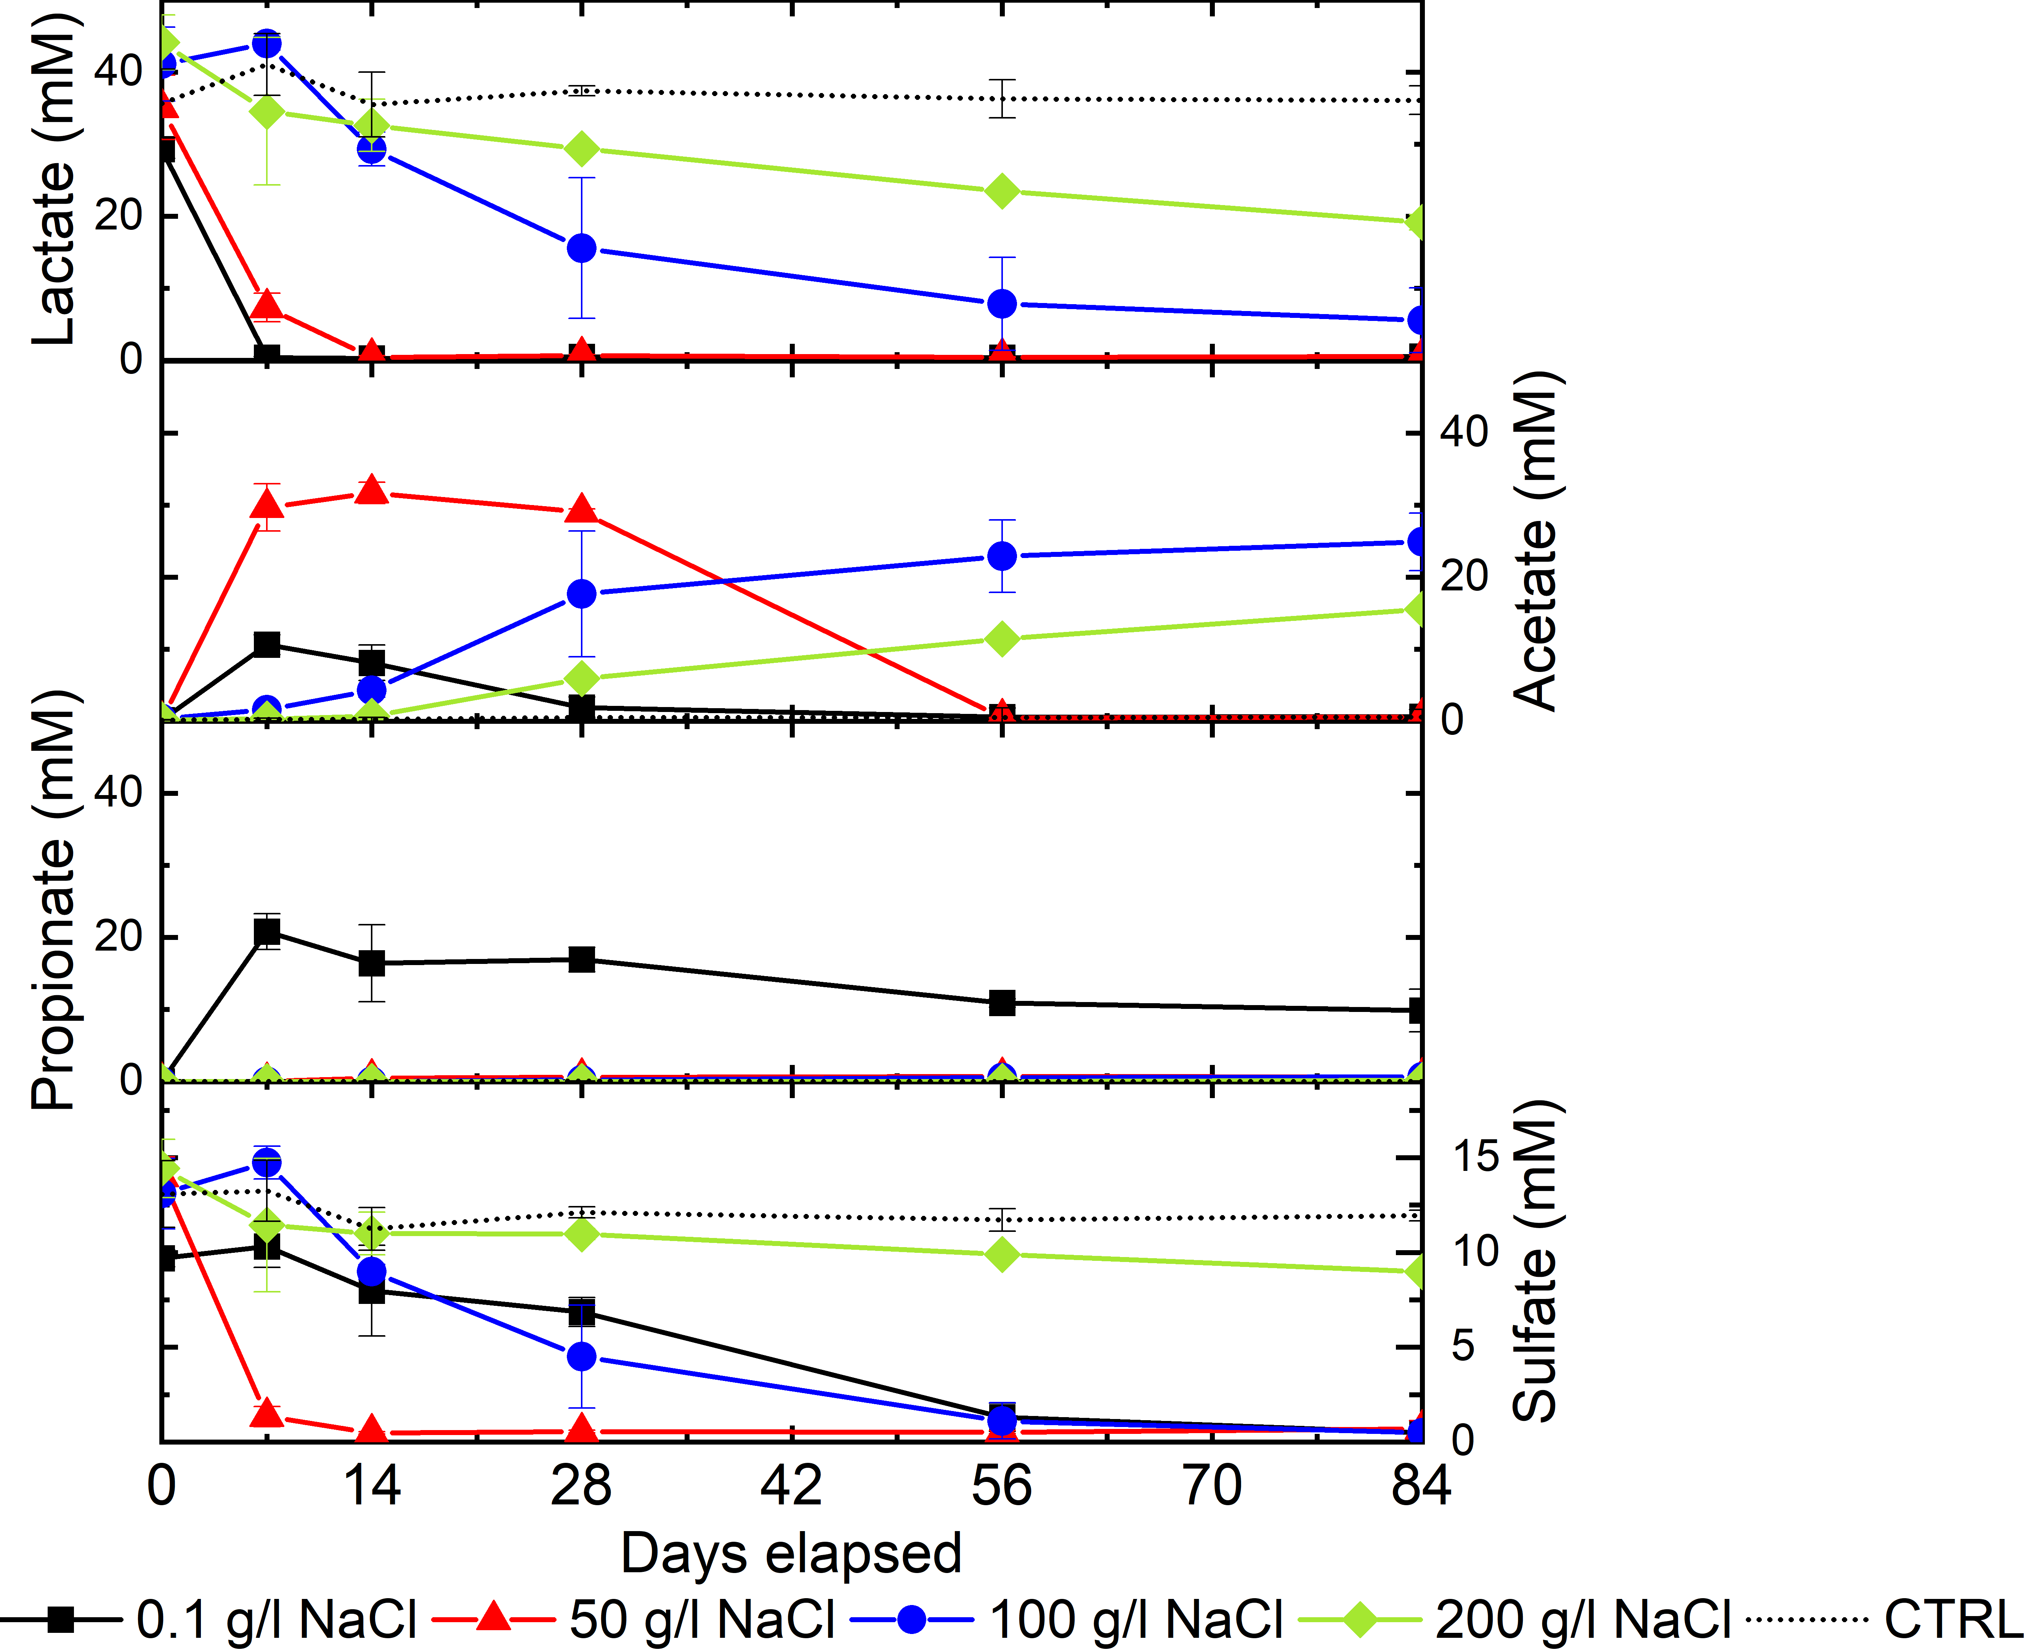
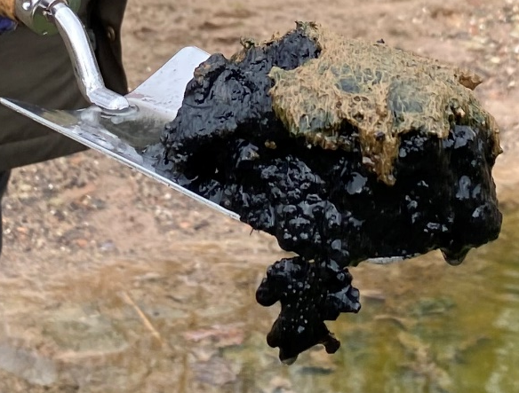
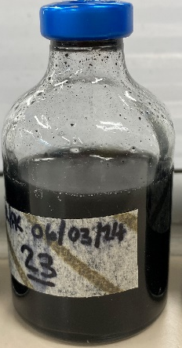
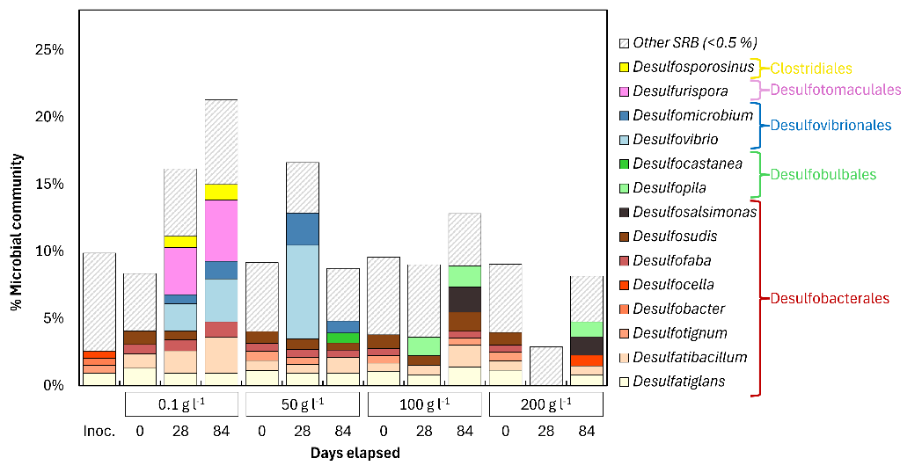
Microbial activity in LSSR systems
Microbial activity in hypersaline systems
Microcosm experiments containing brine pond sediment (Cheshire Brine Springs)
Sulphate-Reducing Bacteria activity with added electron donor up to 200 g l⁻¹ NaCl
Notes:
Finally I would like to highlight some other initial results, where the team form UoM have been preforming microcosm experiments using an inoculum from hypersaline natural waters (Cheshire brine ponds) and have shown biological activity and halophilic SRB up to 200g/l, with the DNA analysis s showing a diverse range fo SRB’s preset
Overall this indicates that microbial processes could occur across the entire groundwater composition range likely to be present within LSSR formations of interest, which in turn indicates that radionuclide behavior, for example via microbial mediated reductive precipitation may occur within these sedimentary systems,
This understanding will be developed within the WP.

Slide 11
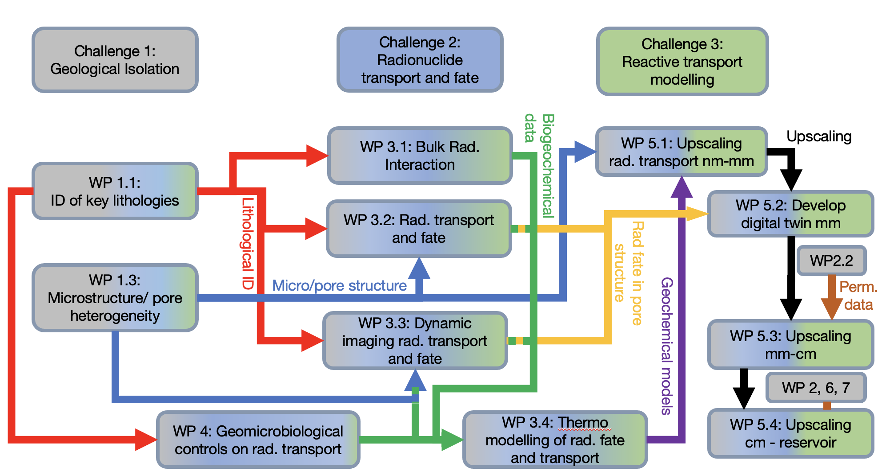
Deliverables
Develop understanding related to:
Bulk partitioning and sorption mechanisms of radionuclides to LSSRs as a function of geochemical conditions
Fate and transport rate of radionuclides through LSSRs.
Impact of indigenous LSSR microbial communities (or introduced halophilies) on radionuclide transport under GDF relevant conditions.
Notes:
If you want more detail .. From previous slides at other meetings
WP4.1 – Microbial characterization of representative LSSR samples BGS led
Objective: To determine how the heterogeneity of LSSR affects its ability to support microbial activity through the provision of organic carbon and nutrient sources and to characterise the microbial communities within LSSR.
Outcomes: Improved understanding of the potential for representative LSSR samples to influence microbial activity that could impact on GDF performance and radionuclide mobility (linking to Objective 1: heterogeneity of LSSR systems), and the development of microbial cultures and identification of suitable samples for use in WPs 4.2 and 4.3.
WP4.2 - Biogeochemical impacts on radionuclides in batch systems (Manchester-led)
Objective: Microcosm batch cultures will be used to quantify the impact of LSSR GDF-relevant microorganisms on the fate of priority radionuclides under a range of relevant biogeochemical conditions expected during LSSR evolution.
Outcomes: A molecular-scale understanding of the key microbial processes impacting on radionuclide solubility in evolving LSSR systems, including the genes involved (for precise microbial profiling in future URL/in situ studies), and the underpinning mechanisms. Key data will also be delivered for WP3.4 biogeochemical models being developed by NNL.
WP4.3 Microbial impact in flow-through systems (BGS and Manchester)
Objective: To determine the impact of microbial processes on radionuclide fate column experiments, designed to mimic the CDZ in a cementitious GDF environment.
Outcomes: The impacts of microbial processes on contaminant flow and radionuclide fate will be determined in heterogeneous flow-through systems, and data shared with modelling WPs as appropriate. Impacts will be quantified
in terms of alteration to permeability, and in terms of geochemical and mineralogical alterations, including radionuclide/metal mobility

