Slide 1
RSO Discipline Update: Geoscience
Discipline Lead – Kevin Taylor (University of Manchester)
SME – Andy Cooke (Research Manager, NWS)
SME – Alex Hughes (Geologist, NWS)

Slide 2
Geoscience Discipline updates
Developments and Activities
NERC GeoDRAW programme: Working with the researchers on “GeoSAFE” to ensure “across-programme” activity and delivery.
Growth of the PGR (NWS-funded and RSO-affiliated) numbers (>15 in the geoscience theme area, or closely related).
Engaged strongly with Geological Society Meeting on Geodisposal and Nuclear Waste at Manchester in June 2024 – several PGR poster presentations.
PGR training workshop at BGS core store (Feb 6th and 7th) 2024 (next slide).
Annual online ‘Research in Progress’ seminars:
Sept 2024: Coupled process modelling in the DECOVALEX programme
Upcoming seminar in 2025 – suggestions welcome!

Slide 3
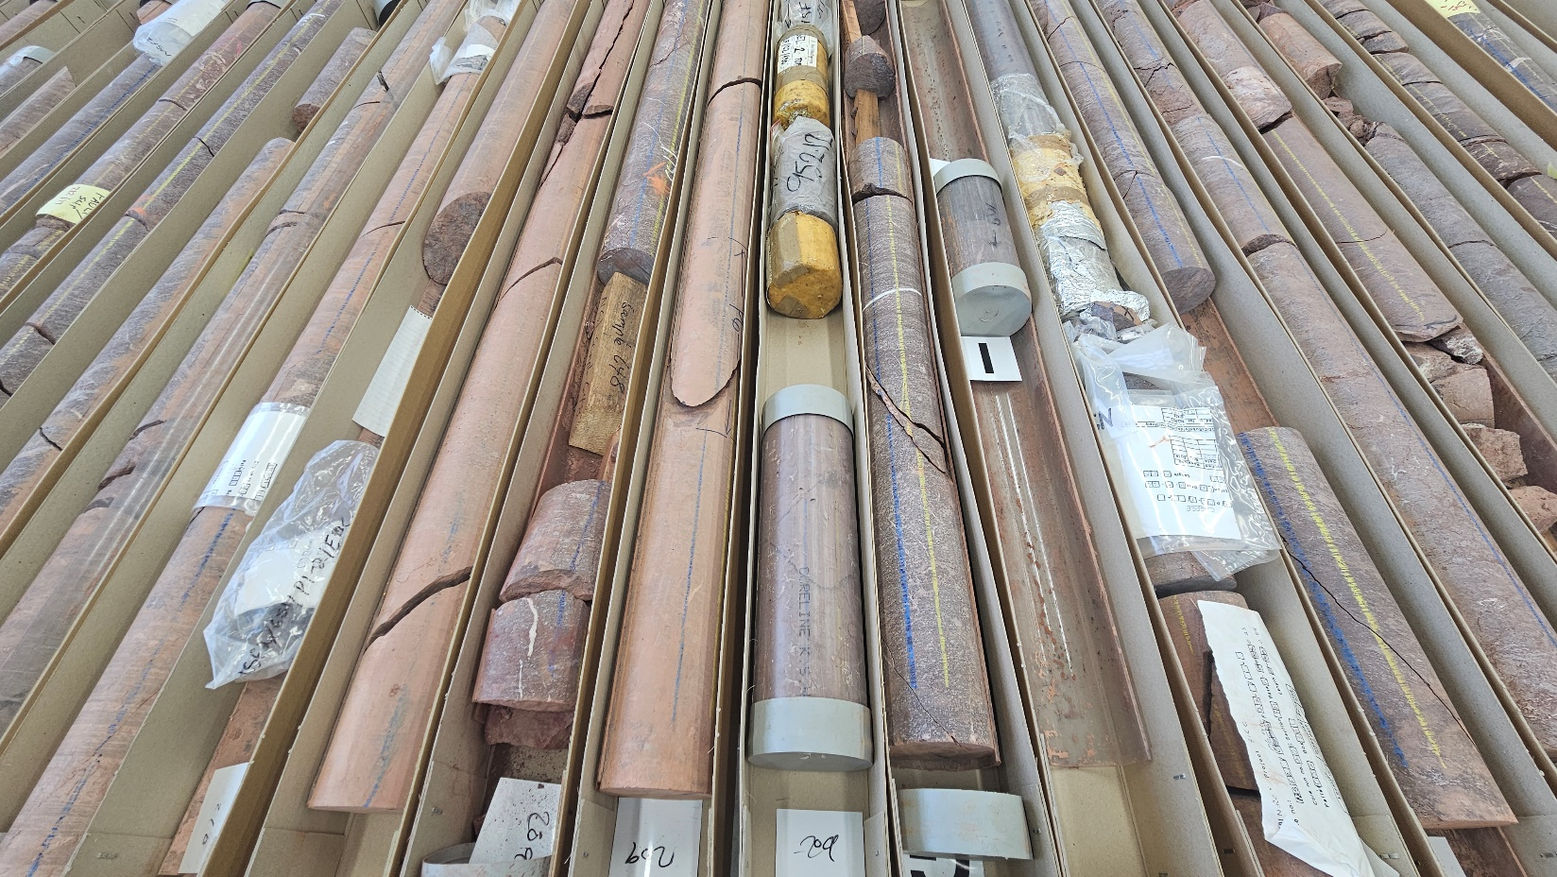
PGR training: BGS core store workshop: summary
Aims:
Networking opportunity for PGRs, building the RSO geoscience cohort, training on rock types of interest and an intro to core-based research
15 attendees, plus NWS staff
Introduced geoscience PGRs to:
BGS National Geological Repository
Rock types of interest / ongoing geoscience work (analyses of core and talks from SMEs)
BGS laboratory facilities
Considerations when working with core (e.g., preservation, sample handling etc.)

Slide 4
Future Plans
Develop topics for focussed workshops (e.g., help specify research needs around upscaling and multi-scale integration)
Build links between academia and NWS Site Characterisation team to assess longer-term research needs and availability of data for academic research.
2025 RSO Seminar – Topic TBD!
PGR/ECR workshop in 2025. We are canvasing for suggestions and requirements. Views of the PGR/ECR community very welcome! Cross-disciplinary?

