Slide 1
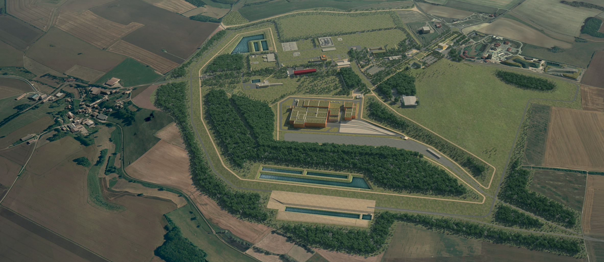
Cigéo : Andra’s GDF Overview
2025 NWS RSO Conference - Bristol

Slide 2
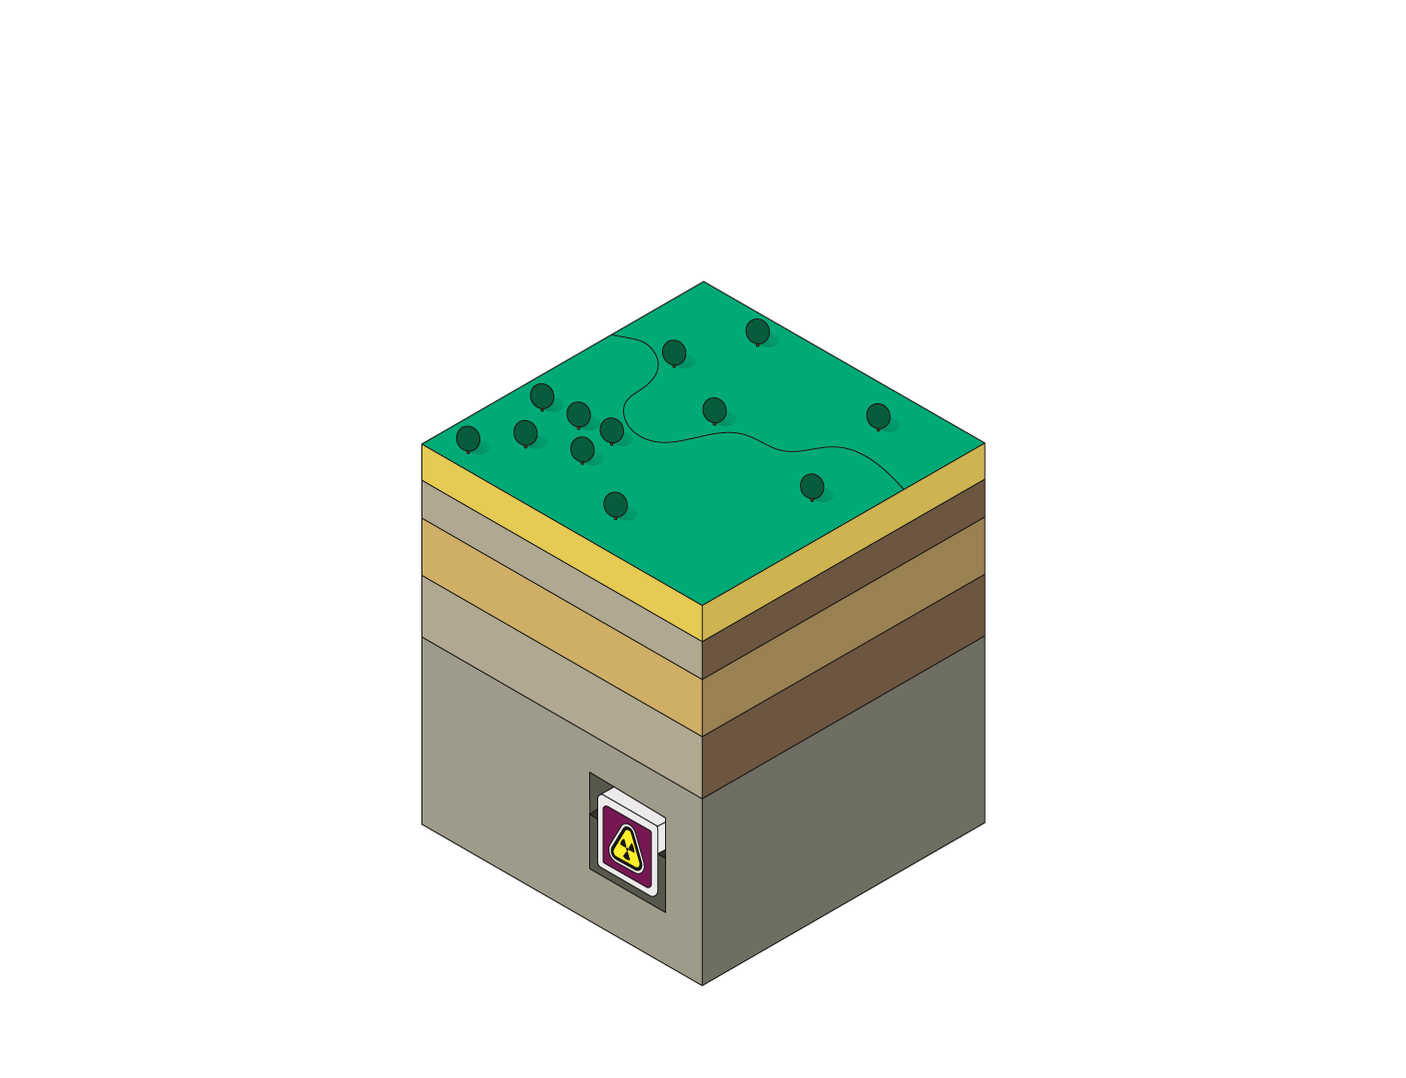
Objectives of a Geological Disposal Facility
Minimize the burden to be borne by future generations
Isolate radioactive waste from surface
Contain the radioactivity until it decays
Ensure passive safety

Slide 3
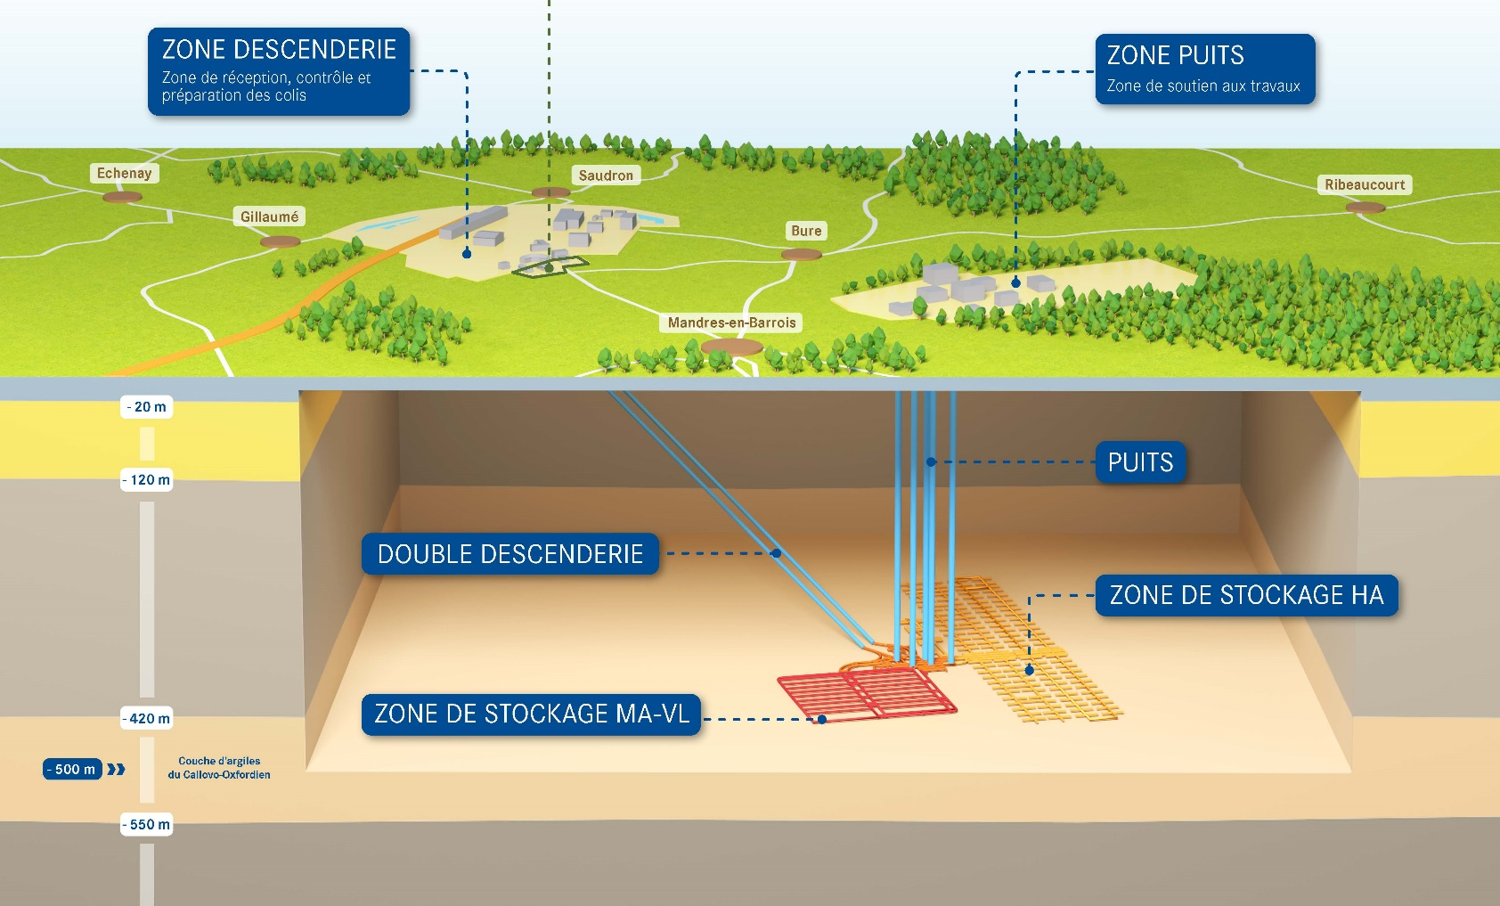

Cigéo Key Features
RAMP ZONE
SHAFT ZONE
550
Meters deep
Km² of disposal area
15
SHAFTS
83000
m³ of waste
RAMP
DISPOSAL ZONE FOR HLW
120
Years of operation
DISPOSAL ZONE FOR ILW-LL
25
Billions euros
Notes:
Pour mettre des mots en exergue : gras + couleur
-----------------------------------------------------
Police courante : Lucida Sans

Slide 4

Ramp Zone
296 ha
Notes:
Pour mettre des mots en exergue : gras + couleur
-----------------------------------------------------
Police courante : Lucida Sans

Slide 5
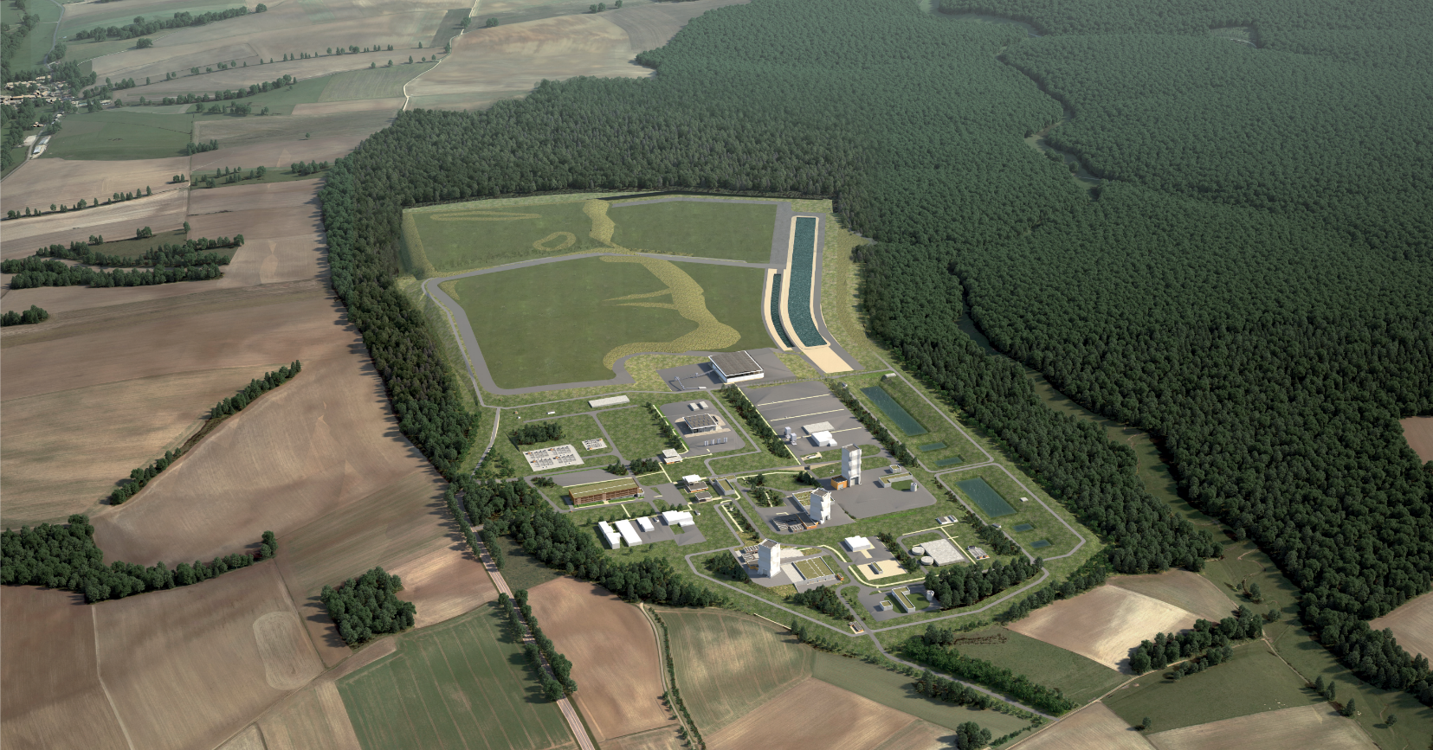
Shaft Zone
202 ha
Notes:
Pour mettre des mots en exergue : gras + couleur
-----------------------------------------------------
Police courante : Lucida Sans

Slide 6
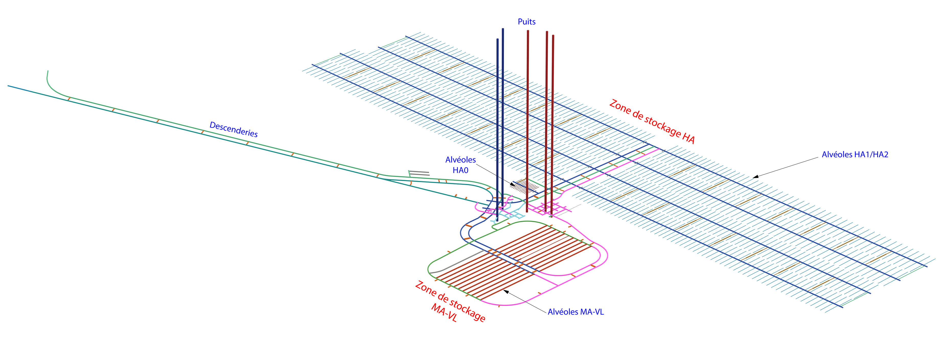
Underground Layout
Notes:
Pour mettre des mots en exergue : gras + couleur
-----------------------------------------------------
Police courante : Lucida Sans

Slide 7
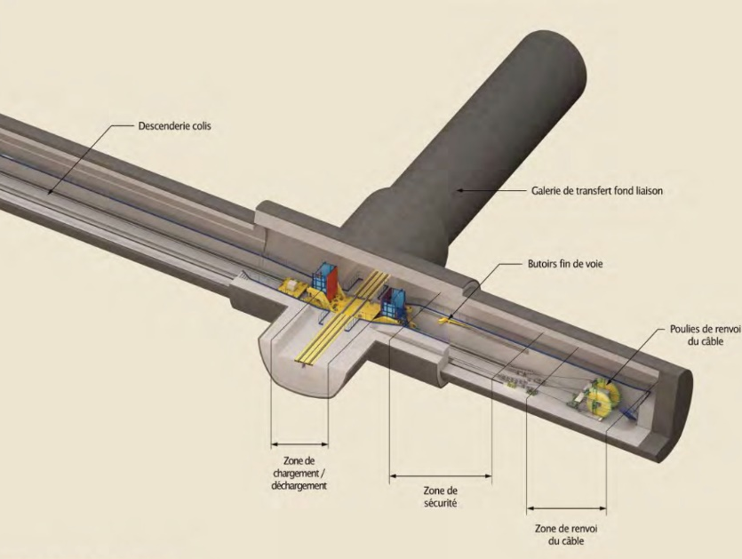
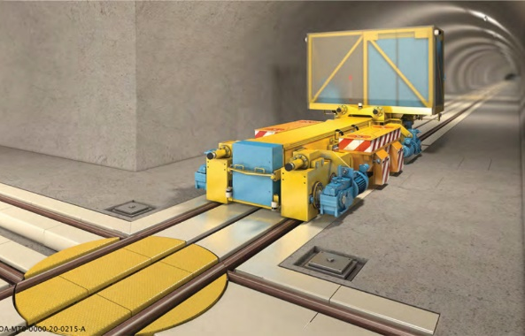
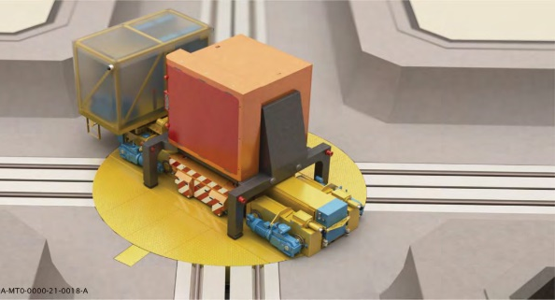
250km of Underground Drifts
150 km : HLW Cells
15 km : ILW Vaults
85 km : access and connecting drifts

Slide 8
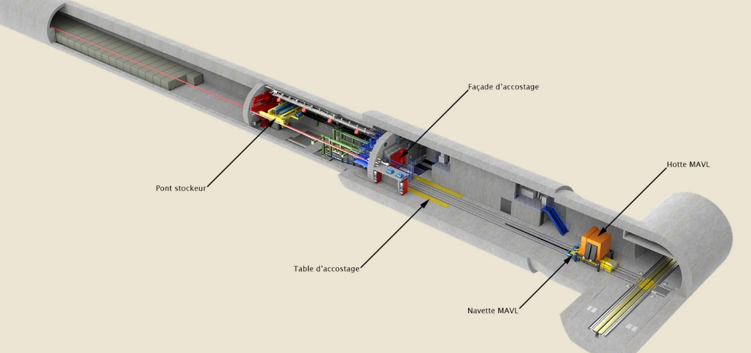
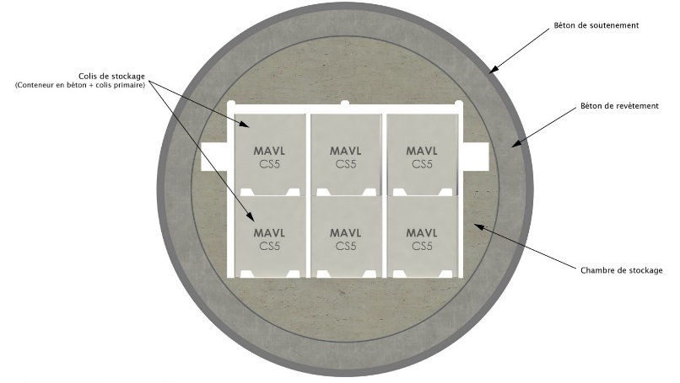
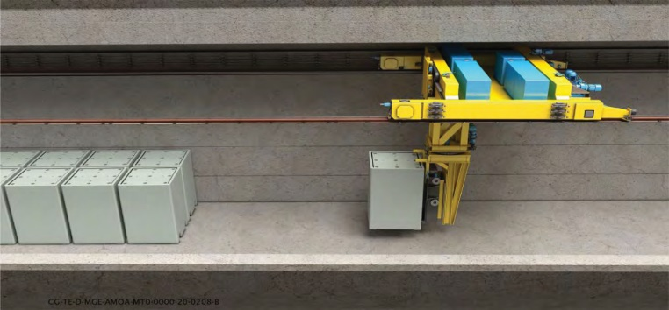
ILW-LL Vaults
600 m
8,4 m
22
Length
Diameter
Disposal
Vaults

Slide 9
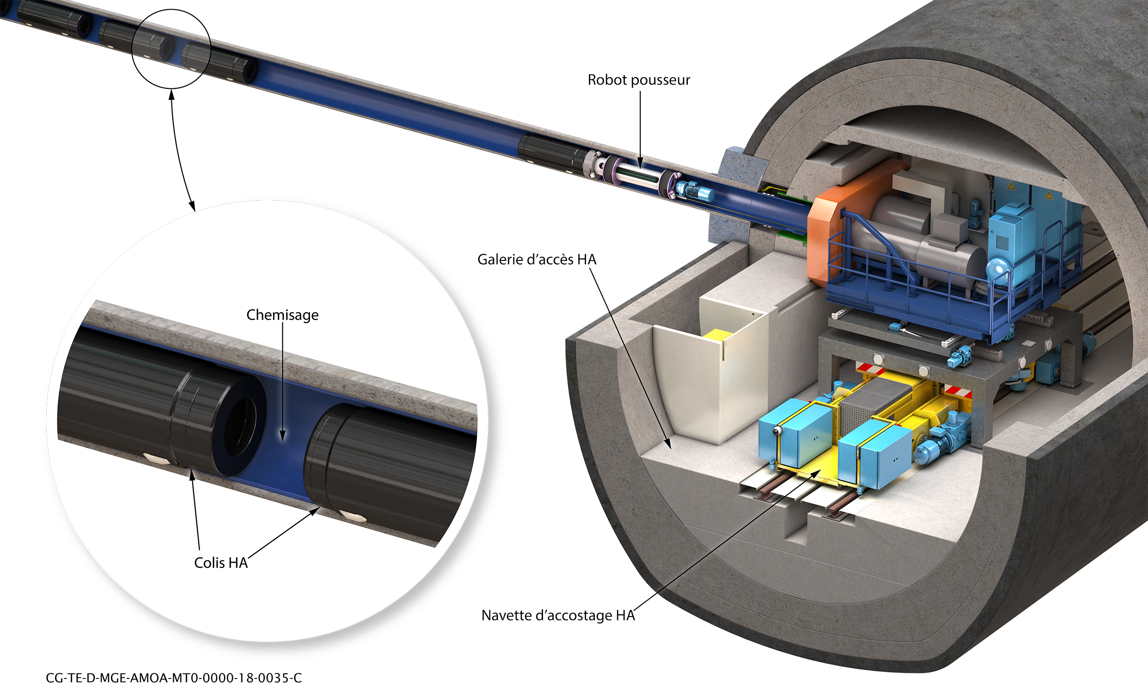
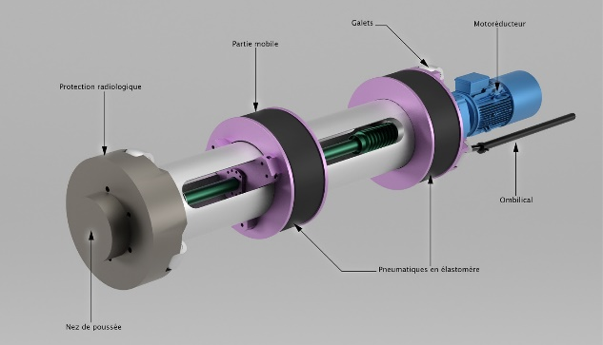
HLW cells
150 m
90 cm
935
Length
Diameter
Disposal
Cells

Slide 10
Cigéo Roadmap

Slide 11
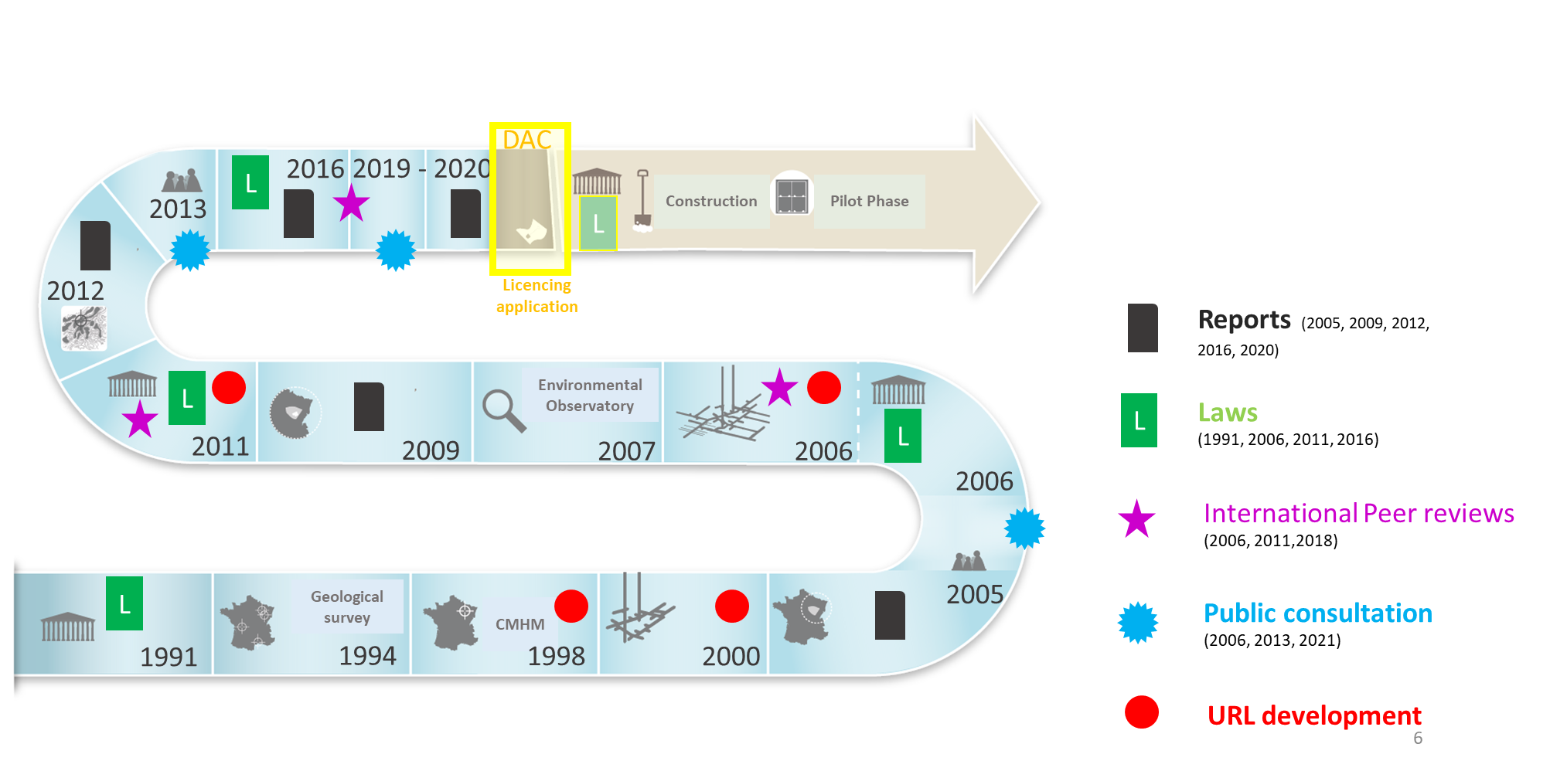
Cigéo Roadmap

Slide 12
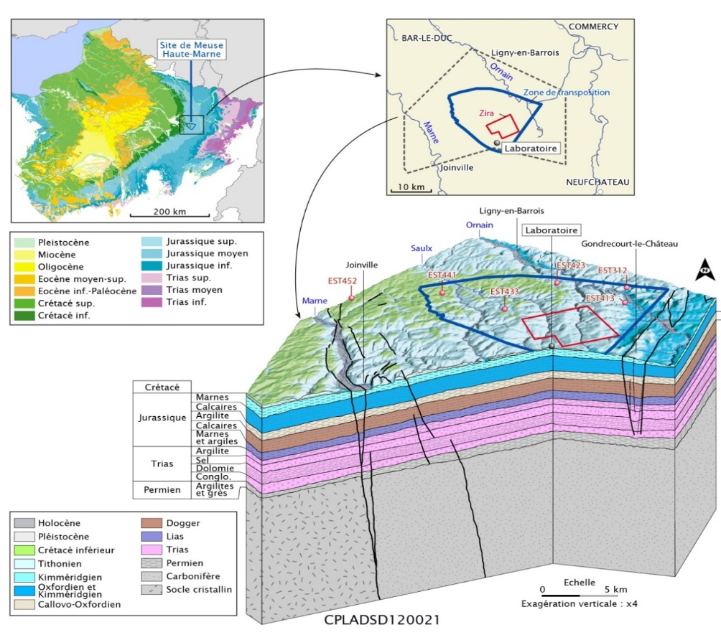
The Geological Framework of the Paris Basin
  A geological structure acquired over tens of millions of years
Kimmeridgian limestone
Aquifer
Kimmeridgian marly
barrier
Oxfordian limestone
Aquifer - Aquitard
Callovo -Oxfordian
165-160 Ma
barrier
Limestone Dogger
Aquifer - Aquitard

Slide 13
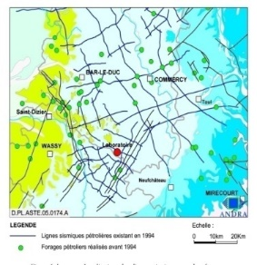
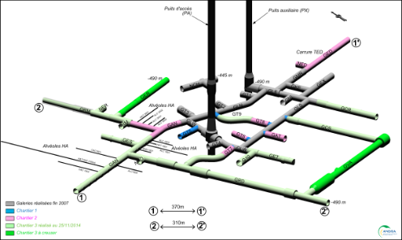
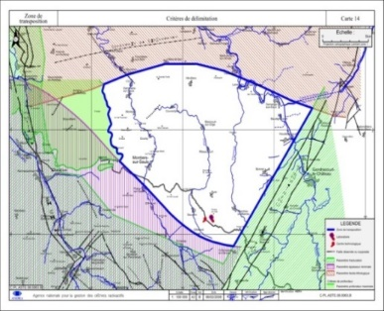
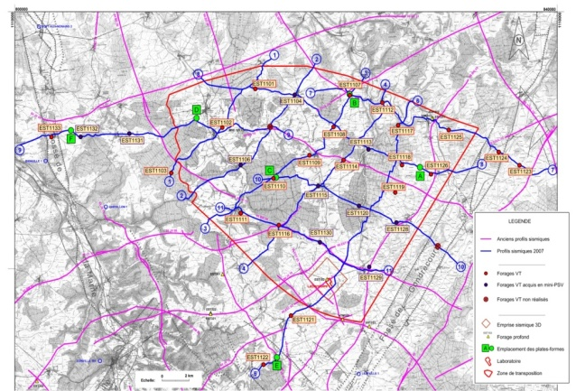
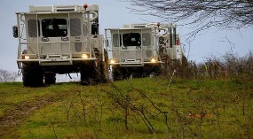
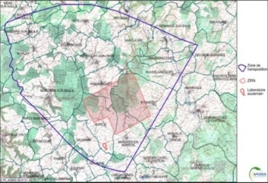
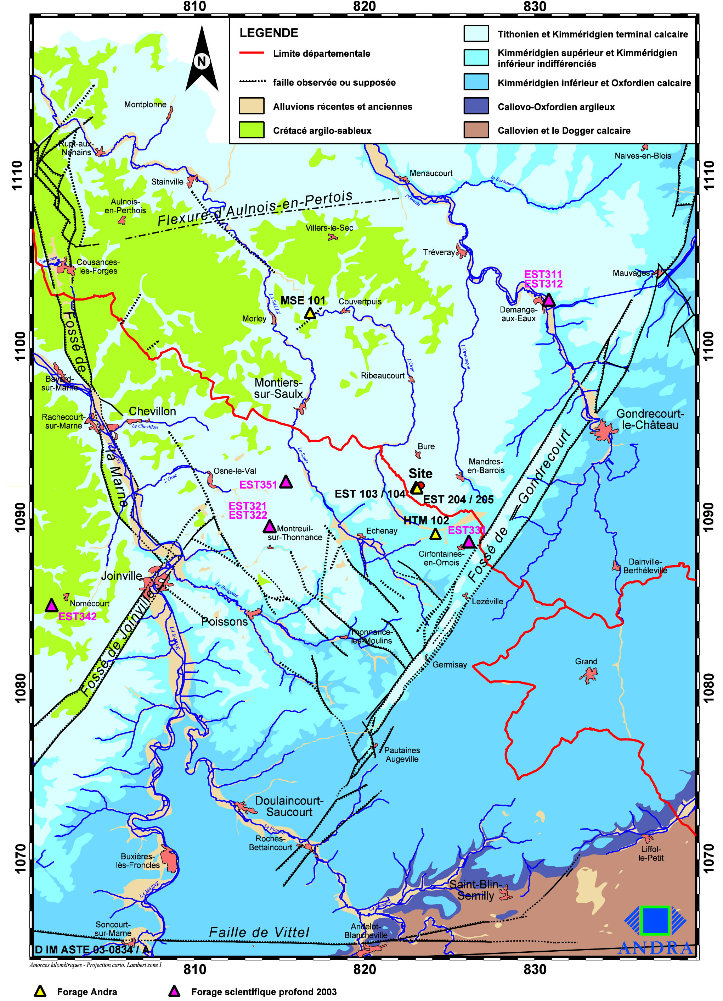
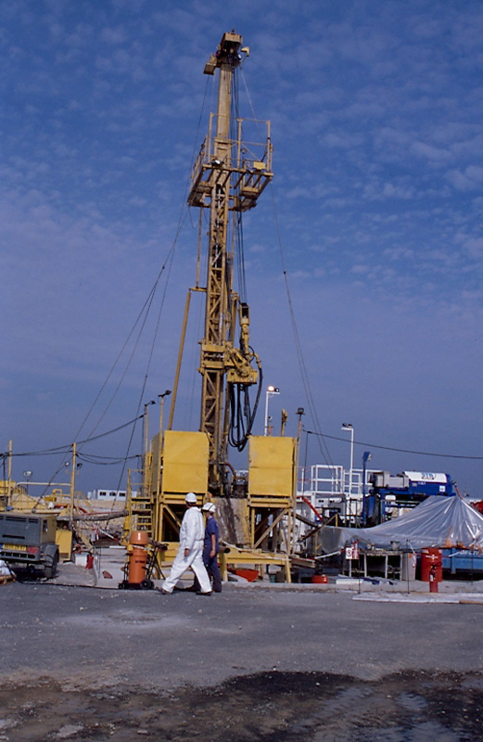
Site Characterization – 30 Years of Siting Phase
  Drilling (Sector, ZT, ZIRA), 2D Seismic (200 km), 3D Seismic (4 km², 37 km²)
1995
15 km of 2D seismic
  Successive Characterization Phases
2001
3.5 km of 2D seismic
4.4 km² of 3D seismic
1994
ZT
2007
150 km of 2D seismic
2001-2003 : 2800 km²
2010
37 km² of 3D seismic
ZT
2005 : 250 km²
Drillings in the sector
  97 drillings
  5850 m of cored samples / 3146 m in the Callovo-Oxfordian
2009
Zira
2009 File: 30 km ²

Slide 14
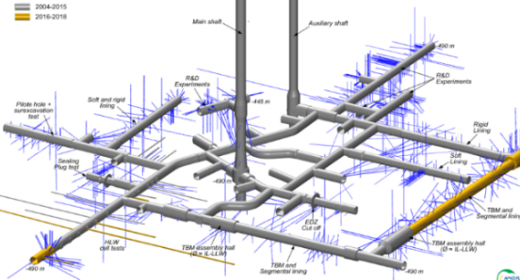
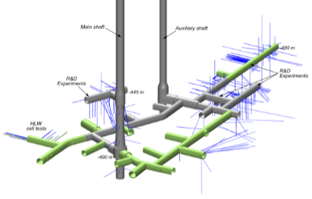
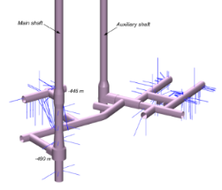
The Major Stages of R&D Activities in the Bure URL
2023-2038 ⇨ Preparing the pilot industrial phase of Cigéo
2016-2022 ⇨ Preparing the Licensing File (DAC)
  Consolidation of the Callovo -Oxfordian scientific knowledge
  Demonstrations of the constructability of Cigéo components
  Exploring avenues for optimizing Cigéo
2010-2015 ⇨ preparing the Safety Options File (DOS)
  Demonstration of the feasibility of excavation, support and tunnel boring machines, seals, etc.
2006-2009 ⇨ Behavior of the Callovo -Oxfordian and materials
  Characterization of coupled processes (chemical, thermal, mechanical interactions, etc. with concrete, steel, heat, digging, etc.)
  First technological experiments (ILW cells, drifts supports, etc.)
2000-2005 ⇨ Intrinsic properties of Callovo -Oxfordian argillaceous rocks
  Petrology, mineralogy, permeability, geochemistry…
  Mechanical, thermal and hydraulic properties; support behavior, excavation damaged area
  Mobility/sorption of radionuclides in the Callovo-Oxfordian argillaceous rock

Slide 15
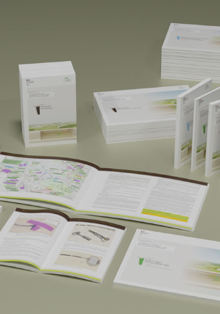
Review of the Creation License Application File (DAC)
January 16, 2023, submission of the Creation License Application (DAC)
  23 documents & ∼ 10000 pages
  Project information and,
  Scientific knowledge, operational safety, long-term safety, environmental impact…
DAC Technical Review
  Expected to last 3 to 5 years
  Technical exchanges with the French Safety Authority (IRSN then ASNR established January 1, 2025)
  “Permanent groups” : Experts meetings on 3 themes
    1/ The Basic assumptions and data for the safety assessment of Cigéo
    2/ The safety assessment in the operating phase
    3/ The safety assessment in the post-closure phase

Slide 16
Current Status of the Creation License Review
The review of the “basic assumptions and data” was evaluated positively
  IRSN "considers that Andra has developed a body of knowledge on waste packages, the Meuse/Haute-Marne site, the Callovo-Oxfordian formation and cementitious materials, which provides sufficient data for assessing the safety of Cigéo at the DAC dossier stage".
Recommendations were formulated leading to Andra commitment
  Characterization of the surface geological formation (Barrois karstic formation) → support for the construction of surfaces installations.
  Corrosion of the steel lining (HLW cell) → support for the choice of materials (grouting material…) and optimize the design of the HLW cell
  Assessment of the potential effects of climate change (operational to post-closure period) with extreme scenarios
  Design and demonstrations of the robustness of the seals → Post-closure gas issue

Slide 17
Current S&T Programme

Slide 18
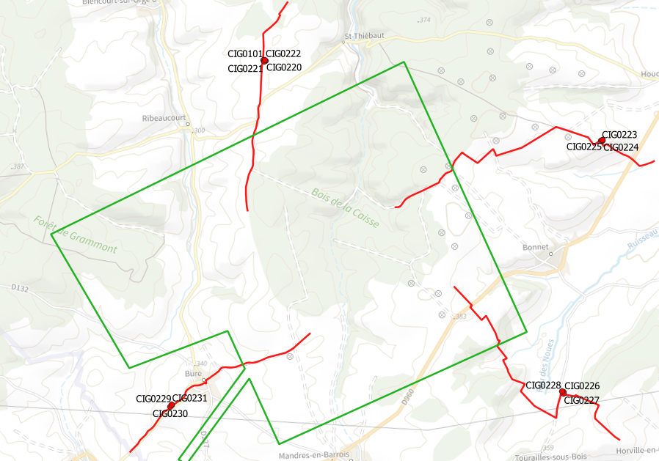
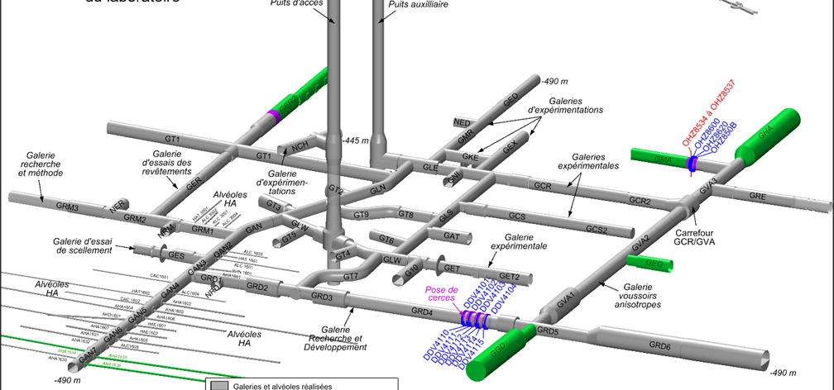
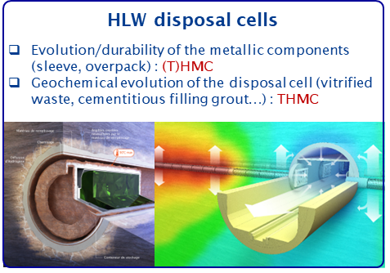
Current Cigéo S&T programme
In the framework of the DAC file, the scientific and technology program has been renewed
  and 15 transverse domains
    Geology
    Radionuclide migration
    Corrosion
    …
  Update of the S&T Programme
  9 main components
    HL waste cells
    IL-LL waste cells
    Closing systems
    …
  Key S&T Activities (2025-2038)
    Drilling campaigns (2025 - 2028) + …
      Hydrogeology and geotechnic of surface formations
      Geology & hydrogeology of deep formations
    Pursuit of demonstrators at URL (HL waste cells, sealing systems…) (2025-2038)
    R&D on multi physic coupling in conjunction with the development of the digital twin

Slide 19
S&T Programme Activities by Components and Transverse Domains
Transverse Domains
Processes at the scale of the Cox formation
Environnement and climate
Geology, seismic hazard and geoprospective
Corrosion of metallic materials
Waste
Geomechanics of the Callovo-Oxfordian
Hydrogeology and solute transport
Geochemistry of clay and cementitious materials
Monitoring
Robotics
Behavior in incidental and accidental situations
Radionuclide behavior
Multi-physics and multi-component simulation
Numerical simulation tools, digital, AI
Human and social sciences
Components
IL-LLW disposal canister
Bitumen waste (canister / disposal cell)
HLW disposal cells
Surface facilities
Tailings
Galeries, IL-LLW disposal cells, intersections
Surface-to-underground connections
Seals and backfills
Package transfer process

Slide 20
S&T Programme – Optimization before Disposal Facility Construction
The scientific programme will address
  Behavior of radionuclides and toxic chemical products in ILW-LL vaults and near-field clay rock, in view of co-disposal of ILL-LL waste
  Understanding near-field transfer of actinides, effect of complexing species and salts on near-field and
  Radionuclides transfer in unsaturated conditions
  The technical programme In the URL comprises large scale experiment comprises
  ILLW Disposal vault
  Cross-roads without and with compressible lining,
  HLW and IL-LLW disposal vaults and seals

Slide 21
Deep Drilling Campaign 2026-2028
4 platforms with 3 deep boreholes
  Oxfordian/Callovo-Oxfordian/Dogger
Objectives
Improvement of the geological & hydrogeological models
  Reduction of the geometrical uncertainties for the excavation of the ramp
Bring new knowledge on the Callovo-Oxfordian properties
  Improvement of formation mechanical stress
  link to the gas fate issue
  Origin of the overpressure
  link to the Post-close safety
  Spatial variability of THMC properties
  support to the construction

Slide 22
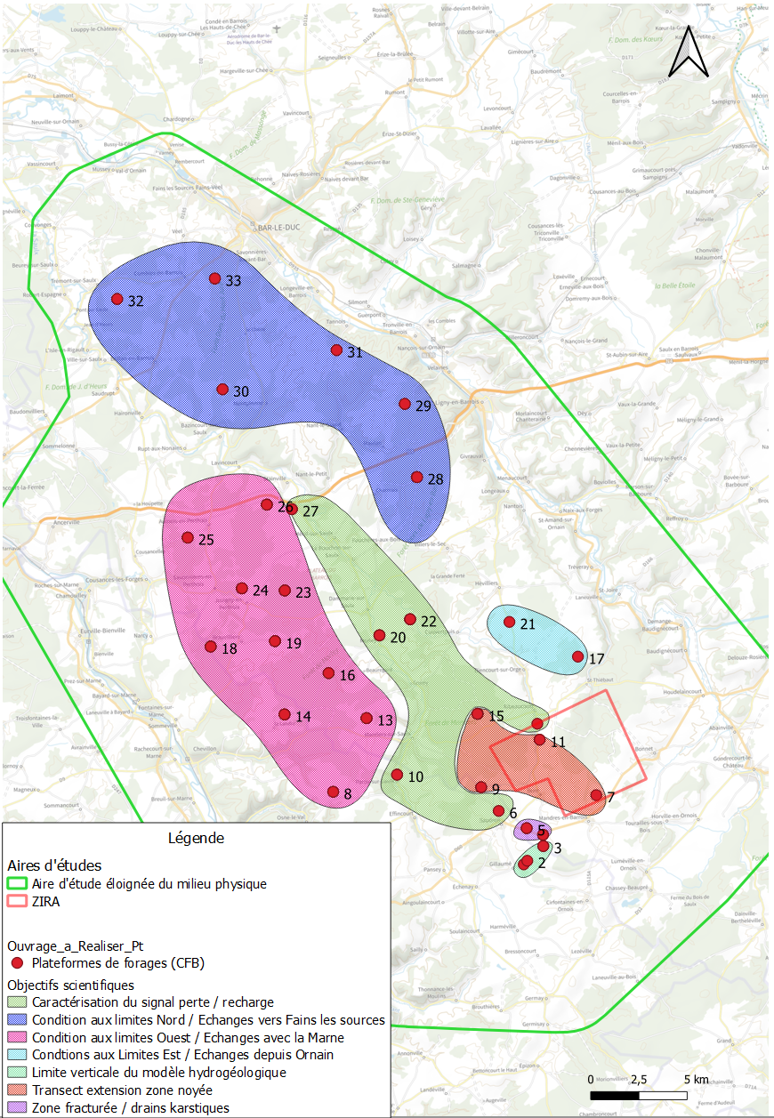
Shallow Drilling Campaign 2025-2027
  180 boreholes in the Barrois formation (Limestones)
Objectives
  Hydrogeological characterization in support of the environmental impact assessment
  Design of the flood protective devices for the buildings
  Geotechnical characterisation in support of building construction (Ramp entrance, nuclear facilities…)

Slide 23
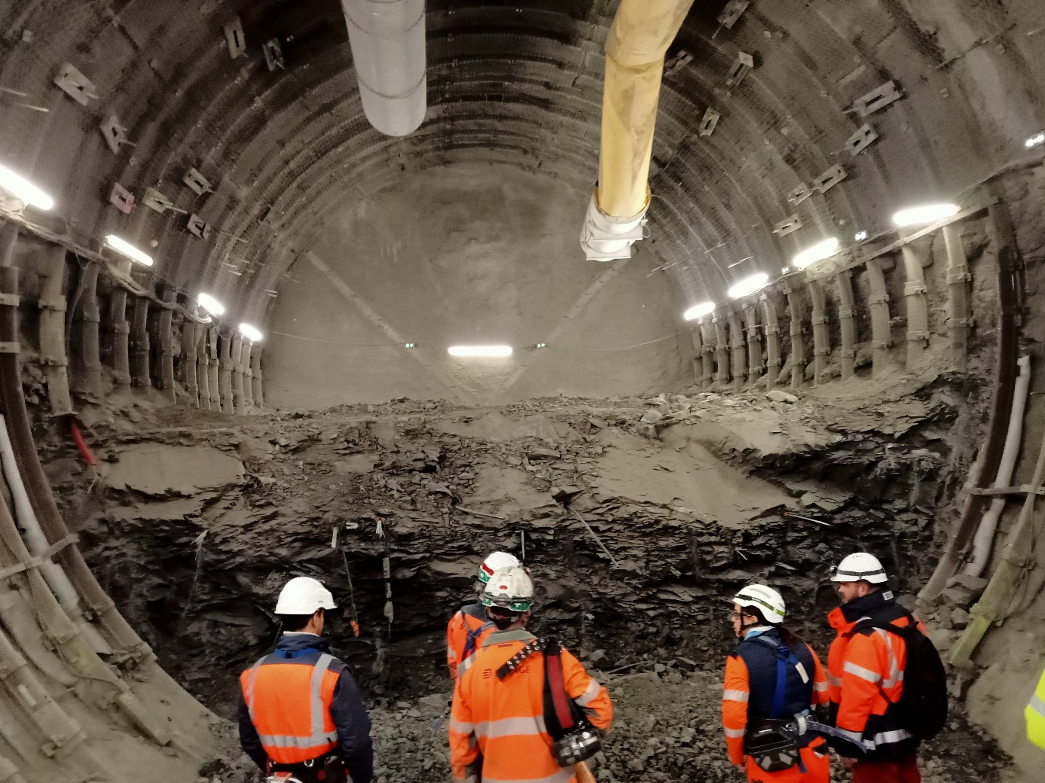
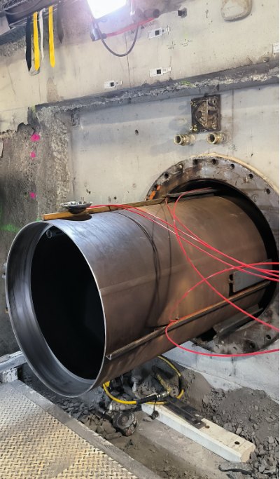
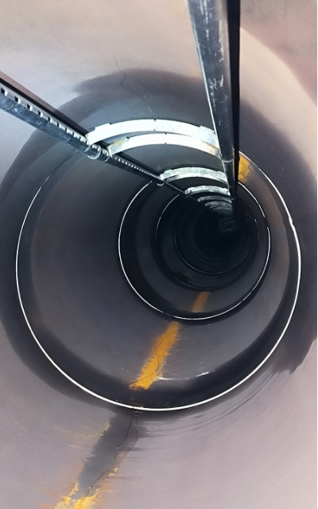
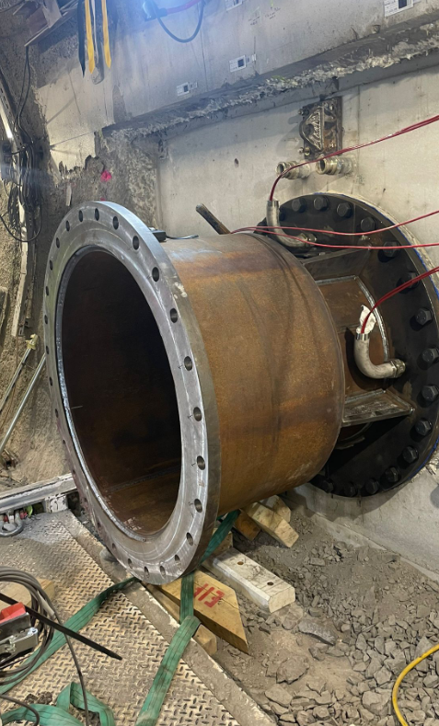
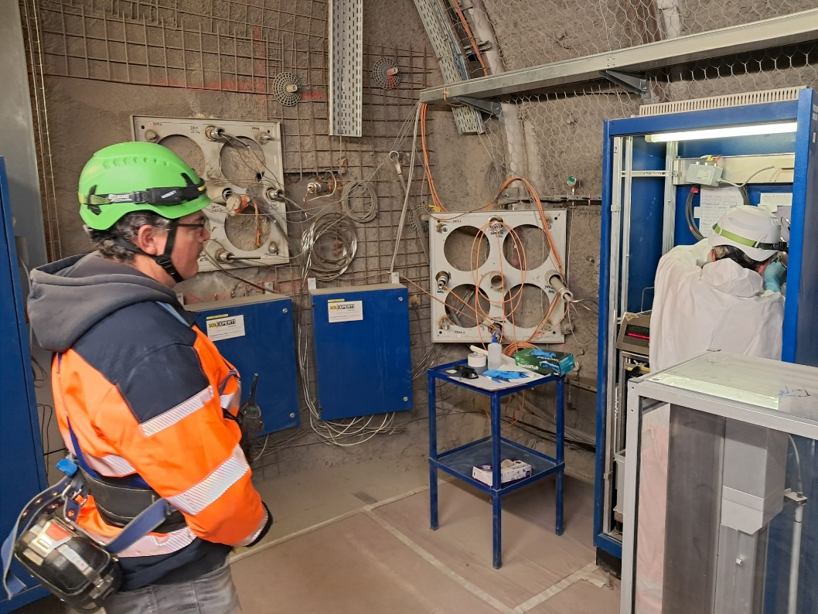
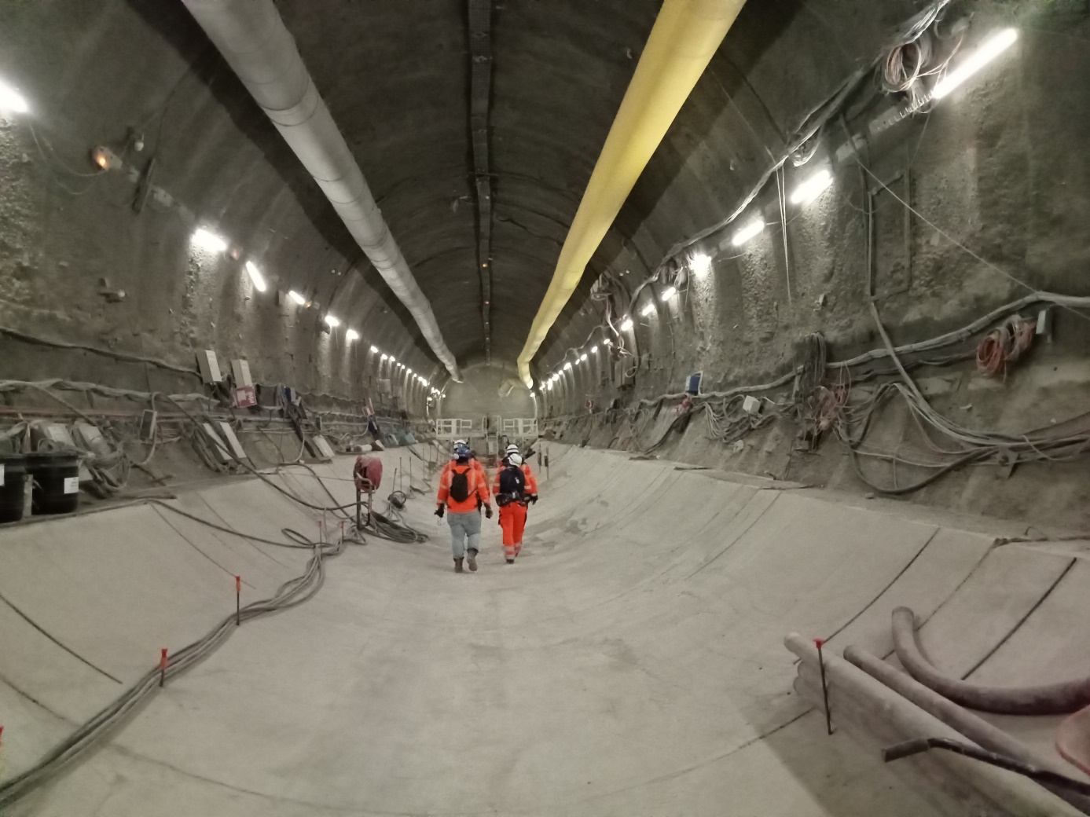
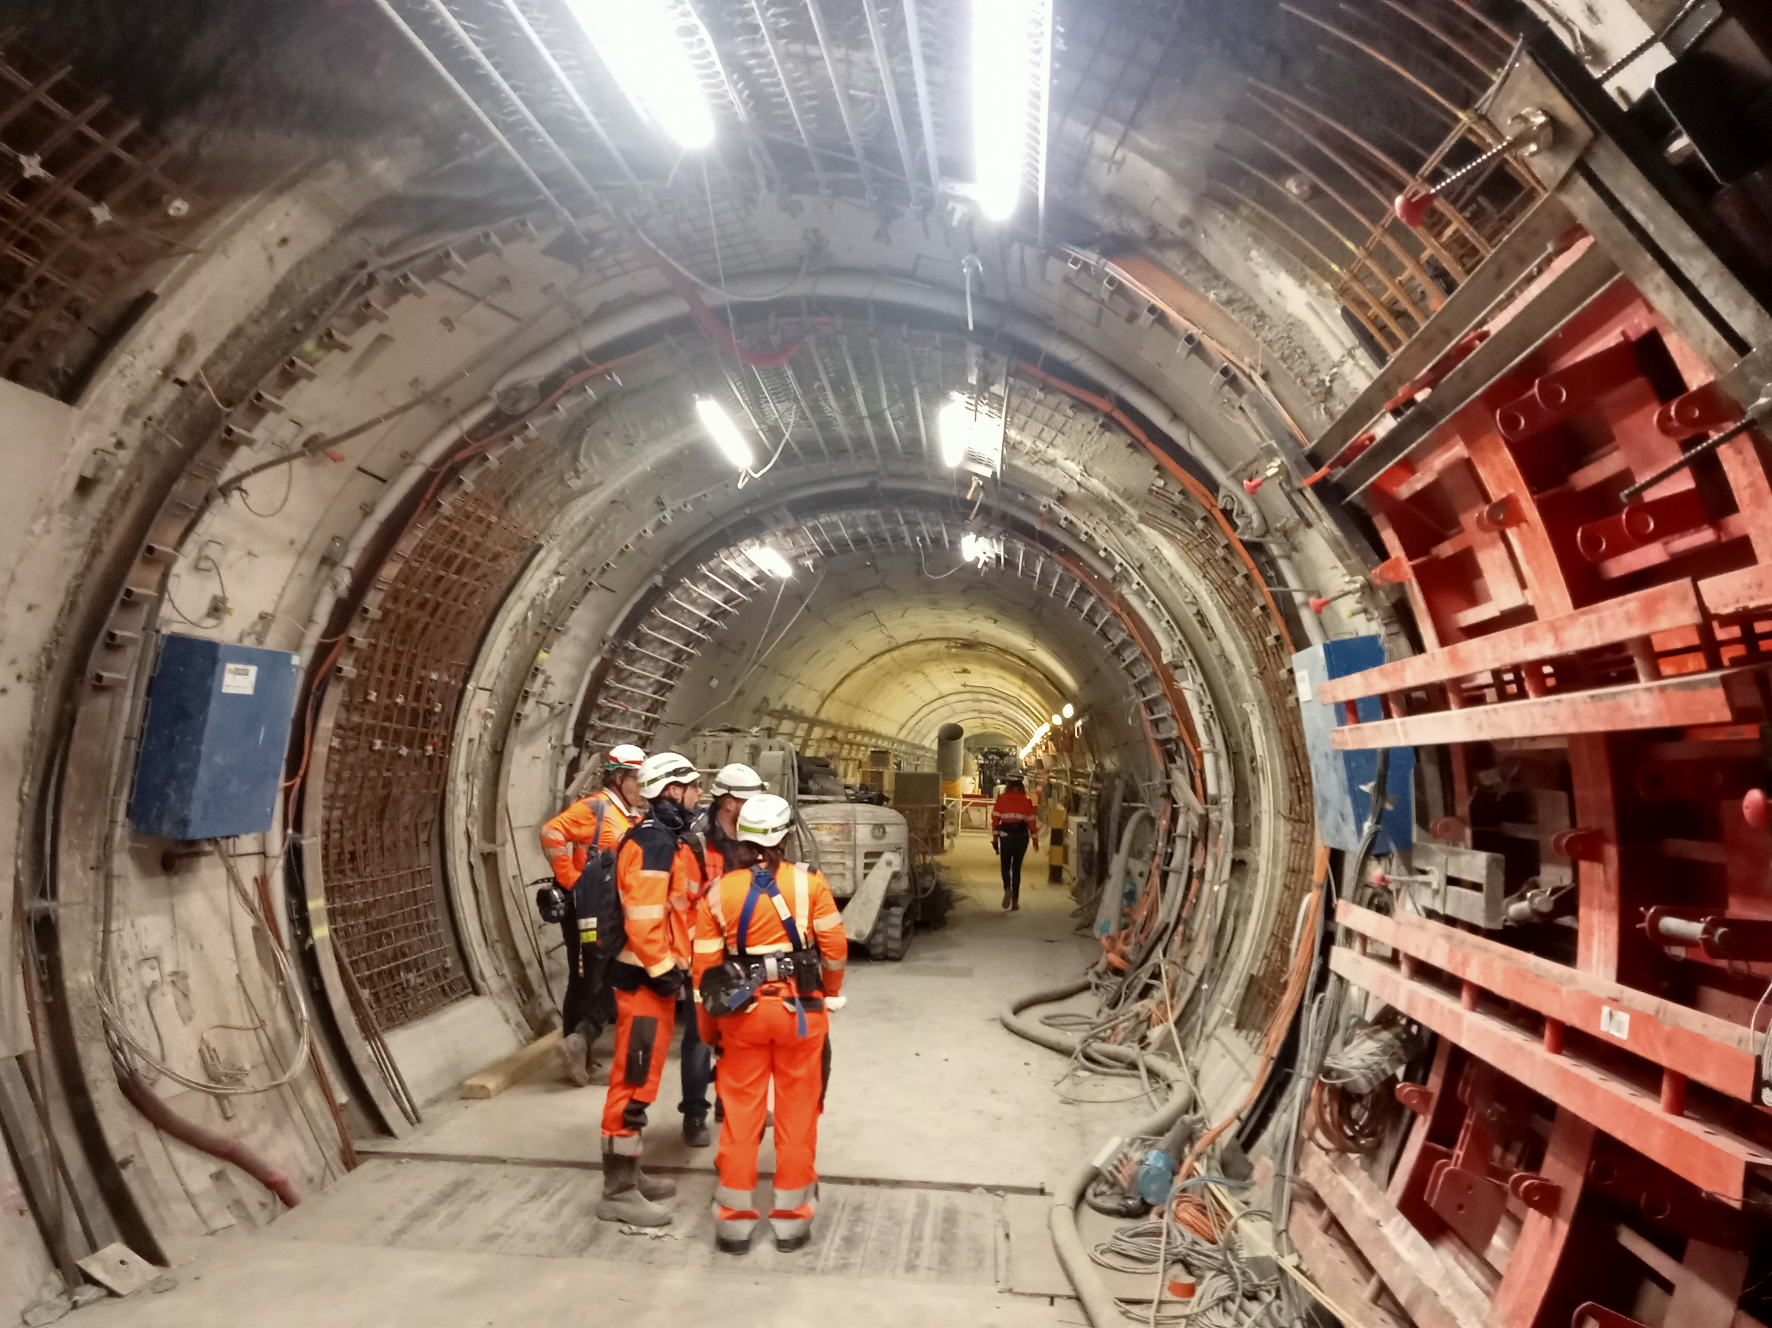
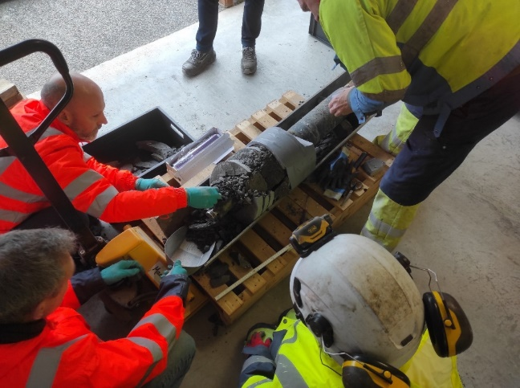
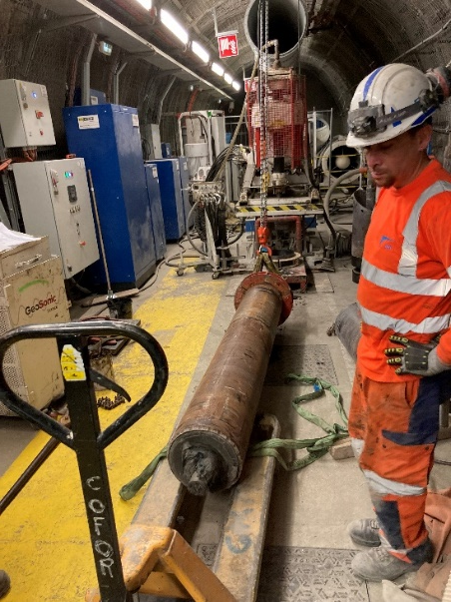
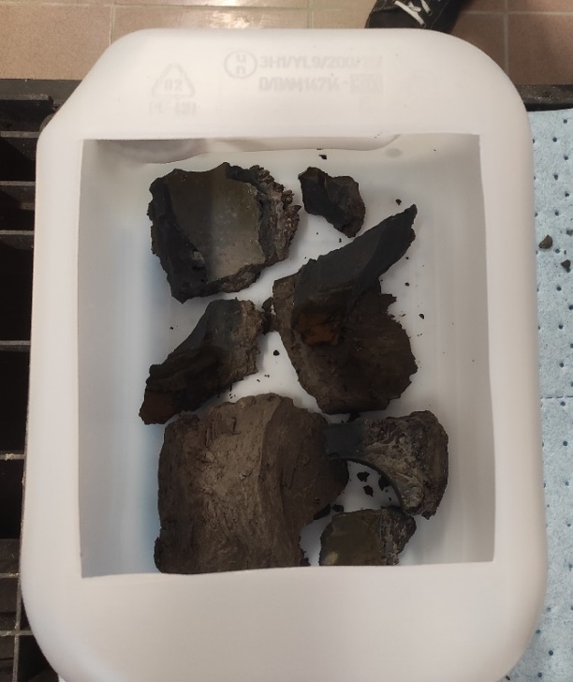
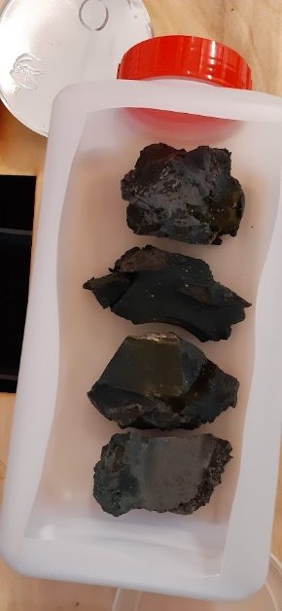
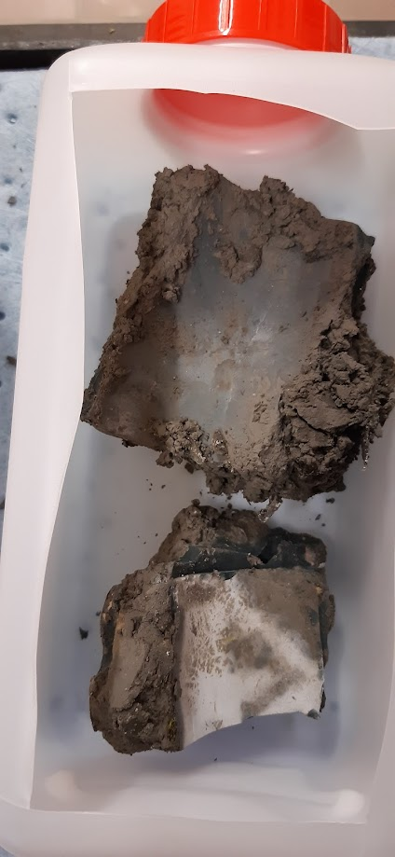
Bure URL Activities in 2024

Slide 24
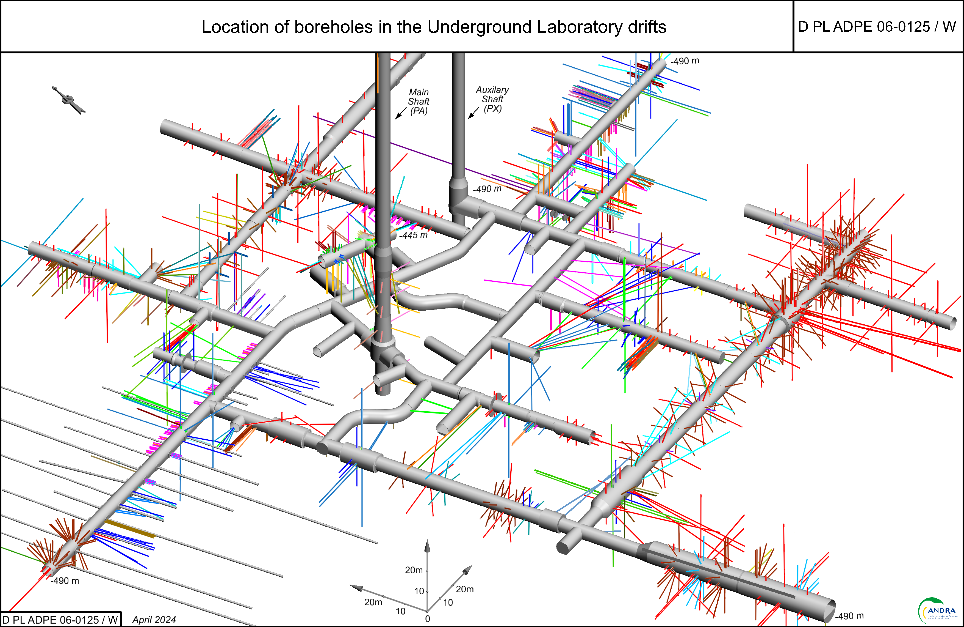
General Setting of the URL in April 2024 (Stage 4)

Slide 25
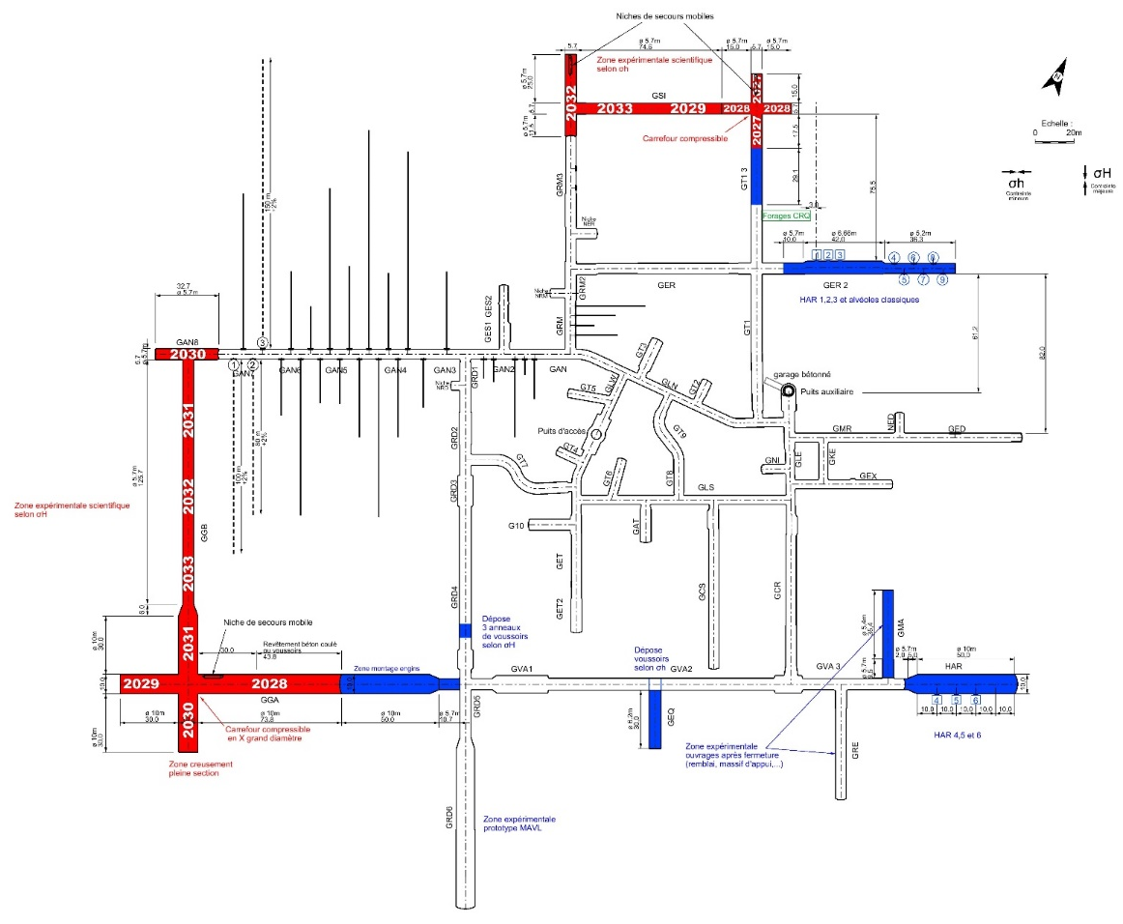
Stage 5 : Preparing Construction of Cigéo Pilot Phase (2027 – 2038)
Experimental priorities
ILW prototype in GRD6 (OMA experiment ) equipement and Disposal vault equipment
Compressible junction (small diameter CGD experiment)
Full Section X Crossroad
Large Diameter Compressible
Junction construction
GSI excavation to have a linear for scientific experiments according to σ h (+ opportunity in GGB according to σ H )
At the end of construction stage 5
Overall length of the gallery network which could reach 2.7 km
More than hundred experiments set up

Slide 26
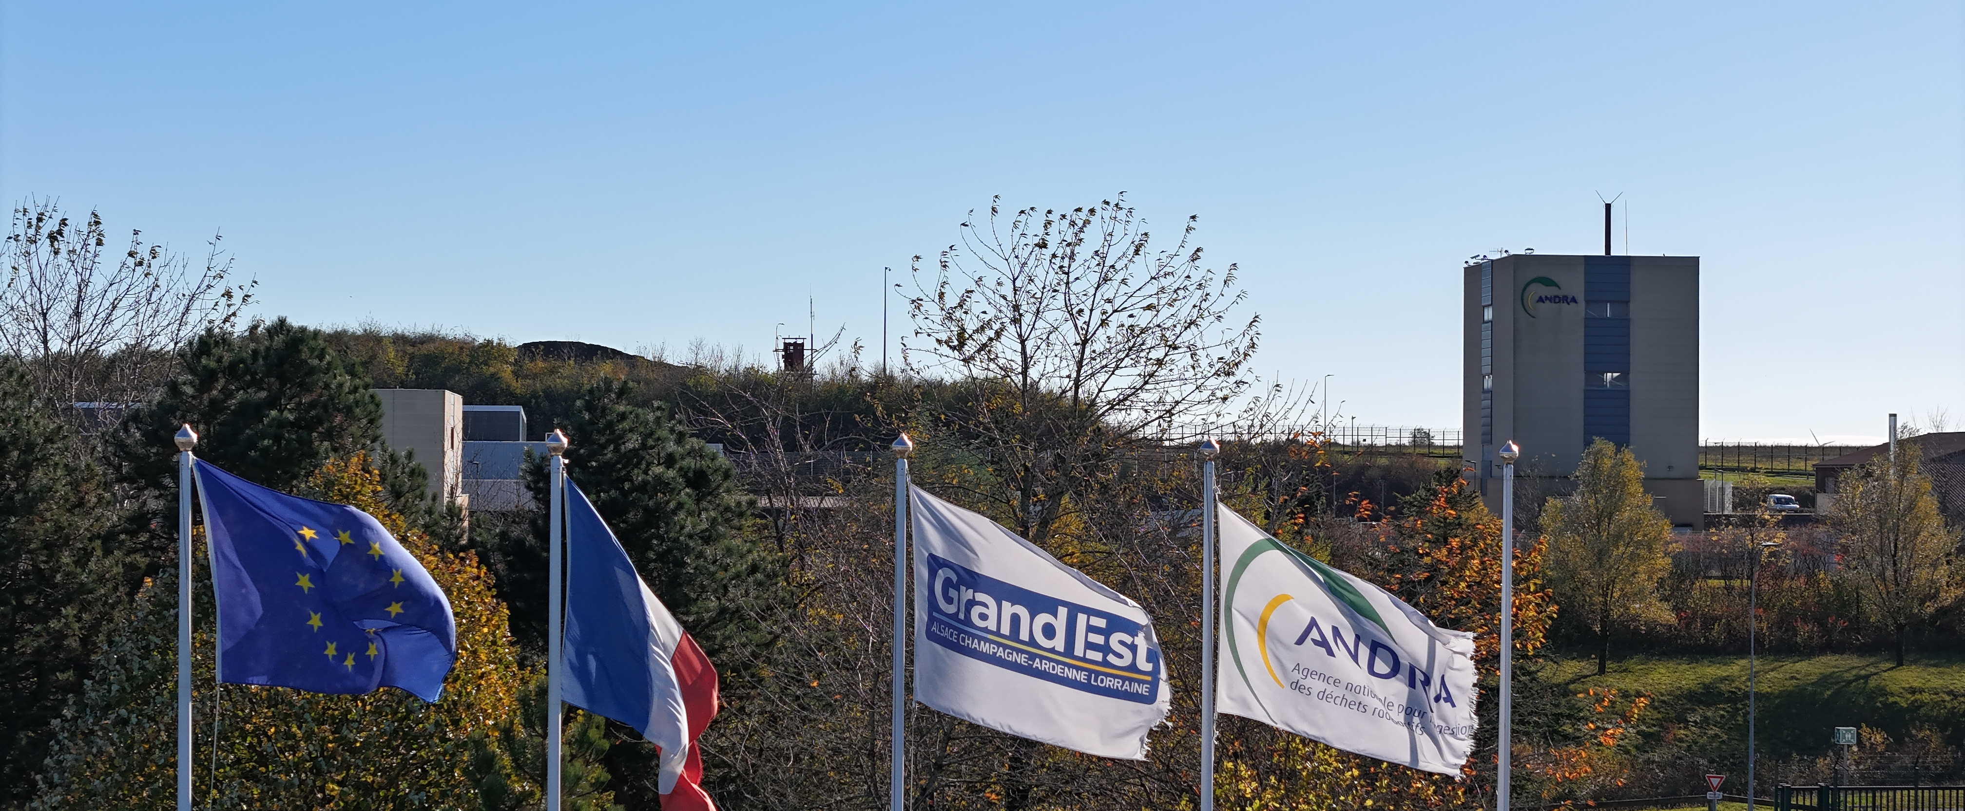
Thank you for your attention
www.andra.fr
www.dechets-radioactifs.com
www.cigéo.com

