Slide 1
Potential Role of Digital Twins in Seeking Consensus for Geological Disposal Facility Siting
Kristof Bartha
University of Manchester

Slide 2
Introduction
Digital twins are increasingly used in engineering, demonstrating a significant value addition to project lifecycles.
Within an integrated nuclear digital environment, a digital twin can address challenges such as knowledge, time and budget management and increase credibility, operability, reliability and safety [1].
This PhD project aimed to investigate the potential of digital twins for a geological disposal facility, deployment methods within the siting process and digital twin scope, usage, and governance.

Slide 3
Research Methods
Systematic literature reviews: a method of searching, identifying, extracting and evaluating all available information. Used to synthesise information about digital twin public engagement applications and energy justice concerns associated with nuclear waste repositories.
Semi-structured interviews: data collection method for in-depth exploration of topics. Used to collect stakeholder expectations for a digital twin.
Thematic analysis: A qualitative research method used to identify and explore patterns in data.

Slide 4
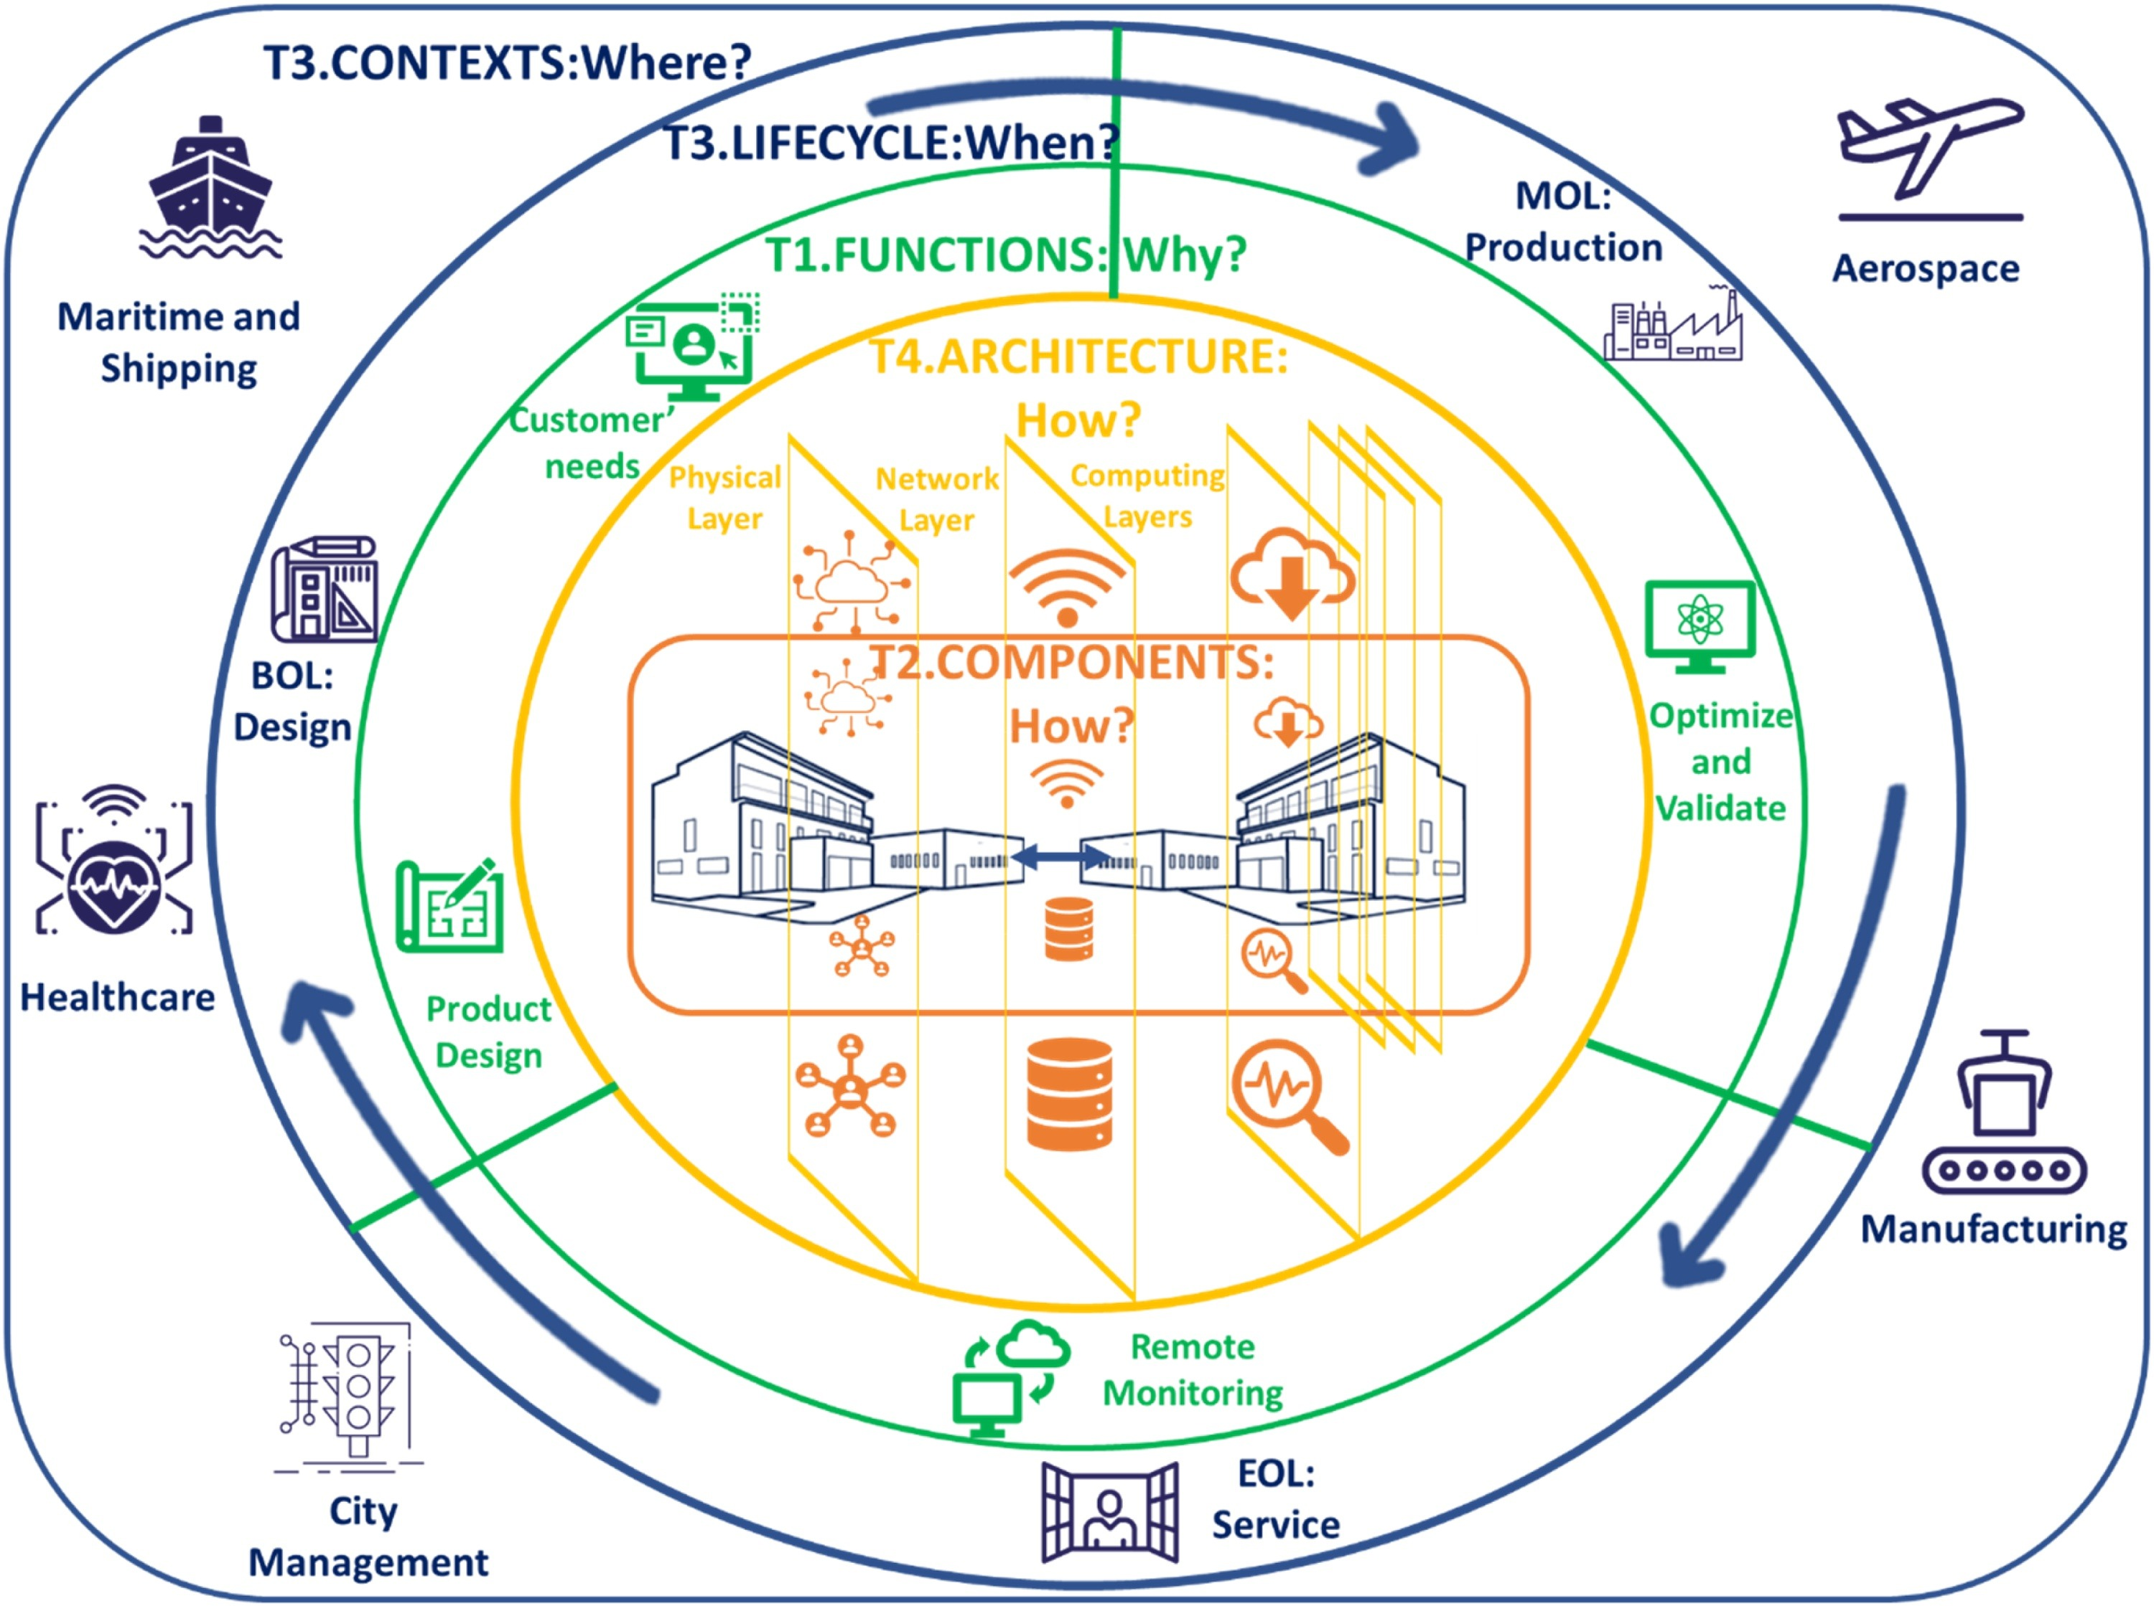
Digital twin definition
30 different definitions were identified by a systematic literature review [2].
Definition used in this research was adopted form the Virtual Engineering Centre [3].
A digital twin requires:
A specified purpose or scenario that it is used to replicate.
Validation versus its real-world equivalent and a resultant accuracy found to be within limits required by the purpose defined in (i)
Continual updating and optimisation based on the input of ‘real-world’ data from its physical counterpart, as required to deliver the purpose defined in (i).
The Digital Twin Paradigm Summarised by Semerano et al. [2]

Slide 5
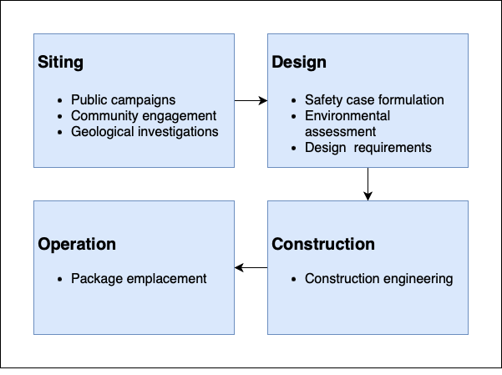
Data collection
Semi-structured interviews of eleven internal stakeholders.
Questions about workflow, safety, cost considerations, use of modelling tools, collaboration and public perception, and how the processes may evolve, particularly with the potential adoption of digital twin technology and its practical application in improving operations.
Key Lifecycle Phases and Associated Tasks of a Geological Disposal Facility

Slide 6
Data analysis
Thematic analysis to identify patterns (themes) in the interview transcripts.
Language model analysis was used to evaluate thematic analysis.
Three main themes were identified across twelve sub-themes, analysing 450 pages of interview transcripts.
The three main themes are digital twin capabilities, applications and influence.

Slide 7
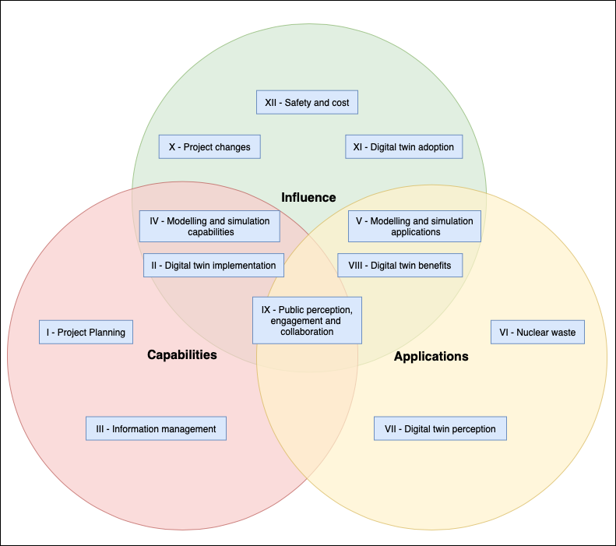
Results
A wide range of use cases and user groups were identified.
Potential to influence public perception, engagement and collaboration.
Thematic Analysis Themes Constructed from sub-themes

Slide 8
Capabilities
Project planning capability integrating requirements, safety and design.
Information management capability providing a standardised and integrated way of collecting, processing, and disseminating information.
Common data environment as a foundation for a digital twin.
Integrated and digitalised site descriptive model.
Digital safety case providing multiple stakeholder interfaces.

Slide 9
Applications
Environmental assessment and monitoring, potential use of citizen science.
Digital nuclear waste packages: static and dynamic component enabling swift package acceptance and long-term knowledge management.
Public engagement applications: interactive communication, data visualisation, community co-design within the partnership framework.

Slide 10
Influence
Digital twins as a communication tool to improve public perception.
As a way of working and inspiring collaborative workflows.
Increasing safety by enabling up-to-date quality information, visualising safety problems and providing a transparent audit trail.
Providing regulators with a subsystem of a digital twin that contains data, information, and analysis of interest was theorised to expedite communication by an order of magnitude [4].
Cost implications were difficult to predict.

Slide 11
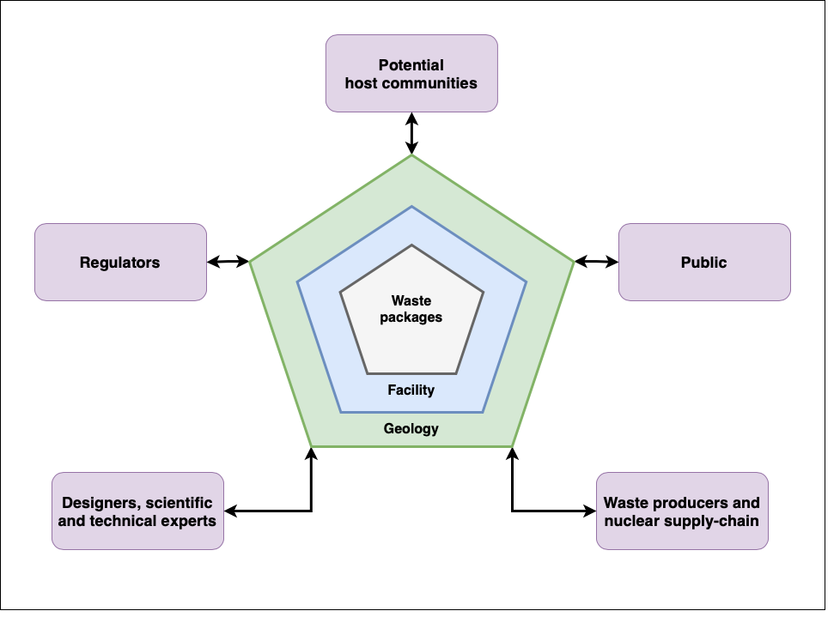
Scope and Usage
Boundary object: “a scientific object that exists in multiple intersecting social worlds and fulfils the informational requirements for each of them.”
Use cases: design and requirements management; collaboration; knowledge management; package emplacement; public engagement; monitoring; and regulation
A boundary Object of a Digital Twin of a Geological Disposal Facility Containing Digital Representations of Waste Packages, Facility and Geology. Flexible and Adaptable to be Used by a Diverse Range of Stakeholder Groups.

Slide 12
Deployment in the Consent-based Siting Process
A systematic review found that digital twins public engagement applications are limited, and the technology has yet to be used for planning a geological disposal facility.
Key factors in public acceptance and perception are a fair process and energy justice.
Energy justice principles identified:
Transparency, openness, and honesty.
Participation.
Impartial oversight, no bias.
Inclusion of opinions such as expert, local, and anti-nuclear.
Information provision, presentation, and curation.
Fair process principles: engagement, explanation, and expectation clarity.
A digital twin should be used to illustrate these.

Slide 13
Implementation and Governance
The initial step is to understand the technology and articulate the needs and vision for a digital twin. Building understanding encompasses training, engagement, integration, and scope definition.
Early implementation should be parallel to the physical entity, connected to integration, standardisation, and the establishment of organisational, industry-wide, and national digital twin standards.
There is a need for appropriate governance and management processes; a digital twin should be co-designed by internal stakeholders and a potential host community, used in collaboration with the nuclear supply chain and operated by a new, independent digital team responsible for the digital twin.

Slide 14
References
[1] – E. A. Patterson, R. J. Taylor, and M. Bankhead, "A framework for an integrated nuclear digital environment," Progress in Nuclear Energy, vol. 87, pp. 97-103, 2016/03/01/ 2016, doi: https://doi.org/10.1016/j.pnucene.2015.11.009.
[2] – C. Semeraro, M. Lezoche, H. Panetto, and M. Dassisti, "Digital twin paradigm: A systematic literature review," Computers in Industry, vol. 130, p. 103469, 2021/09/01/ 2021, doi: https://doi.org/10.1016/j.compind.2021.103469.
[3] - K. V. Andrew Levers, Sally Purdie, Lynn Dwyer, David Bowman, "Transforming digital twins into digital products that thrive in the real world," 2021.
[4] - V. Yadav, Wells, Alison, Pope, Chad L., Andrus, Jason P., Chwasz, Christopher Paul, Trask, Timothy C., Eskins, Doug, Carlson, Jesse, Ulmer, Christopher, Chandran, Nachiketh, & Iyengar, Raj., "Regulatory Considerations for Nuclear Energy Applications of Digital Twin Technologies," 2022, doi: https://doi.org/10.2172/1984814.

