Slide 1

The Ballidon glass burial experiment: A model for HLW glass behaviour in complex natural systems
Garry Manifold, 3rd year PhD student
Dr Clare Thorpe
Professor Russell Hand

Slide 2
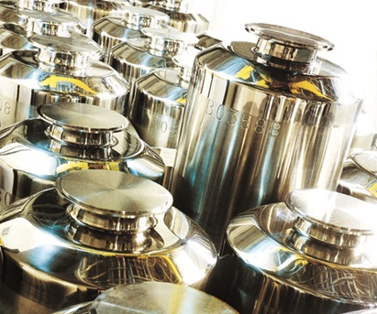
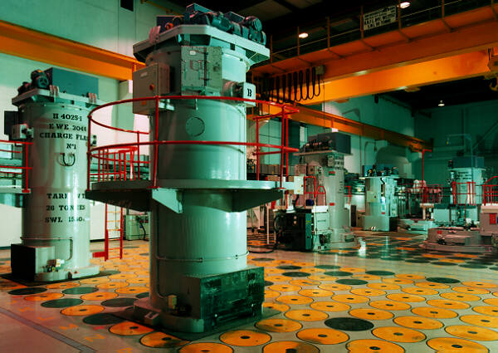
UK stockpiles of vitrified high-level waste (HLW)
Vitrified HLW is produced at Sellafield using a process developed in France.
In general, the glass types produced reflect the proportion of waste loading from Magnox or AGR reactors.
.
Stainless steel canisters used to store vitrified HLW
Loading silos with canisters containing vitrified HLW.
In the UK, the total of current and estimated future arisings of vitrified high level waste is around 1470 m³.
40.4% is derived solely from the waste products of Magnox reactors, referred to here as Magnox glass.
47.2% is derived from the waste products of both Magnox and AGR reactors. This is referred to as Blend glass.

Slide 3
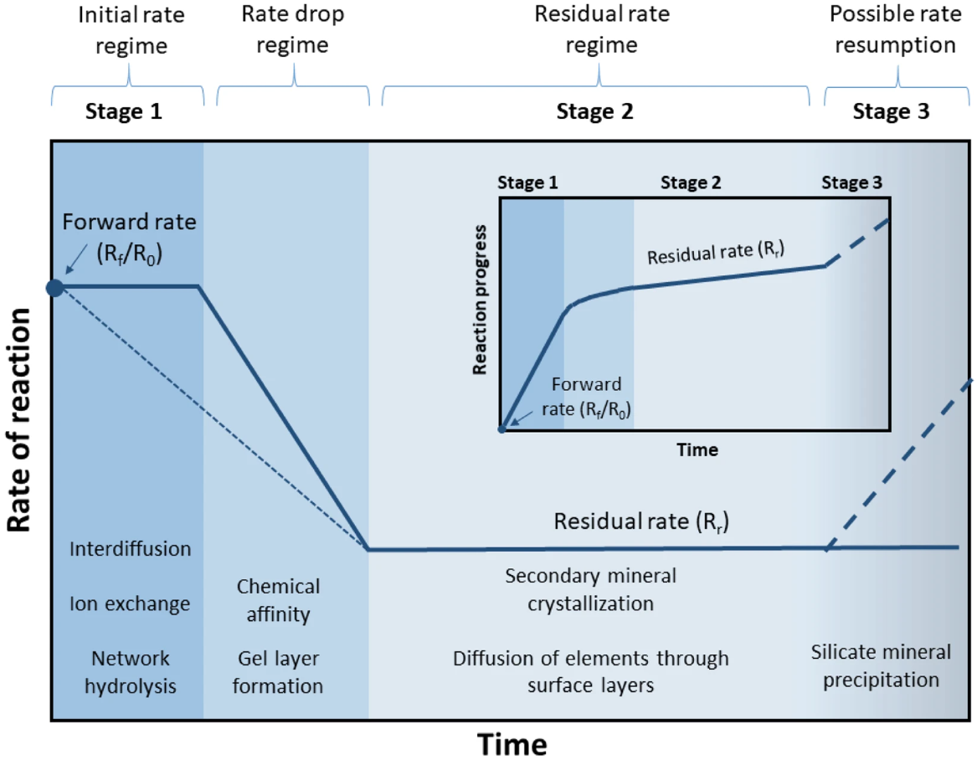
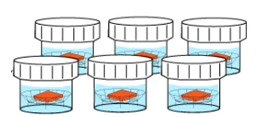
Glass Corrosion Process
Mechanism of aqueous glass corrosion:
Ion exchange and hydrolysis of the silica network, forming an amorphous, silicon rich gel layer.
A slower, long-term rate when minerals might crystallise
Potential resumption, but not in every case.
Glass dissolution mechanisms have been derived largely from laboratory dissolution tests.

Slide 4
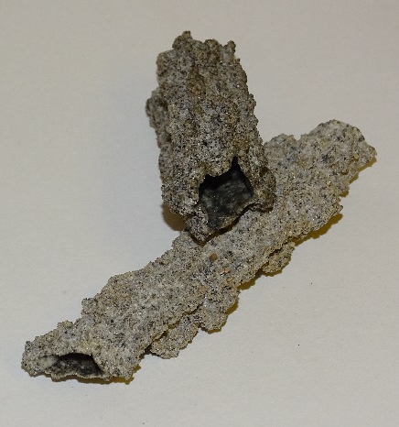
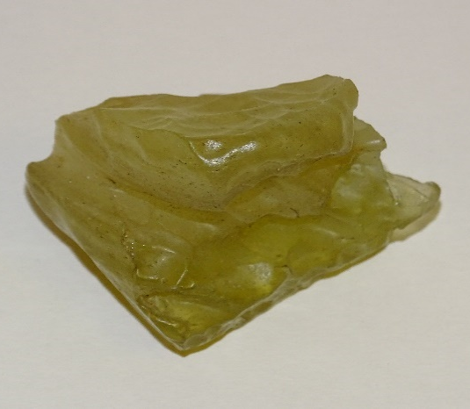
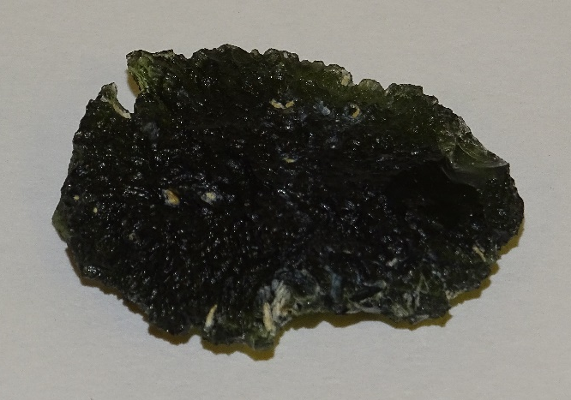
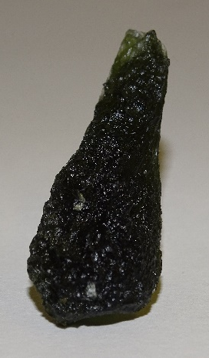
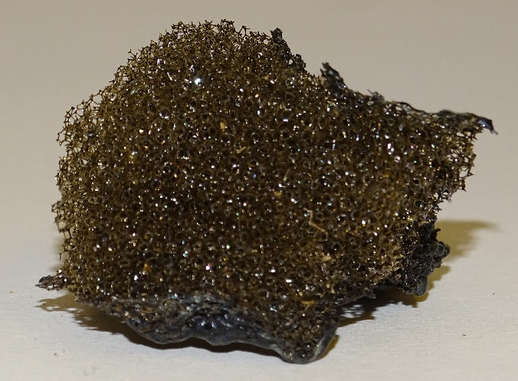
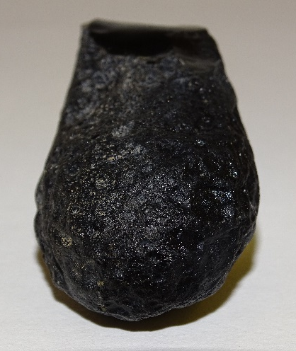
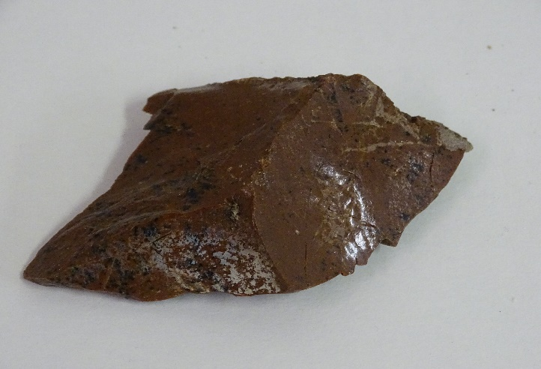
Validation of laboratory tests
Laboratory studies require validation against longer term alteration in more complex environments.
desert glass
tektite
fulgurite
basaltic glass
basaltic glass
tektite
rhyolitic glass
One approach is to investigate natural analogues of glassy waste forms in known environments.
Somewhat different in composition but provide a good benchmark for comparison.

Slide 5
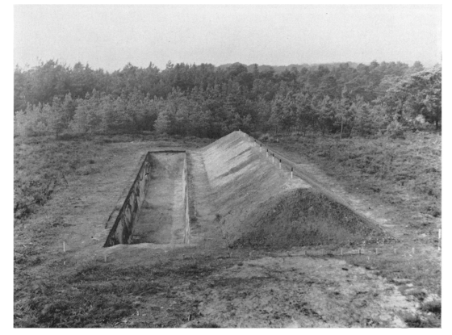
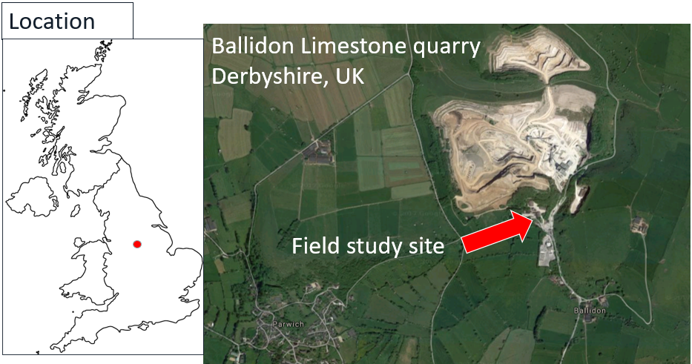
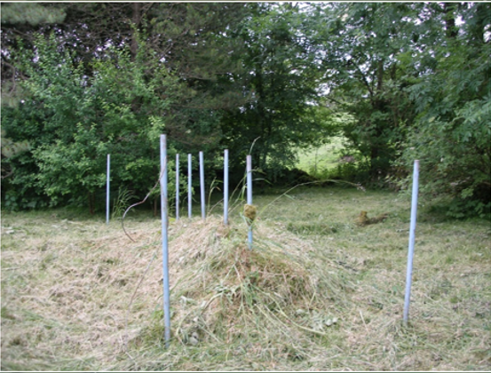
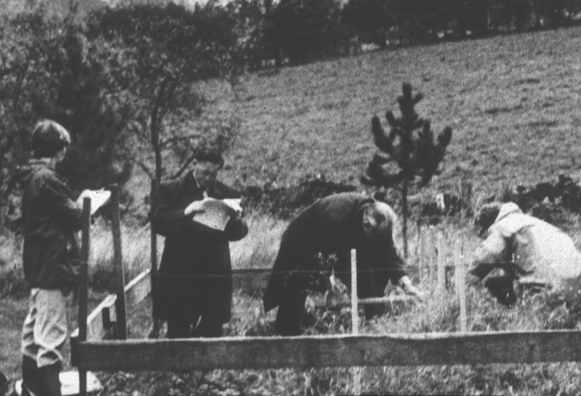
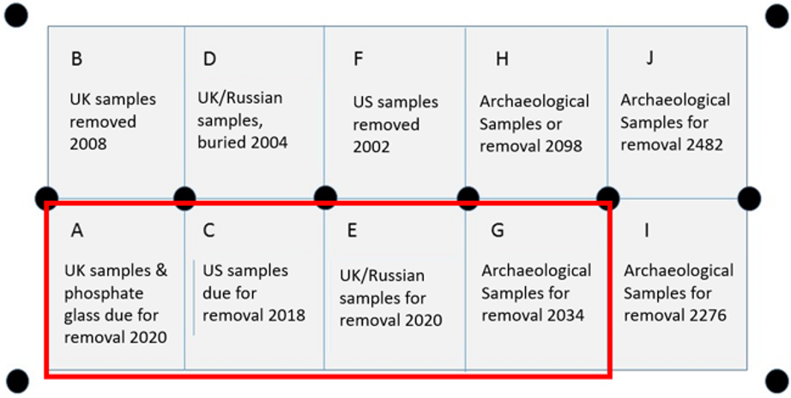
The Ballidon Glass Burial Experiment
1963: Wareham experimental earthworks
Glass burial site today
Low pH (4.5-5) – nine exemplars of modern & archaeological glasses buried at Wareham.
1970: Ballidon glass burial experiment
High pH (originally 9.7) – the same nine glass as Wareham, and subsequently, nuclear waste glasses.
Plots excavated in June 2022.

Slide 6
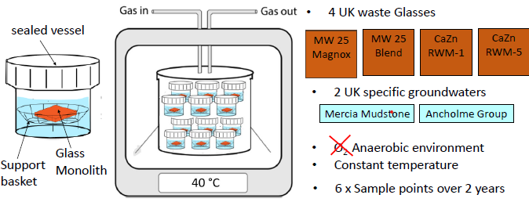
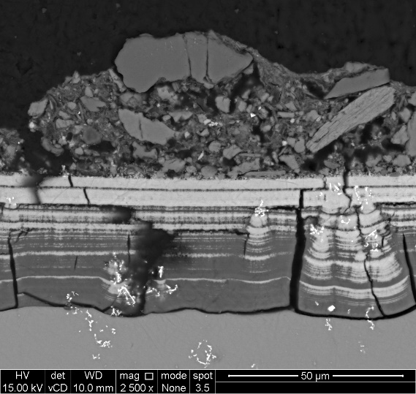
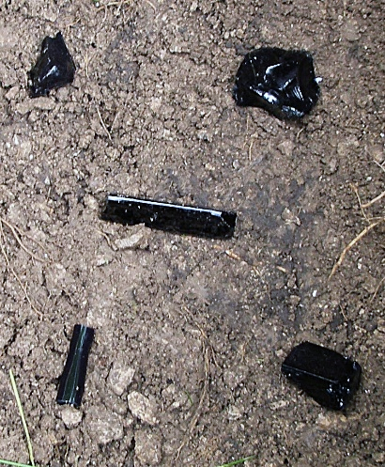
PhD project: The comparison of glass corrosion in the lab with corrosion in a complex natural environment.
Long-term glass dissolution experiment
Typical corrosion of MW25 glass observed in lab dissolution tests
50 µm
East Coast
West Coast
Alteration layer
Pristine glass
Ballidon glass burial experiment
50 µm
Bury MW25 Magnox and MW25 Blend glasses in one of the Ballidon plots
Wait for 20 years

Slide 7
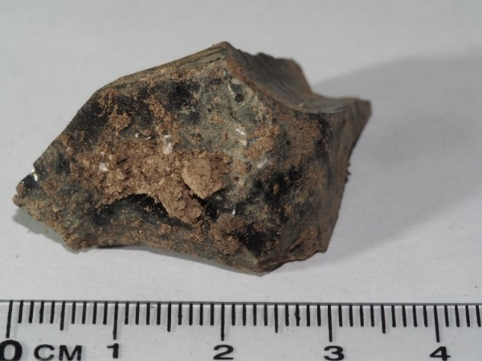
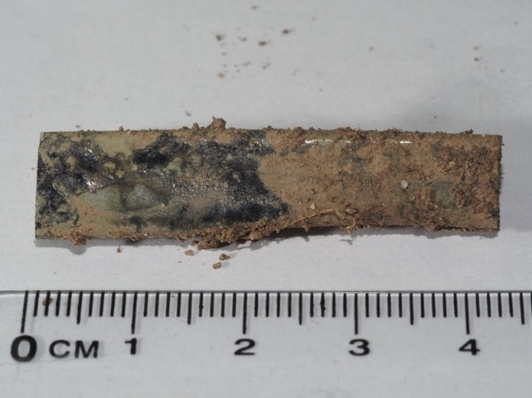
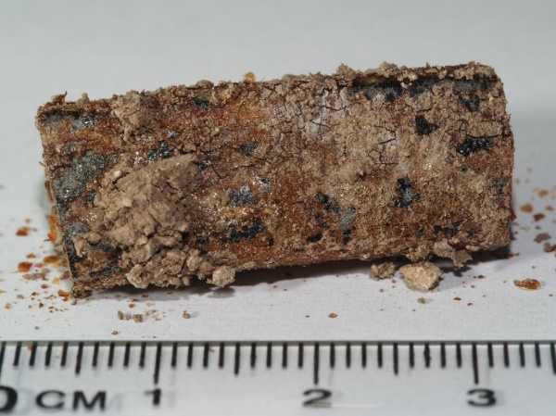
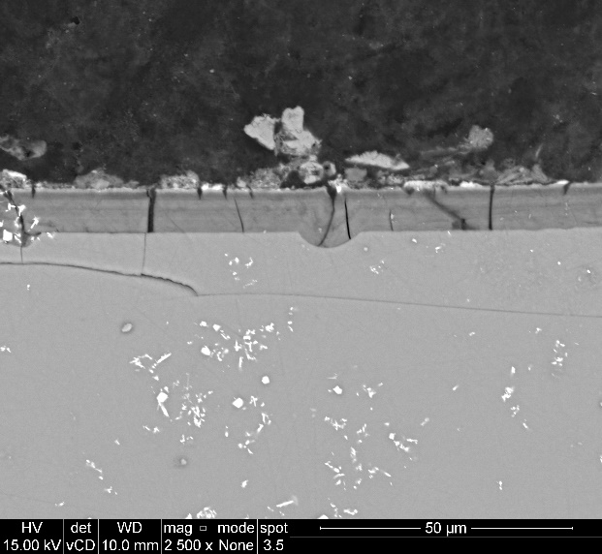

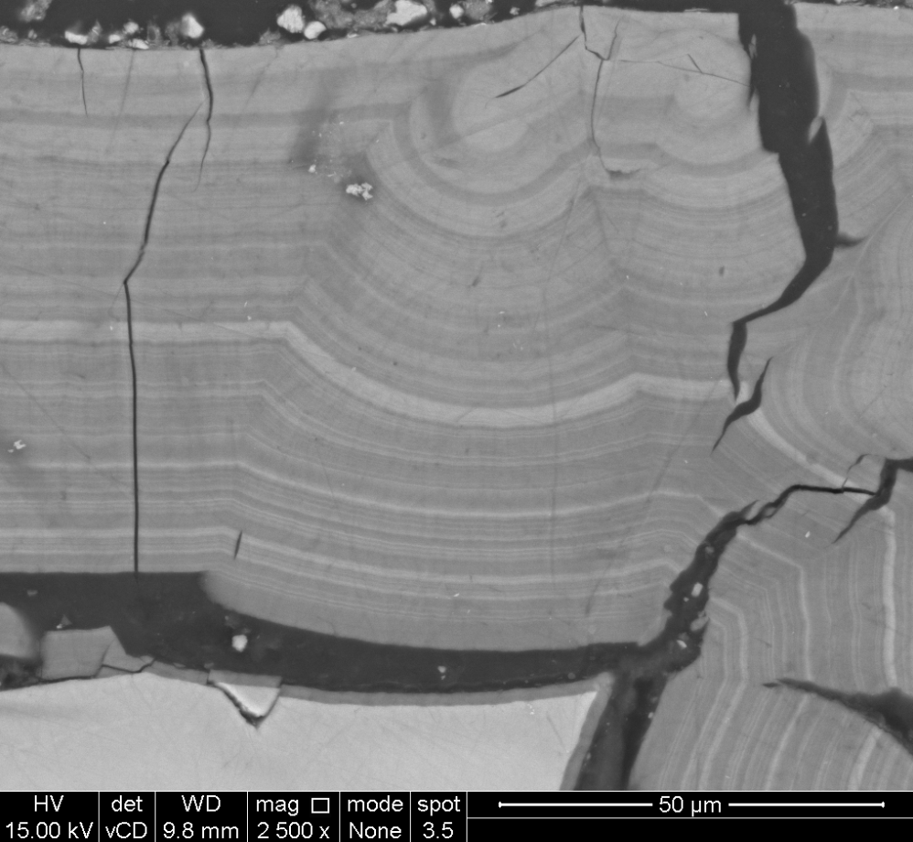
Variable corrosion of Nuclear Waste Glasses
UK Magnox glass
UK Blend glass
Russian K26 glass
Glasses photographed on excavation with SEMs of their alteration layers.

Slide 8
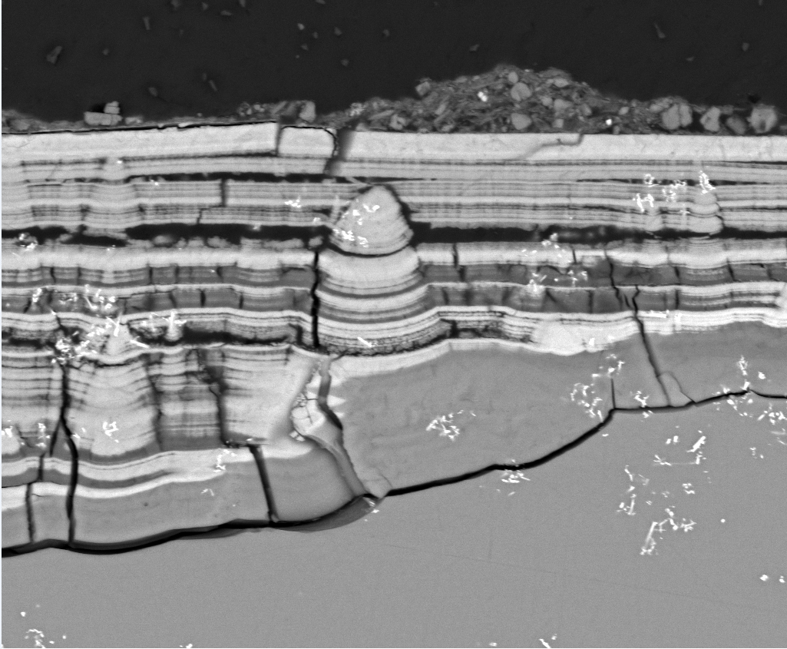
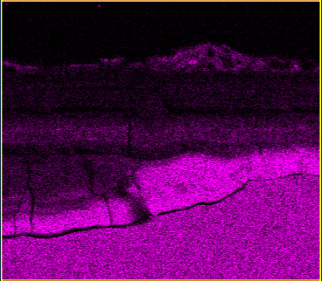
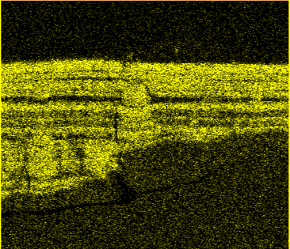
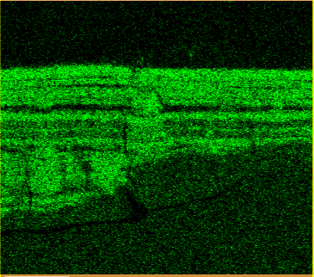
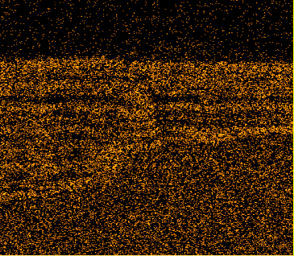
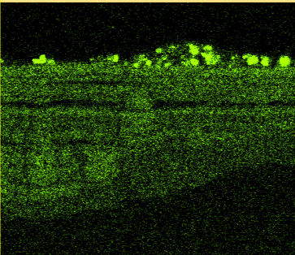
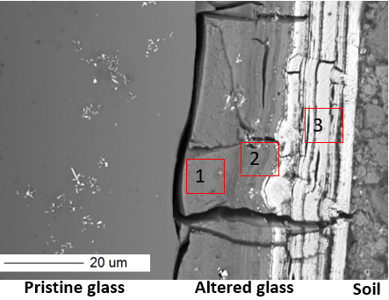
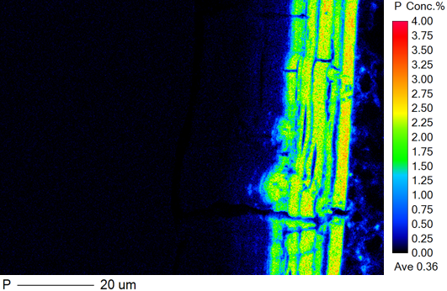
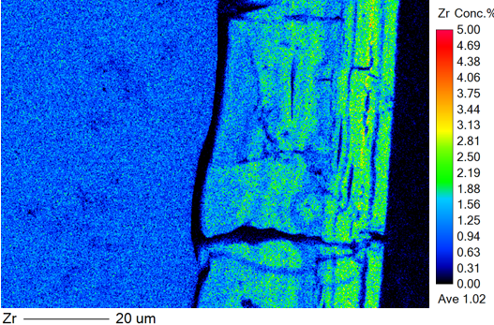
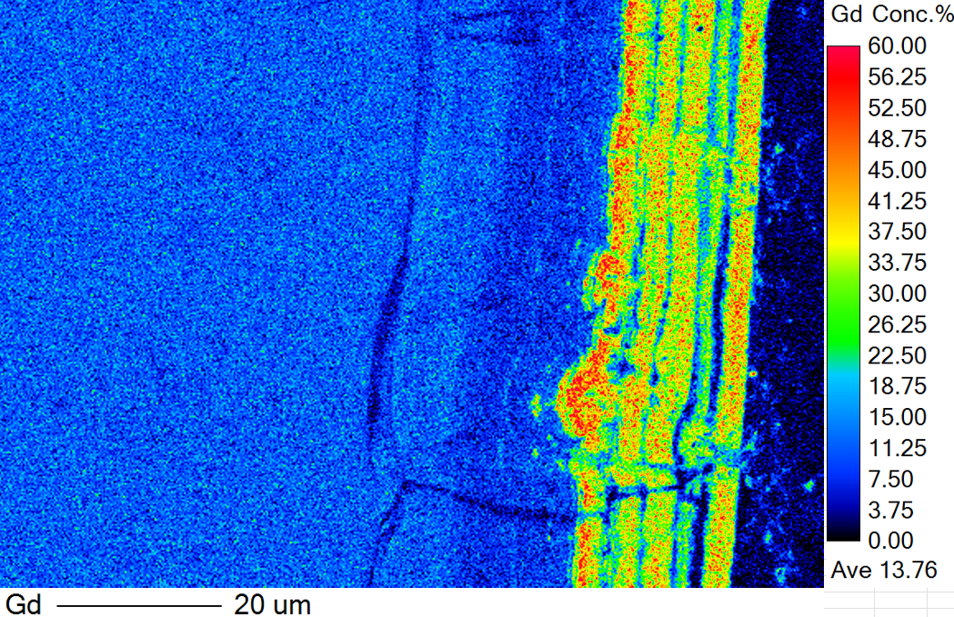
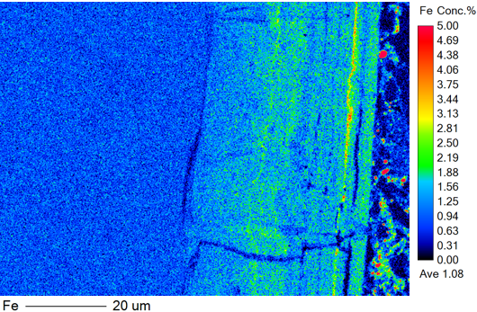
EDS and EPMA of UK Blend glass (sample 16)
Si
P
Zr
Nd
Ca
BSE 2500x
BSE and EDS images of sample 16. The P and Ca above has been sourced almost entirely from the environment.
P
Zr
Gd
Nd
Fe
An EDS Signal overlap between P and Zr is resolved.
Zone 1 is silicon rich – most newly hydrated glass
Zone 2 is rich in Si, Fe, Al and Zr but zero-phosphorus.
Zone 3 is our rare earth/phosphorus/calcium rich zone, but other elements are present we can’t see on EDS.
BSE and EPMA images of sample 16, identifying three alteration zones

Slide 9
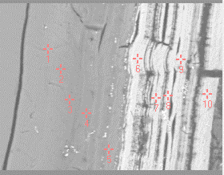
Questions arising
What is the structure/composition of the P/Ca/Lanthanide phase?
This is where the lanthanide fission products and actinide elements are likely to accumulate.
0.12 wt % (Pristine glass)
What is the influence of elements from the environment and pore water on secondary mineral formation?
Are there site-specific issues e.g. wetting and drying?
2.39 wt % (alteration layer)
Phosphorus wt %, UK Blend glass
How similar are any of these process to those that might be encountered in GDF conditions?

Slide 10
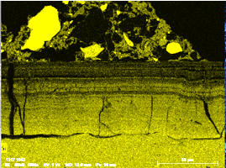
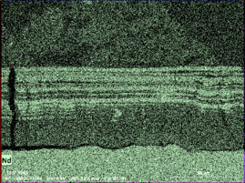
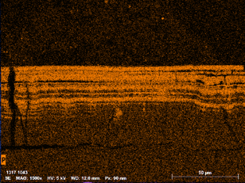
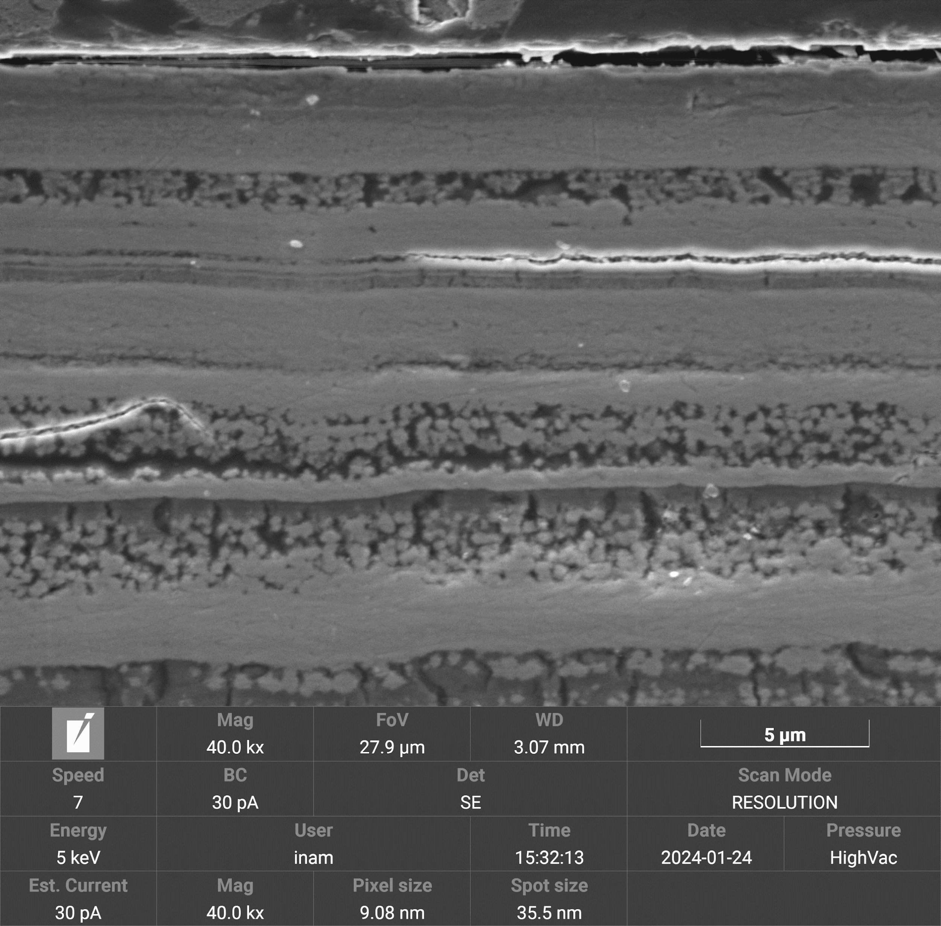
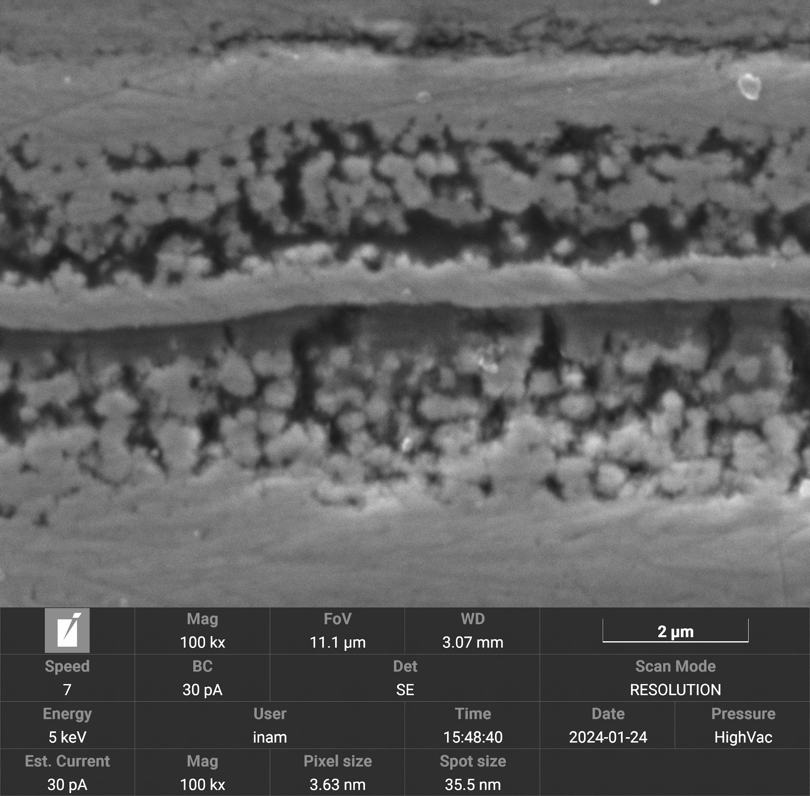
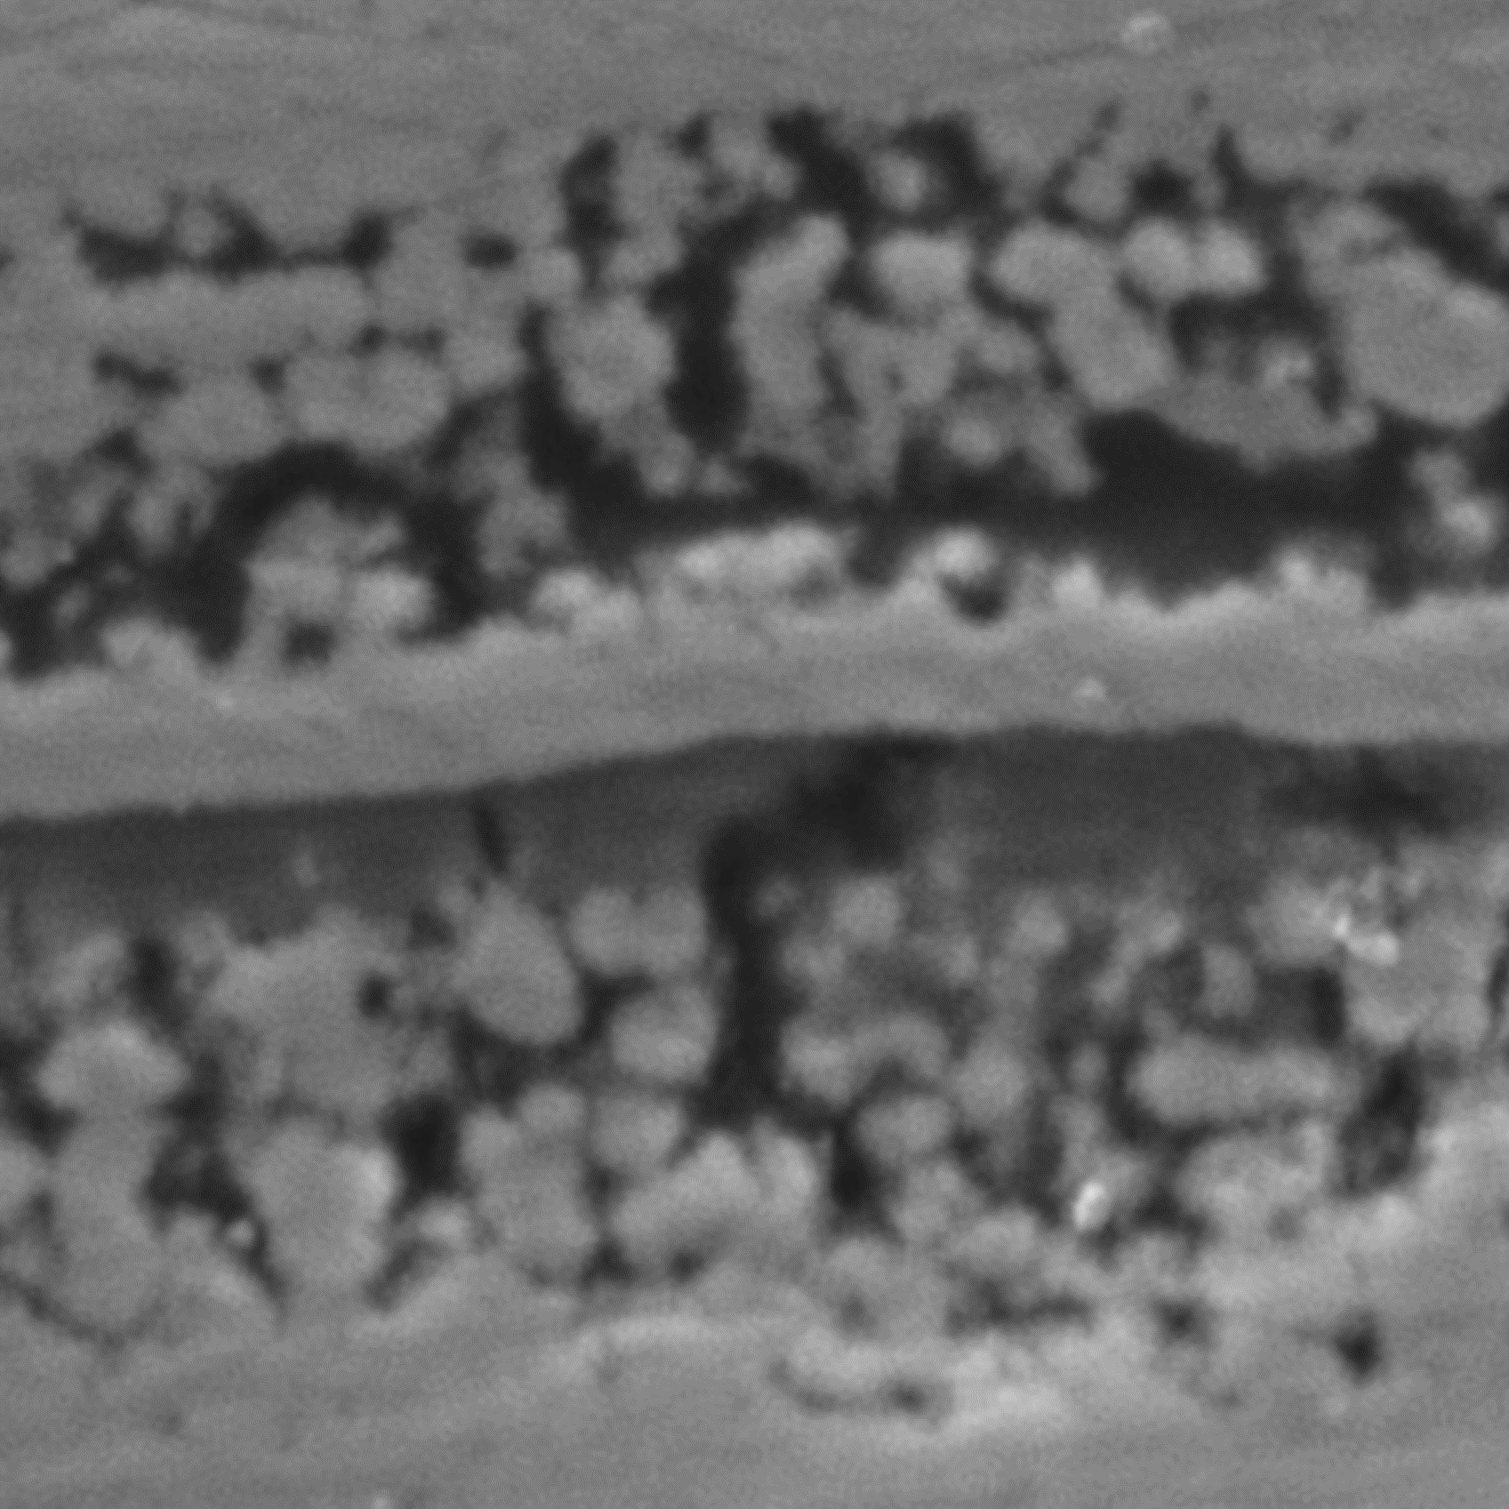
Sample 16: High magnification SEM analysis of an altered silica microstructure
Si
Nd
P
EDS images of Si appear as a negative of lanthanides, phosphorus and calcium
Zooming in on the low-contrast bands (low Z number) reveals what appear to be agglomerates of silica rich particles.

Slide 11

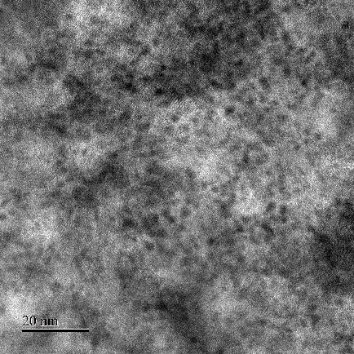
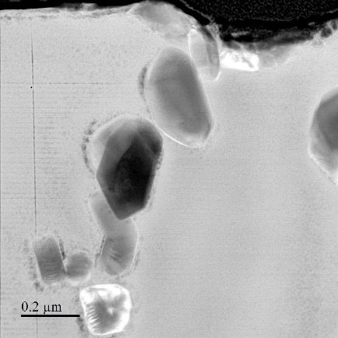
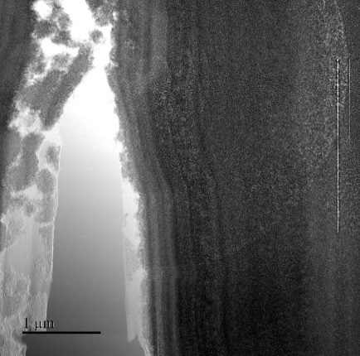
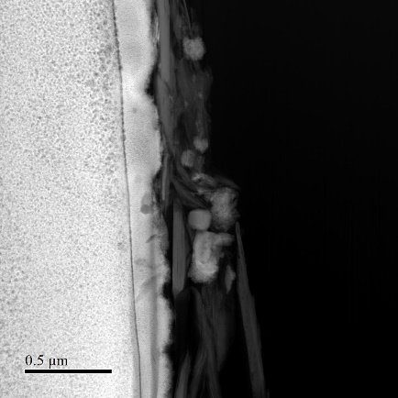
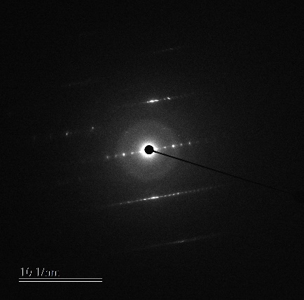
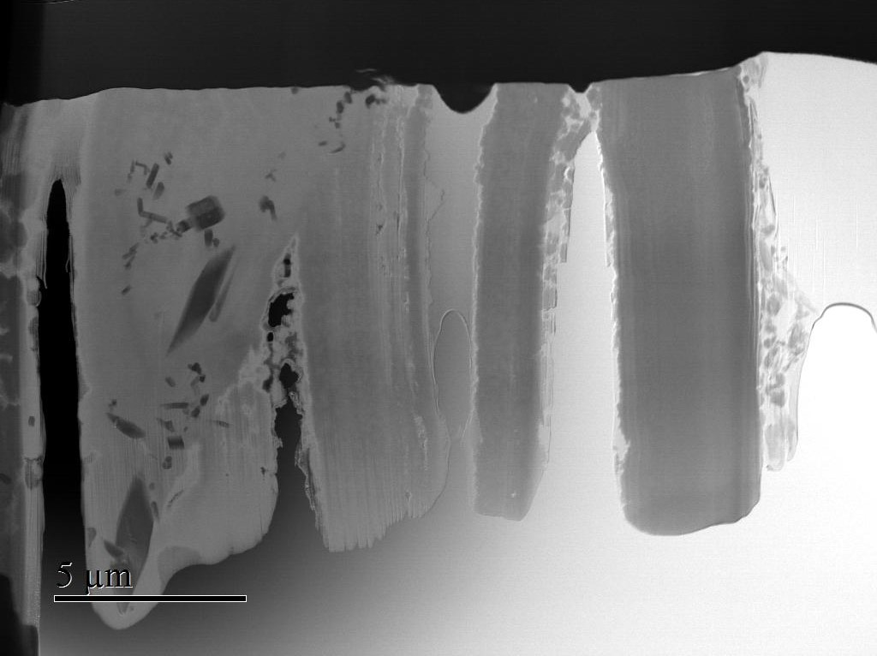
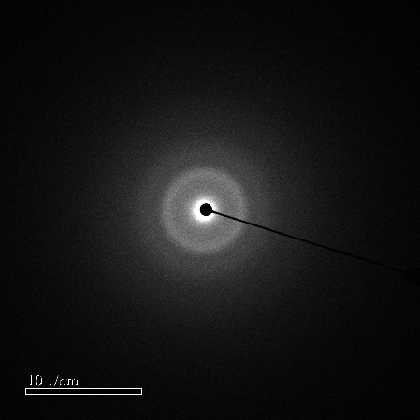
Sample 16: Transmission Electron Microscopy (TEM) analysis
Nano-crystals
Ru crystals
Banded region
Surface
P
Ca
Nd
Gd
Sm
Pr
Si
Fe
Al
20 nm
200 nm
1000 nm
500 nm
Diffraction pattern
Amorphous
10 nmˉ¹
Alteration depth increasing
5 µm
10 nmˉ¹

Slide 12
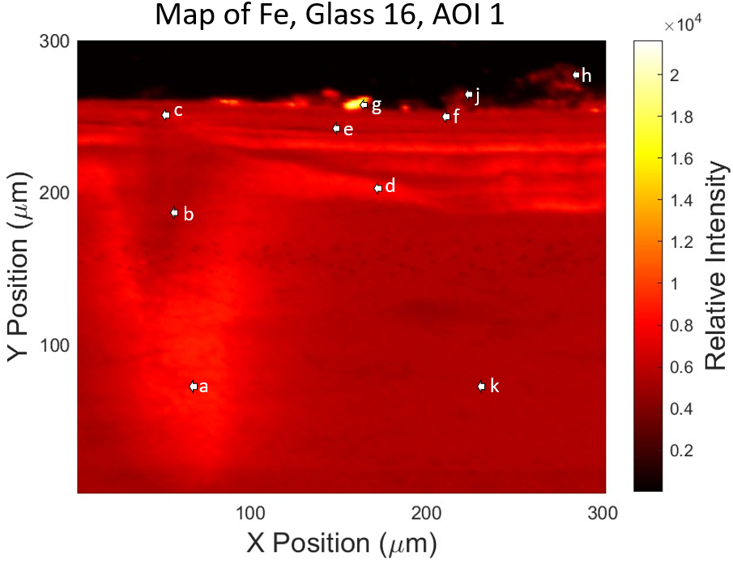

Sample 16: XANES analysis – Iron evolution in the glass and alteration layer
XRF Fe image of Blend glass alteration layer, showing banded regions of higher iron concentration (zone 2 from the previous slide).
‘Farges’ plot confirms that iron remains Fe³⁺ throughout the alteration layer, with the octahedral coordination becoming more dominant the older the alteration layer gets.

Slide 13


Environmental Calcium: XRD and ICP-MS anlaysis
Ballidon Bedrock
Ballidon soil (burial depth)
Pore water ions/ppm
Calcium | 77.62
Iron | 0.16
Potassium | 14.15
Magnesium | 3.18
Sodium | 7.26
Phosphorus | 0.71
The Ballidon site is adjacent to a limestone quarry.
XRD and ICP–MS analysis confirm the ready availability of calcium ions to our glass samples.

Slide 14



Environmental phosphorus: Olsen-P analysis
Olsen-phosphorus extraction index, Department for Environment Food and Rural Affairs (DEFRA)*.
Phosphate ions enter the soil pore water via the phosphorus cycle. At Ballidon this will be mediated by saprophytic fungi and bacteria, but phosphorus levels can be raised by agricultural use of land.
Olsen-P extraction for 7 sites at the Ballidon burial mound and nearby.
We have ‘normal’ levels of phosphorus in our soil at Ballidon. There is no evidence of agricultural pollution.
*Advice for arable crop rotations is to maintain soils at Olsen P Index 2.

Slide 15


Silicic acid competition for phosphate sorption sites
?
A range of scientific disciplines have noted that silicic acid can compete effectively with phosphorus for mineral sorption sites, releasing phosphate into the environment, so why not the silicic acid dissolving from our glass?
Schematic of proposed phosphorus/silicon species interaction at glass soil interface
It is possible that silicic acid from the glass is increasing available phosphorus at the soil glass interface.
Also….polymerisation increases as pH increases and gives silicic acid a competitive advantage – polymers have greater binding affinity.
Silicic acid loses a hydrogen
De-protonated silicic acid now able to polymerise

Slide 16

GDF relevance
Ballidon cannot be compared directly with a GDF:
Different porewater chemistry
Different mineralogy
Surface system (lower temperatures, variable saturation, microbiology, vegetation)
What does Ballidon show:
More complex alteration layer formation in open systems compared to laboratory experiments
Influence of porewater/mineralogy on alteration layer formation
Evolution of layers over time

Slide 17
Ongoing/future work
Evaluation of the competition of silicic acid, arising from UK waste glass dissolution, for phosphate sorption sites.
Paper covering the analysis UK waste glasses excavated at Ballidon.
Long-term lab dissolution experiment with Four UK waste glasses and two UK-relevant groundwaters.
Further analysis of Ballidon archaeological glass samples
(Paper in review in NPJ Materials Degradation).

Slide 18


Acknowledgements
We gratefully acknowledge support from:
Special thanks to my supervisors, Dr Clare Thorpe and Professor Russell Hand, School of Chemical, Materials and Biological Engineering, University of Sheffield,
Also, Cari Littler, Department of Geography, University of Sheffield,
Stuart Creasey-Grey, School of Chemical, Materials and Biological Engineering, University of Sheffield,
Professor Anamul Mir, University of Huddersfield, and
Dr Jiahui Qi, School of Chemical, Materials and Biological Engineering, University of Sheffield
Prof Claire Corkhill, School of Earth Sciences, University of Bristol.

