Slide 1
Radiochemistry
Discipline Lead: Prof. Andy Cundy
NWS Subject Matter Expert: Dr. Will Bower

Slide 2
Who are we?
Andy Cundy
Professor of Environmental Radiochemistry University of Southampton
Will Bower
Senior Research Manager – Waste, Barriers & Pathways Team
Nuclear Waste Services

Slide 3
What do we do?
The Radiochemistry Discipline aims to improve the predictability of radionuclide behaviour across the GDF system and supports the safety case by:
Verifying the containment functions of the Engineered Barrier System
Simulating the evolutionary chemical behaviour of wasteforms
Developing the radioanalytical techniques required for site investigation
Exploring the biogeochemical features and processes that influence radionuclide transport
Cross-linked with other disciplines

Slide 4
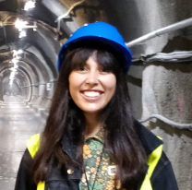
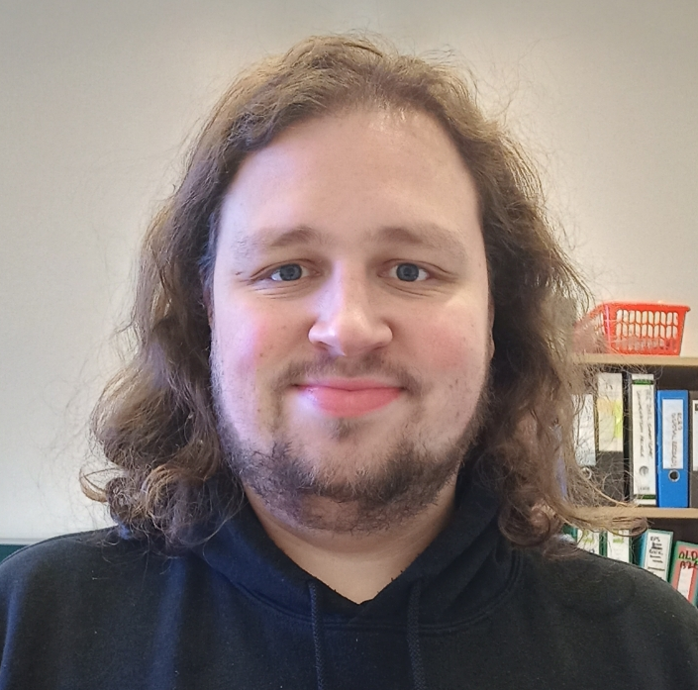
Active PhD Projects
Co Supervisors: Dr Olwen Stagg, Dr Toni Yorkshire, Dr Naji Bassil, Dr Paul Heath
Meg Watters
The missing sink?
Controls on iodine migration in the geosphere
SUBMITTED END 2024
Charlotte Istance
Mechanisms of radionuclide retention in aged cement
James Cooper
Can the co-mobility of actinides and neutron poisons be better understood to support criticality safety?
Raphael Margreiter
Phosphate-bearing cements for depleted uranium disposal
Affiliate Students
Charley Nevin Resolving mass transfer mechanisms in caesium- and strontium-loaded geopolymer cement wasteforms
Corinne Hatton Computational modelling of U incorporation into goethite (α-FeOOH)
Becky Snow
Geological fate & impact of isosaccharinic acid (GEO-FISA)

Slide 5
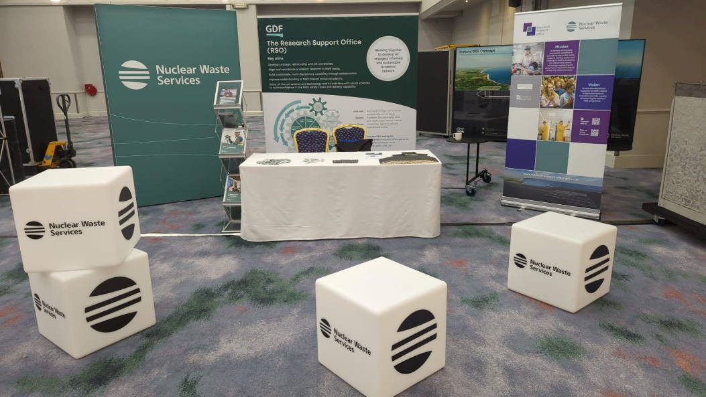
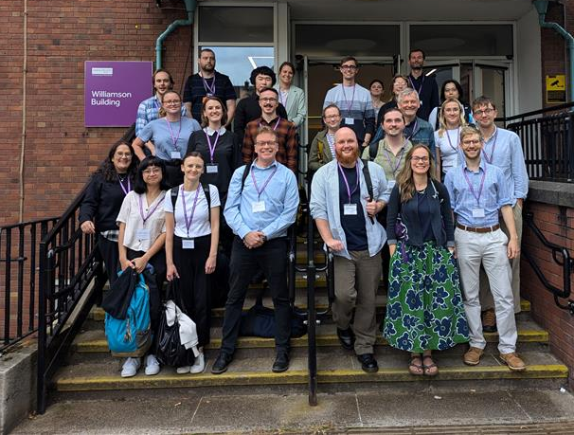
Other Interactions in 2024
10th International Conference on Nuclear and Radiochemistry, Brighton, August
Environmental Mineralogy Group Research in Progress Meeting
Manchester, July
Cross-RSO Discipline Area Tour of BOSCORF/NOC
Southampton, May

Slide 6
Future Priorities
Independent Advisory Panel (AC) & Challenge Area Lead (WB)
Integration of cross-cutting radionuclide biogeochemistry research into new NWS/RSO structure.
Continued presence at major conferences (e.g. Migration 2025, MARC XIII)

