Slide 1
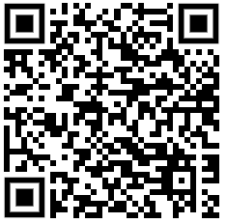
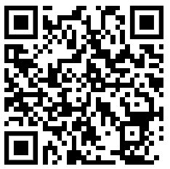
NWS RSO ECR Network Careers Webinar April 2025
Read more about the ECR Network here
Sign up to the RSO Newsletter here

Slide 2
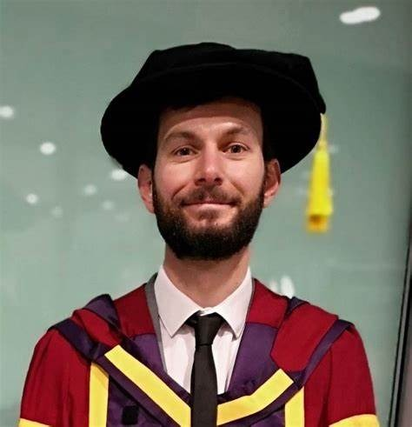
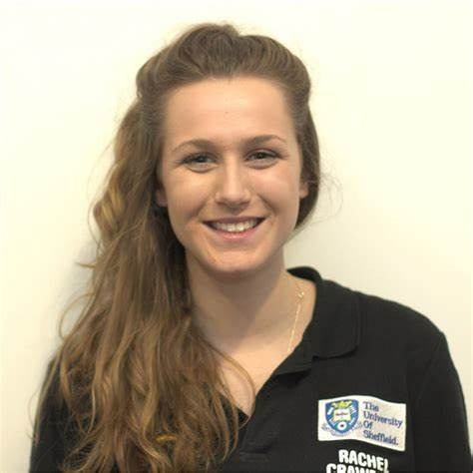
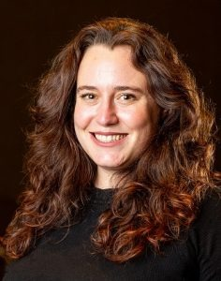
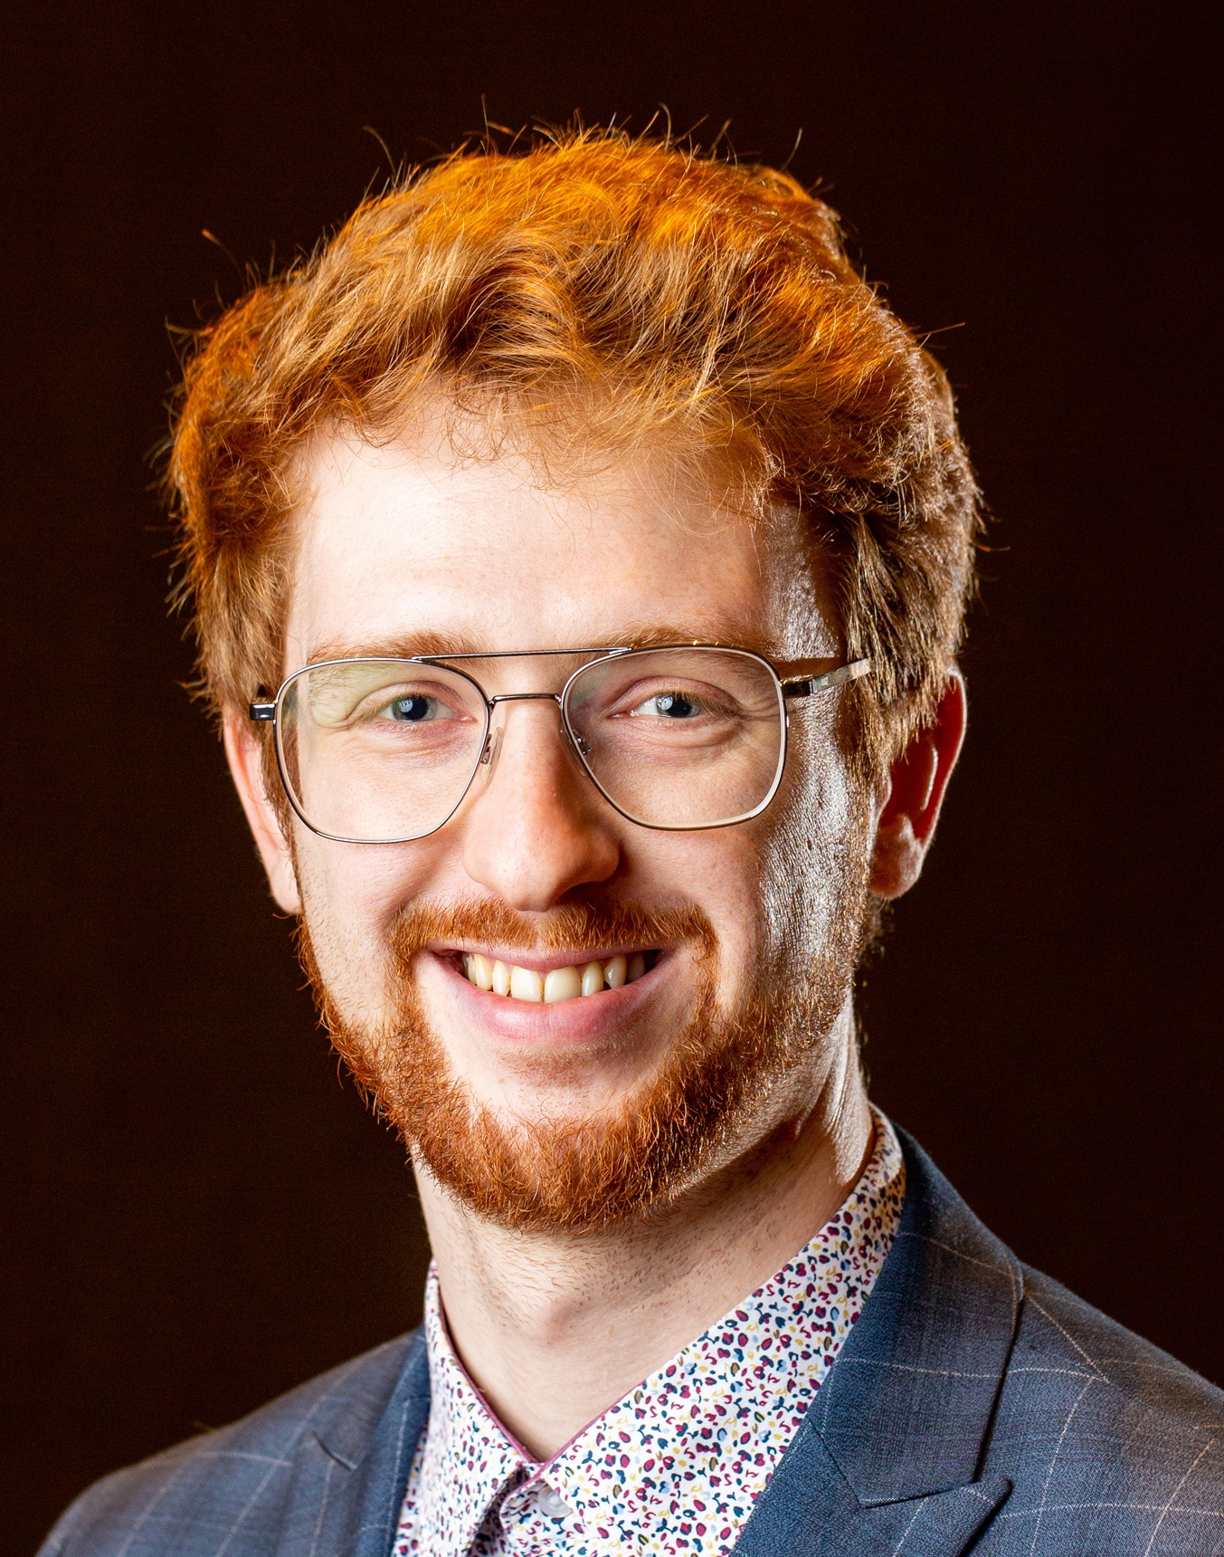
About the RSO ECR Network
The aim of the NWS RSO ECR Network is to develop a support network for early careers researchers who would like to build their research careers in radioactive waste disposal.
QR code will link to the new ECR Network webpage
Including ‘What does the RSO Early Career Researcher Network do?’ and link to LinkedIn group
Following the renewal of the RSO contract, the ECR now has a formal funding stream that will enable future work to be done by the committee
We are looking for committee members!
Are you an early career researcher interested in contributing? Get in touch!
Please contact rso-gdf@manchester.ac.uk to register your interest
Tom Neill (UoM)
Rachel Crawford (UoSH)
Read more about the ECR Network here
Kat Raines (NWS)
Luke Townsend (NWS)

Slide 3
About the RSO ECR Network
Previous meetings: in-person kick-off event and webinars
We have recently trialled a fellowship support service where feedback can be elicited from academic and NWS colleagues to help support your proposals. If you’re interested in this, please reach out to us
We are also in the process of setting up our own mailing list and email – keep your eyes peeled for this as it’ll be the primary way of keeping in touch with the ECR Network
Tom Neill (UoM)
Rachel Crawford (UoSH)
Read more about the ECR Network here
Kat Raines (NWS)
Luke Townsend (NWS)

Slide 4
RSO ECR Network Careers Webinar April 2025
This webinar aims to provide different perspectives on how best to prepare and sell yourself when it comes to applying for jobs or fellowships / grants in the nuclear sector in the UK.
Agenda:
13:30 – 13:40 ECR Network Background / Event Introduction
13:40 – 14:10 Purdey Spooner (Nuclear Waste Services)
14:10 – 14:20 Comfort break
14:20 – 14:50 Kath Rothwell (University of Stirling)
14:50 – Close Additional Q&A time / Event close
Sign up to the RSO Newsletter here

